Slide 1
ICCQIP Surveillance Update:Q18 Jul-Sep 2020 – Q24 Jan-Mar 2022
ICCQIP Surveillance Update: Q15 Oct-Dec 2019 – Q21 Apr-Jun 2021

Slide 2
Participation
 | Acute Trusts | All CCUs | Adult CCUs | Paediatric CCUs | Neonatal CCUs
Number in England | 138 | 428 | 240 | 25 | 163
Number registered on ICU Data Capture System | 132 | 283 | 235 | 21 | 27
Number with a registered Local Administrator | 96 | 156 | 139 | 4 | 13
Number which ever entered any data | 104 | 173 | 153 | 9 | 11
Number which have entered any data in last 7 quarters | 80 | 123 | 110 | 4 | 9
Number which have entered any data in Q24 Jan-Mar 2022 | 63 | 83 | 74 | 3 | 6

Slide 3
Active participation
Where units have submitted complete data for each quarter (both numerator and denominator)

Slide 4
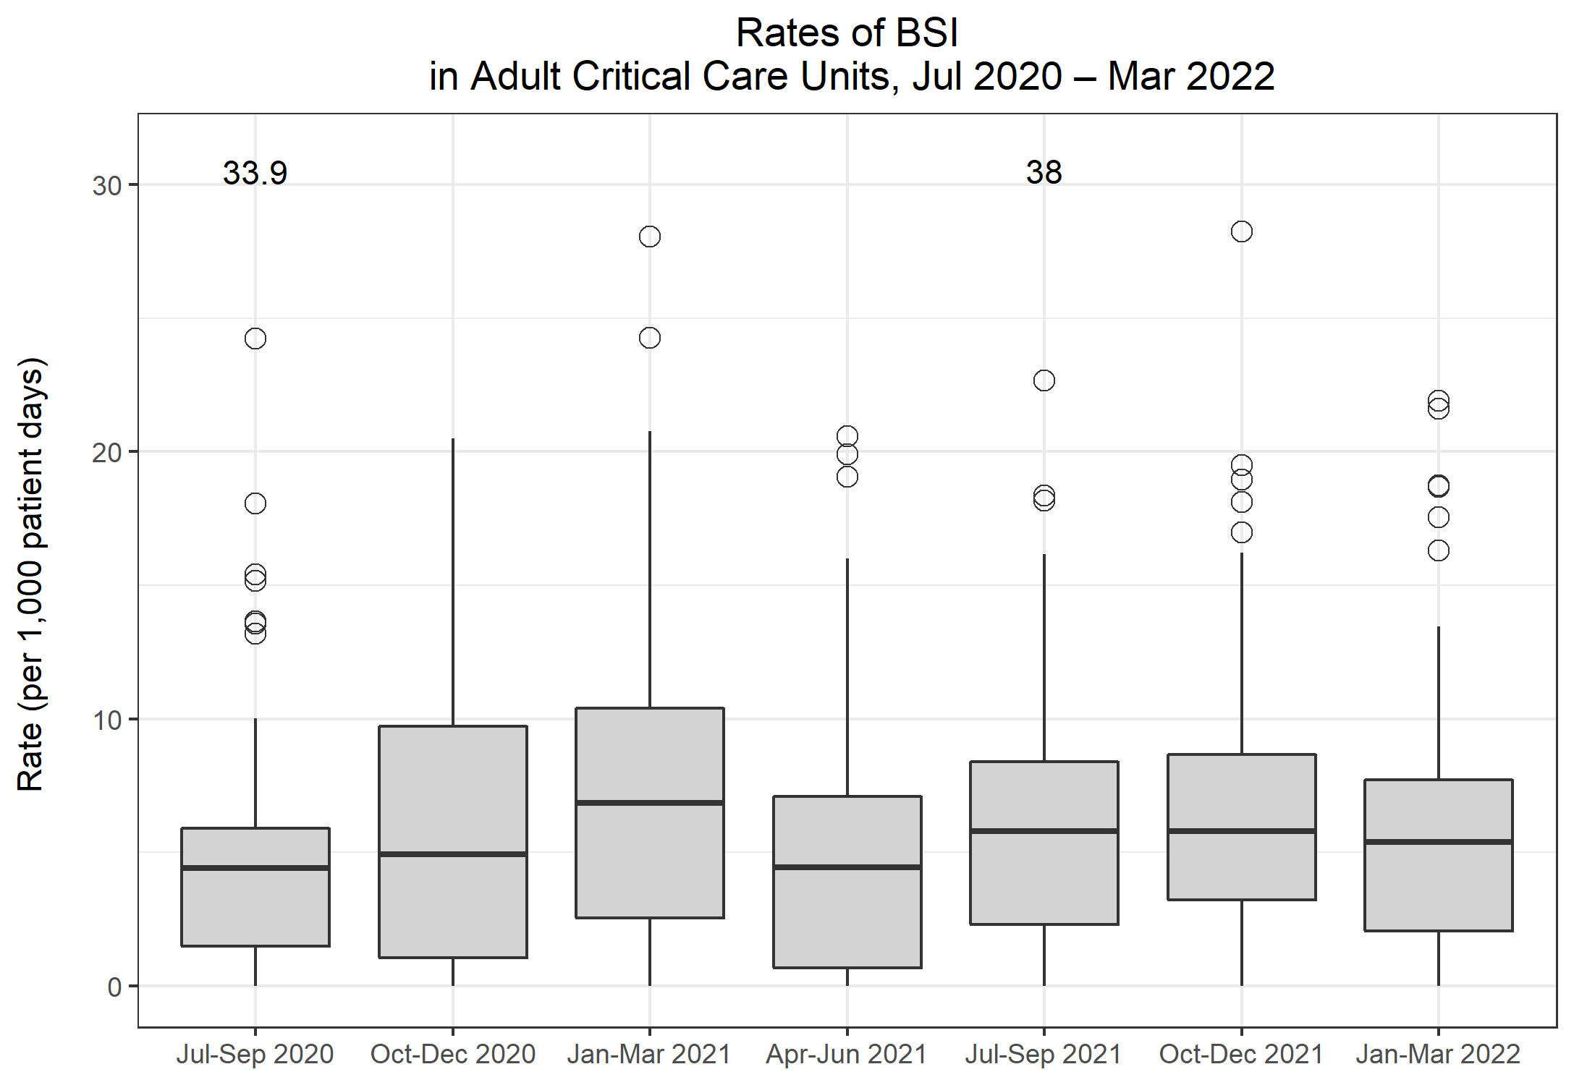
Rates of BSI in Adult CCUs
Metric | Q18 Jul-Sep 2020 | Q19 Oct-Dec 2020 | Q20 Jan-Mar 2021 | Q21 Apr-Jun 2021 | Q22 Jul-Sep 2021 | Q23 Oct-Dec 2021 | Q24 Jan-Mar 2022
Total number of positive blood cultures | 569 | 969 | 1,670 | 786 | 1,095 | 1,116 | 790
Total number of patient days | 67,733 | 94,374 | 117,810 | 90,388 | 96,520 | 98,133 | 86,151
Rate of positive blood cultures per 1,000 patient days | 8.4 | 10.3 | 14.2 | 8.7 | 11.3 | 11.4 | 9.2
Total number of positive blood cultures | 569 | 969 | 1,670 | 786 | 1,095 | 1,116 | 790
Total number of blood culture sets taken | 7,871 | 10,957 | 16,902 | 10,958 | 11,773 | 11,569 | 10,178
Rate of positive blood cultures per 1,000 blood culture sets taken | 72.3 | 88.4 | 98.8 | 71.7 | 93.0 | 96.5 | 77.6
Total number of BSIs | 350 | 589 | 962 | 484 | 653 | 673 | 482
Rate of BSI per 1,000 patient days | 5.2 | 6.2 | 8.2 | 5.4 | 6.8 | 6.9 | 5.6

Slide 5
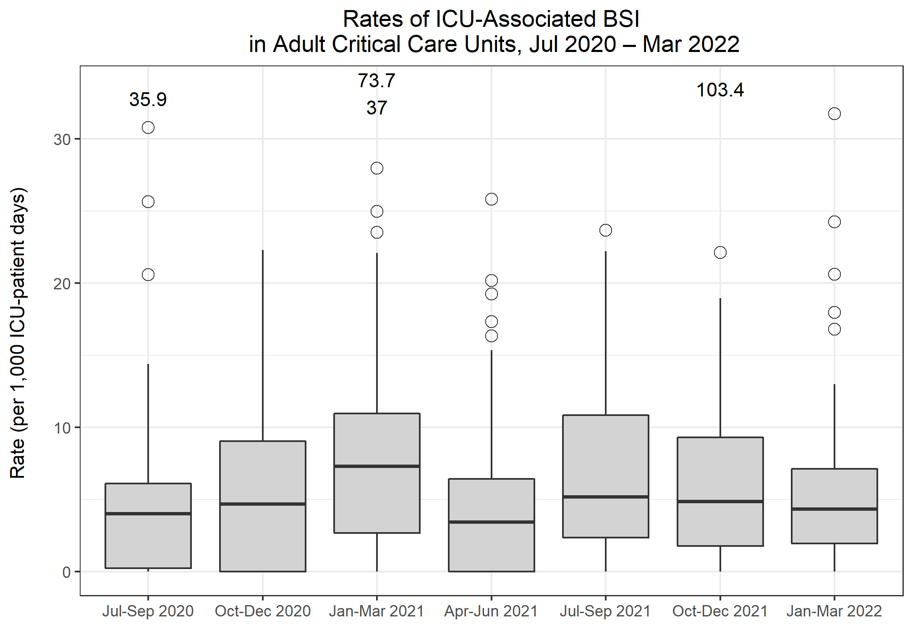
Rates of ICU-associated BSI in Adult CCUs
Metric | Q18 Jul-Sep 2020 | Q19 Oct-Dec 2020 | Q20 Jan-Mar 2021 | Q21 Apr-Jun 2021 | Q22 Jul-Sep 2021 | Q23 Oct-Dec 2021 | Q24 Jan-Mar 2022
Number of ICU-associated BSIs | 240 | 465 | 827 | 335 | 491 | 481 | 325
Number of patient days, amongst patients in the ICU>2 days | 46,993 | 70,568 | 95,461 | 65,959 | 71,734 | 74,410 | 63,786
Rate of ICU-associated BSI per 1,000 ICU-patient days | 5.1 | 6.6 | 8.7 | 5.1 | 6.8 | 6.5 | 5.1

Slide 6
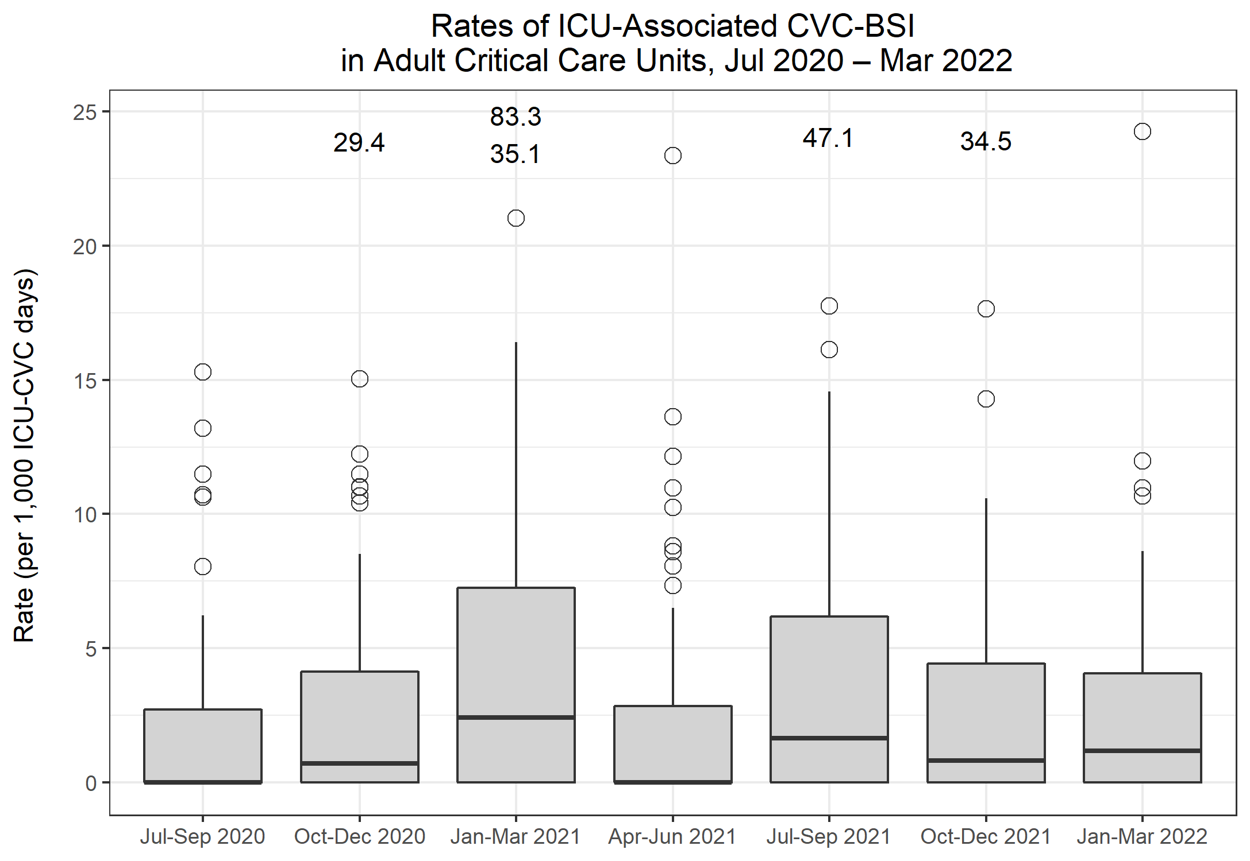
Rates of ICU-associated CVC-BSI in Adult CCUs
Metric | Q18 Jul-Sep 2020 | Q19 Oct-Dec 2020 | Q20 Jan-Mar 2021 | Q21 Apr-Jun 2021 | Q22 Jul-Sep 2021 | Q23 Oct-Dec 2021 | Q24 Jan-Mar 2022
Number of ICU-associated CABSIs | 43 | 83 | 141 | 73 | 98 | 95 | 65
Number of CVC days, amongst patients in the ICU>2 days | 30,351 | 44,944 | 61,751 | 41,802 | 44,542 | 46,659 | 38,341
Rate of ICU-associated CABSI per 1,000 ICU-CVC days | 1.4 | 1.8 | 2.3 | 1.7 | 2.2 | 2.0 | 1.7
Number of ICU-associated CRBSI | 48 | 100 | 163 | 72 | 116 | 72 | 65
Rate of ICU-associated CRBSI per 1,000 ICU-CVC days | 1.6 | 2.2 | 2.6 | 1.7 | 2.6 | 1.5 | 1.7
Number of all ICU-associated CVC-BSI | 75 | 156 | 258 | 124 | 175 | 140 | 109
Rate of all ICU-associated CVC-BSI per 1,000 ICU-CVC days | 2.5 | 3.5 | 4.2 | 3.0 | 3.9 | 3.0 | 2.8
CVC utilisation | 64.6% | 63.7% | 64.7% | 63.4% | 62.1% | 62.7% | 60.1%

Slide 7
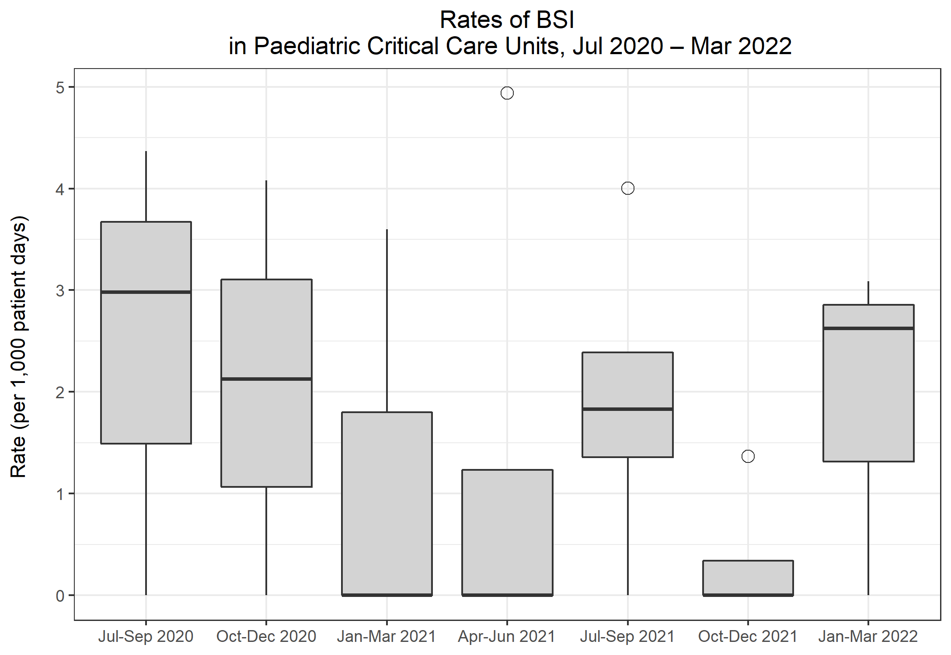
Rates of BSI in Paediatric CCUs
Metric | Q18 Jul-Sep 2020 | Q19 Oct-Dec 2020 | Q20 Jan-Mar 2021 | Q21 Apr-Jun 2021 | Q22 Jul-Sep 2021 | Q23 Oct-Dec 2021 | Q24 Jan-Mar 2022
Total number of positive blood cultures | 6 | 9 | 2 | 5 | 7 | 8 | 4
Total number of patient days | 1,479 | 1,705 | 1,030 | 1,151 | 2,224 | 1,623 | 1,155
Rate of positive blood cultures per 1,000 patient days | 4.1 | 5.3 | 1.9 | 4.3 | 3.1 | 4.9 | 3.5
Total number of positive blood cultures | 6 | 9 | 2 | 5 | 7 | 8 | 4
Total number of blood culture sets taken | 186 | 263 | 129 | 116 | 215 | 139 | 99
Rate of positive blood cultures per 1,000 blood culture sets taken | 32.3 | 34.2 | 15.5 | 43.1 | 32.6 | 57.6 | 40.4
Total number of BSIs | 3 | 3 | 1 | 2 | 6 | 1 | 3
Rate of BSI per 1,000 patient days | 2.0 | 1.8 | 1.0 | 1.7 | 2.7 | 0.6 | 2.6

Slide 8
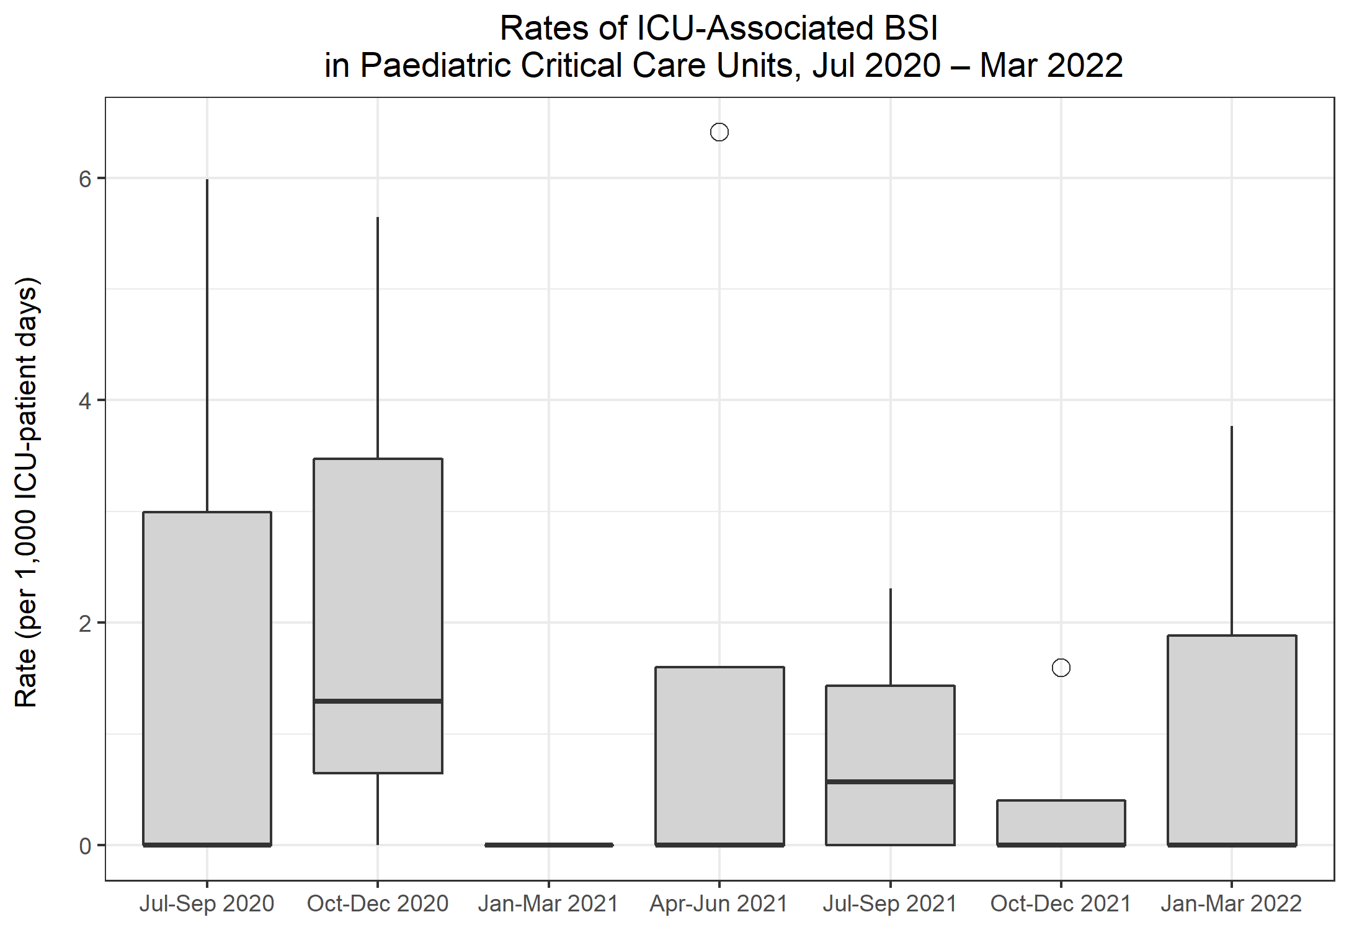
Rates of ICU-associated BSI in Paediatric CCUs
Metric | Q18 Jul-Sep 2020 | Q19 Oct-Dec 2020 | Q20 Jan-Mar 2021 | Q21 Apr-Jun 2021 | Q22 Jul-Sep 2021 | Q23 Oct-Dec 2021 | Q24 Jan-Mar 2022
Number of ICU-associated BSIs | 1 | 2 | 0 | 2 | 2 | 1 | 2
Number of patient days, amongst patients in the ICU>2 days | 1,238 | 1,377 | 826 | 857 | 1,708 | 1,276 | 871
Rate of ICU-associated BSI per 1,000 ICU-patient days | 0.8 | 1.5 | 0.0 | 2.3 | 1.2 | 0.8 | 2.3

Slide 9
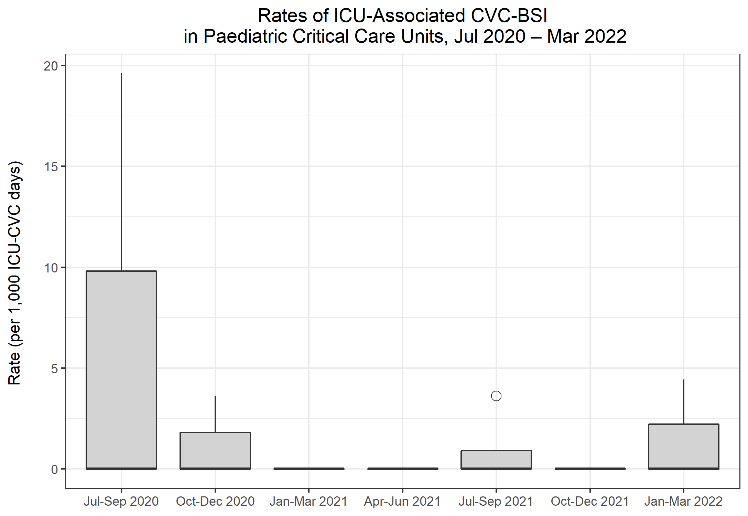
Rates of ICU-associated CVC-BSI in Paediatric CCUs
Metric | Q18 Jul-Sep 2020 | Q19 Oct-Dec 2020 | Q20 Jan-Mar 2021 | Q21 Apr-Jun 2021 | Q22 Jul-Sep 2021 | Q23 Oct-Dec 2021 | Q24 Jan-Mar 2022
Number of ICU-associated CABSI | 1 | 0 | 0 | 0 | 1 | 0 | 2
Number of CVC days, amongst patients in the ICU>2 days | 687 | 690 | 446 | 506 | 745 | 758 | 673
Rate of ICU-associated CVC-associated BSI per 1,000 ICU-CVC days | 1.5 | 0.0 | 0.0 | 0.0 | 1.3 | 0.0 | 3.0
Number of ICU-associated CRBSI | 0 | 1 | 0 | 0 | 0 | 0 | 0
Rate of ICU-associated CVC-related BSI per 1,000 ICU-CVC days | 0.0 | 1.4 | 0.0 | 0.0 | 0.0 | 0.0 | 0.0
Number of all ICU-associated CVC-BSI | 1 | 1 | 0 | 0 | 1 | 0 | 2
Rate of all ICU-associated CVC-BSI per 1,000 ICU-CVC days | 1.5 | 1.4 | 0.0 | 0.0 | 1.3 | 0.0 | 3.0
CVC utilisation | 55.5% | 50.1% | 54.0% | 59.0% | 43.6% | 59.4% | 77.3%

Slide 10
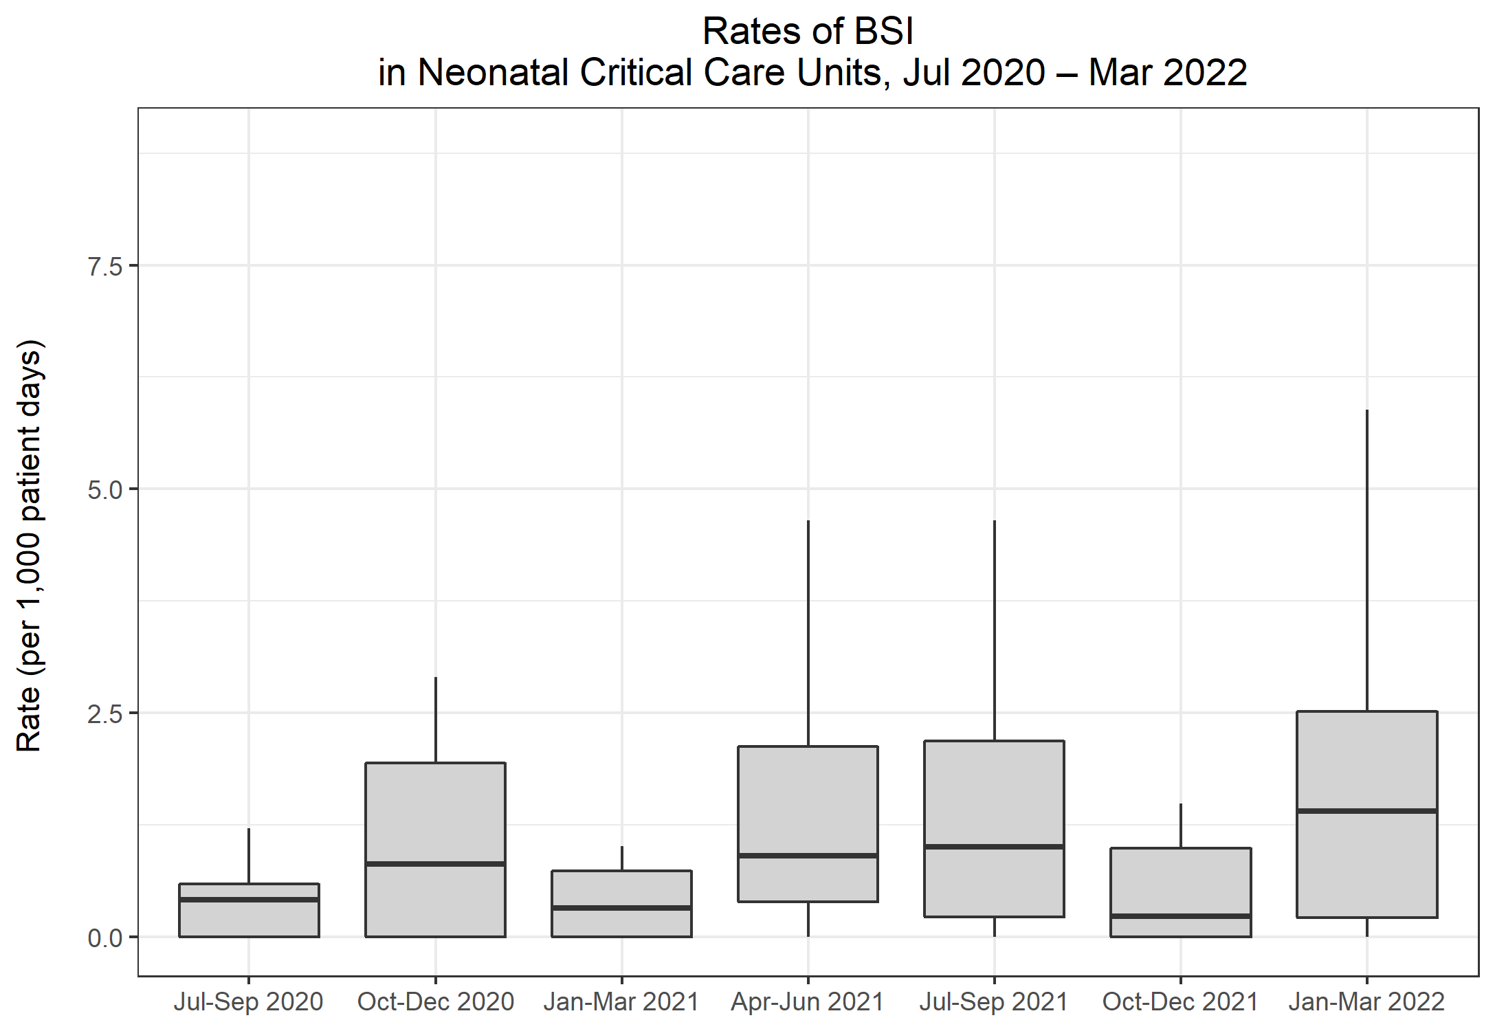
Rates of BSI in Neonatal CCUs
Metric | Q18 Jul-Sep 2020 | Q19 Oct-Dec 2020 | Q20 Jan-Mar 2021 | Q21 Apr-Jun 2021 | Q22 Jul-Sep 2021 | Q23 Oct-Dec 2021 | Q24 Jan-Mar 2022
Total number of positive blood cultures | 27 | 33 | 20 | 31 | 34 | 38 | 36
Total number of patient days | 9,103 | 8,220 | 8,283 | 7,772 | 9,490 | 9,999 | 8,872
Rate of positive blood cultures per 1,000 patient days | 3.0 | 4.0 | 2.4 | 4.0 | 3.6 | 3.8 | 4.1
Total number of positive blood cultures | 22 | 26 | 14 | 24 | 28 | 25 | 27
Total number of blood culture sets taken | 531 | 496 | 492 | 431 | 599 | 521 | 469
Rate of positive blood cultures per 1,000 blood culture sets taken | 41.4 | 52.4 | 28.5 | 55.7 | 46.7 | 48.0 | 57.6
Total number of BSIs | 5 | 11 | 3 | 7 | 10 | 8 | 14
Rate of BSI per 1,000 patient days | 0.5 | 1.3 | 0.4 | 0.9 | 1.1 | 0.8 | 1.6

Slide 11
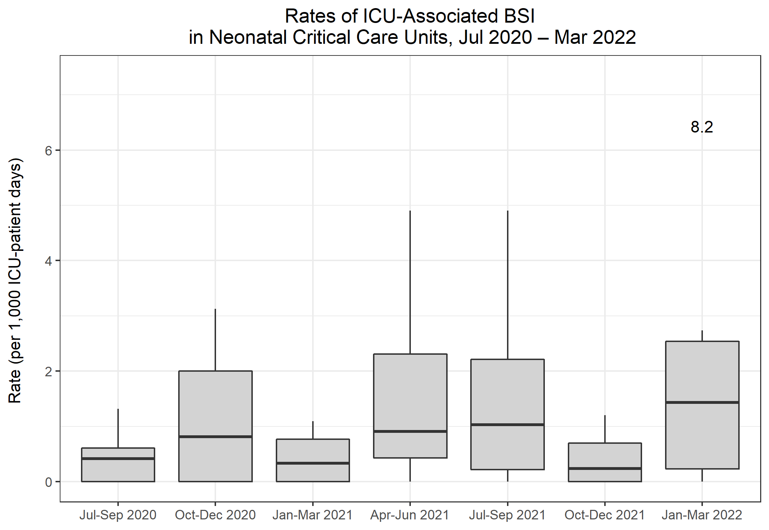
Rates of ICU-associated BSI in Neonatal CCUs
Metric | Q18 Jul-Sep 2020 | Q19 Oct-Dec 2020 | Q20 Jan-Mar 2021 | Q21 Apr-Jun 2021 | Q22 Jul-Sep 2021 | Q23 Oct-Dec 2021 | Q24 Jan-Mar 2022
Number of ICU-associated BSIs | 5 | 11 | 3 | 7 | 9 | 6 | 14
Number of patient days, amongst patients in the ICU>2 days | 8,685 | 7,837 | 7,905 | 7,384 | 8,883 | 9,608 | 8,552
Rate of ICU-associated BSI per 1,000 ICU-patient days | 0.6 | 1.4 | 0.4 | 0.9 | 1.0 | 0.6 | 1.6

Slide 12
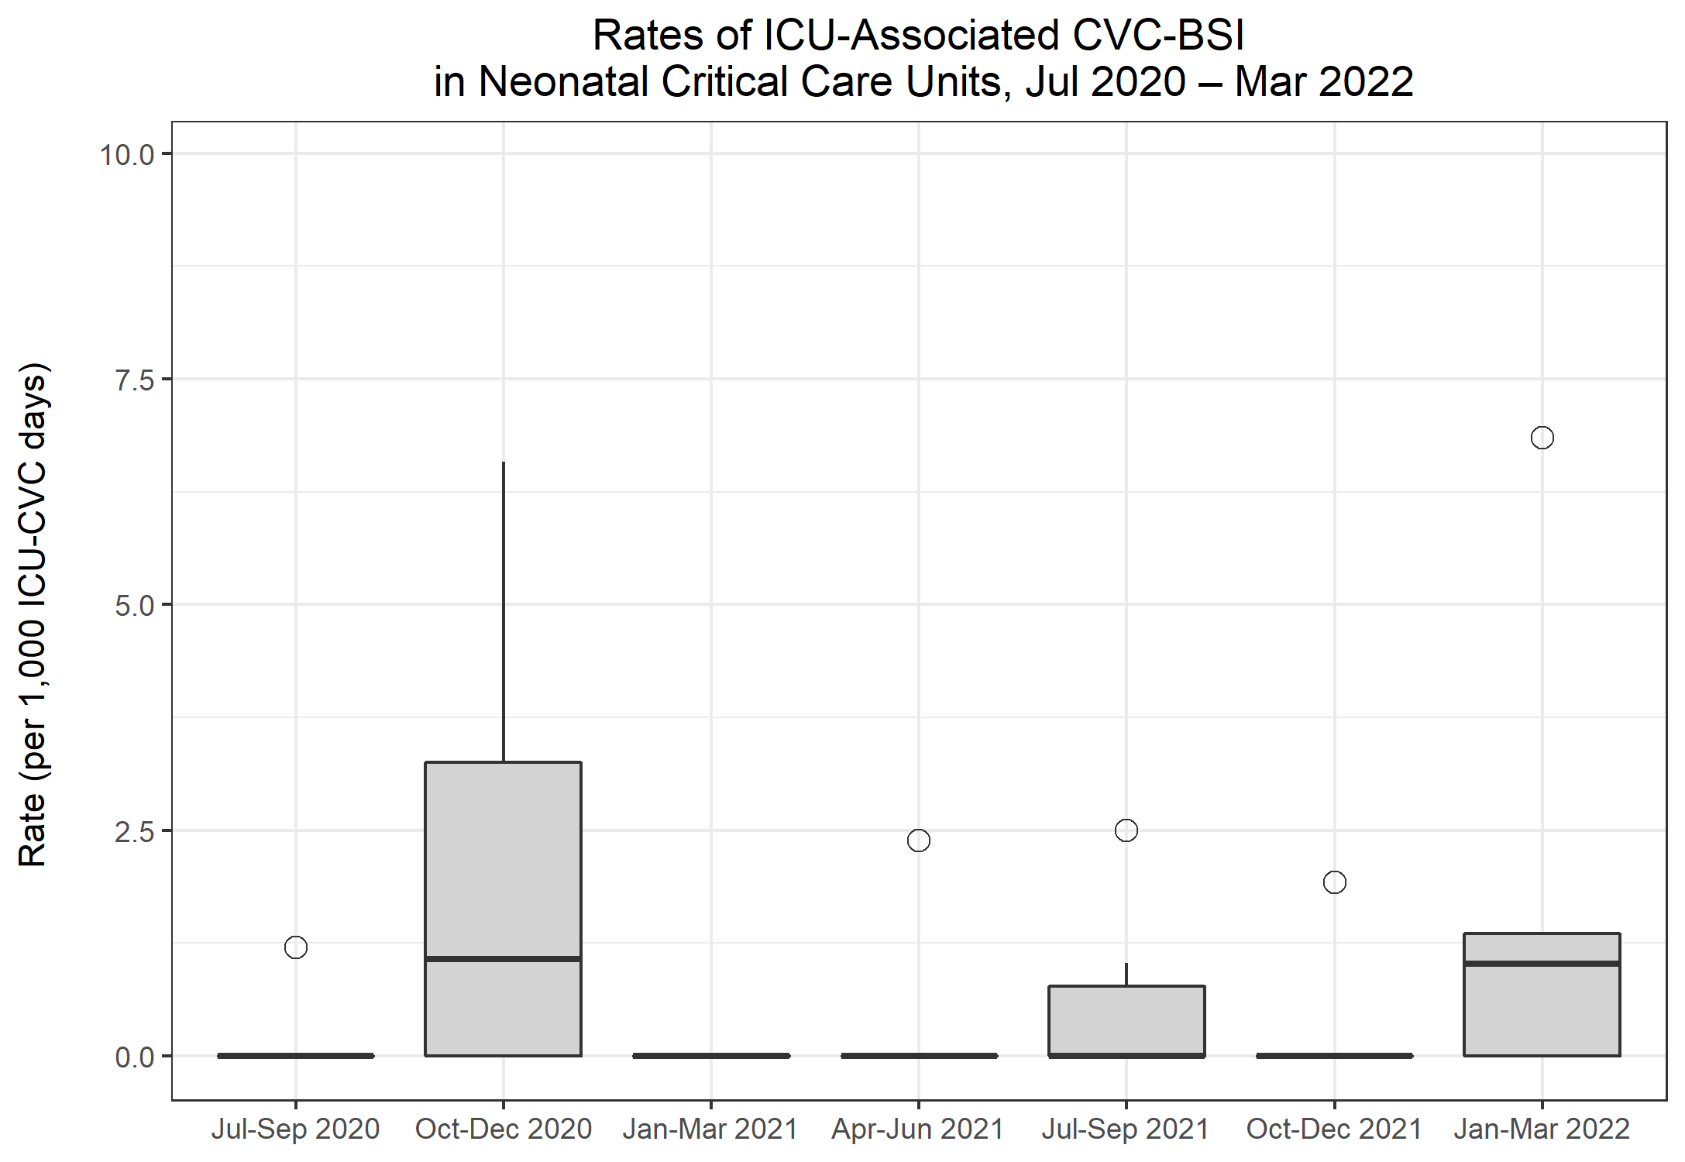
Rates of ICU-associated CVC-BSI in Neonatal CCUs
Metric | Q18 Jul-Sep 2020 | Q19 Oct-Dec 2020 | Q20 Jan-Mar 2021 | Q21 Apr-Jun 2021 | Q22 Jul-Sep 2021 | Q23 Oct-Dec 2021 | Q24 Jan-Mar 2022
Number of ICU-associated CABSI | 1 | 4 | 0 | 1 | 3 | 1 | 4
Number of CVC days, amongst patients in the ICU>2 days | 1,759 | 1,747 | 1,875 | 1,828 | 2,583 | 2,652 | 2,359
Rate of ICU-associated CVC-associated BSI per 1,000 ICU-CVC days | 0.6 | 2.3 | 0.0 | 0.5 | 1.2 | 0.4 | 1.7
Number of ICU-associated CRBSI | 0 | 3 | 0 | 0 | 3 | 0 | 2
Rate of ICU-associated CVC-related BSI per 1,000 ICU-CVC days | 0.0 | 1.7 | 0.0 | 0.0 | 1.2 | 0.0 | 0.8
Number of all ICU-associated CVC-BSI | 1 | 5 | 0 | 1 | 3 | 1 | 5
Rate of all ICU-associated CVC-BSI per 1,000 ICU-CVC days | 0.6 | 2.9 | 0.0 | 0.5 | 1.2 | 0.4 | 2.1
CVC utilisation | 20.3% | 22.3% | 23.7% | 24.8% | 29.1% | 27.6% | 27.6%

Slide 13
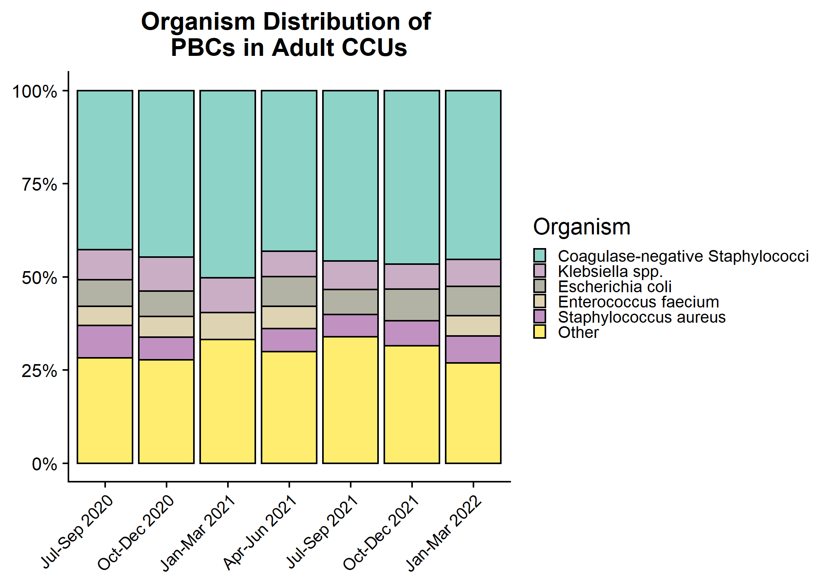
Organism distribution: all PBCs in Adult CCUs

Slide 14
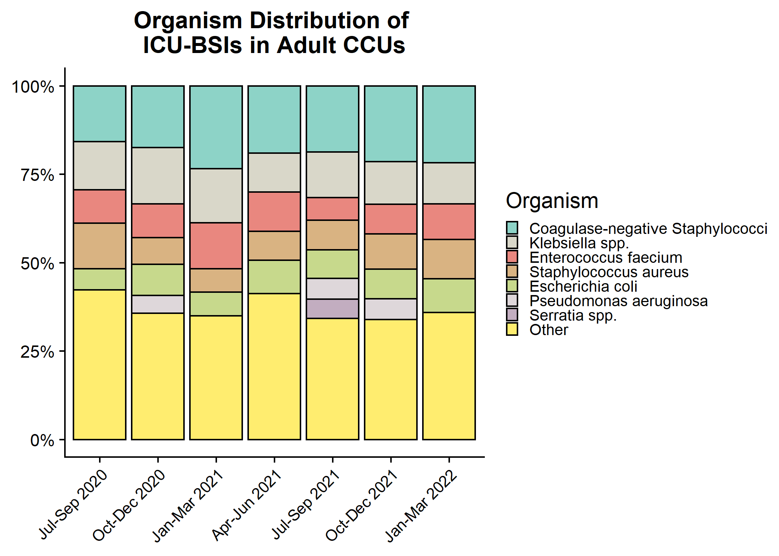
Organism distribution: ICU-associated BSIs in Adult CCUs

Slide 15
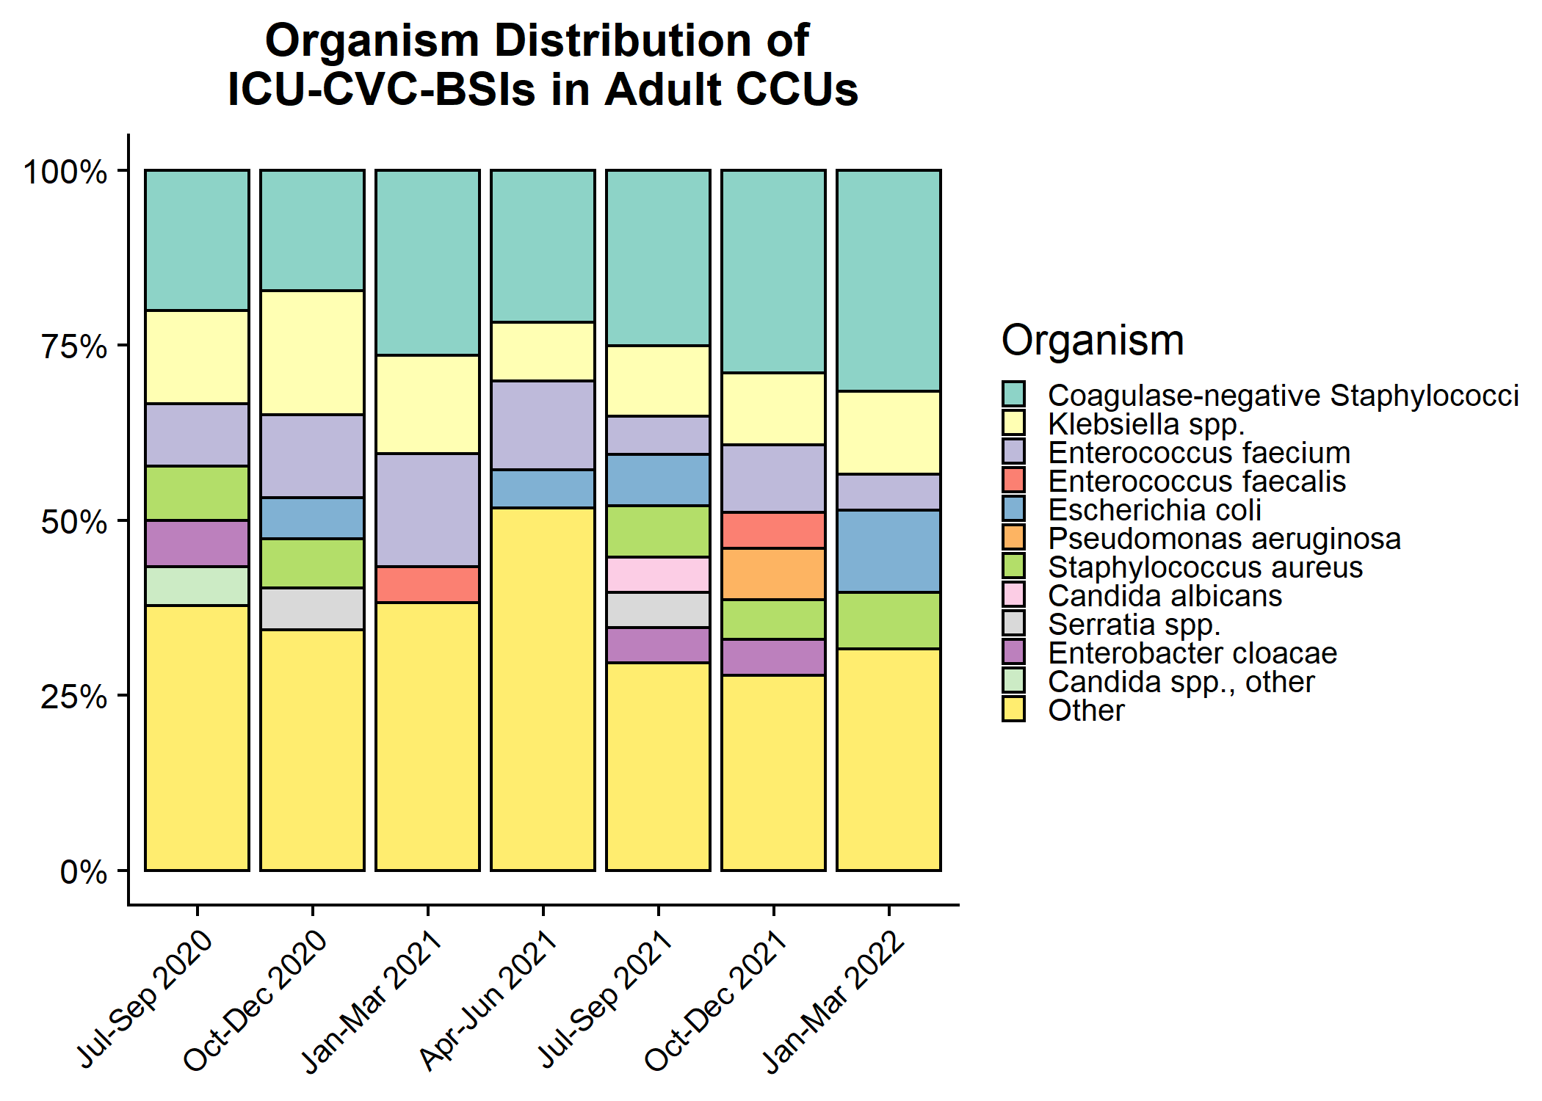
Organism distribution: ICU-CVC BSIs in Adult CCUs

Slide 16
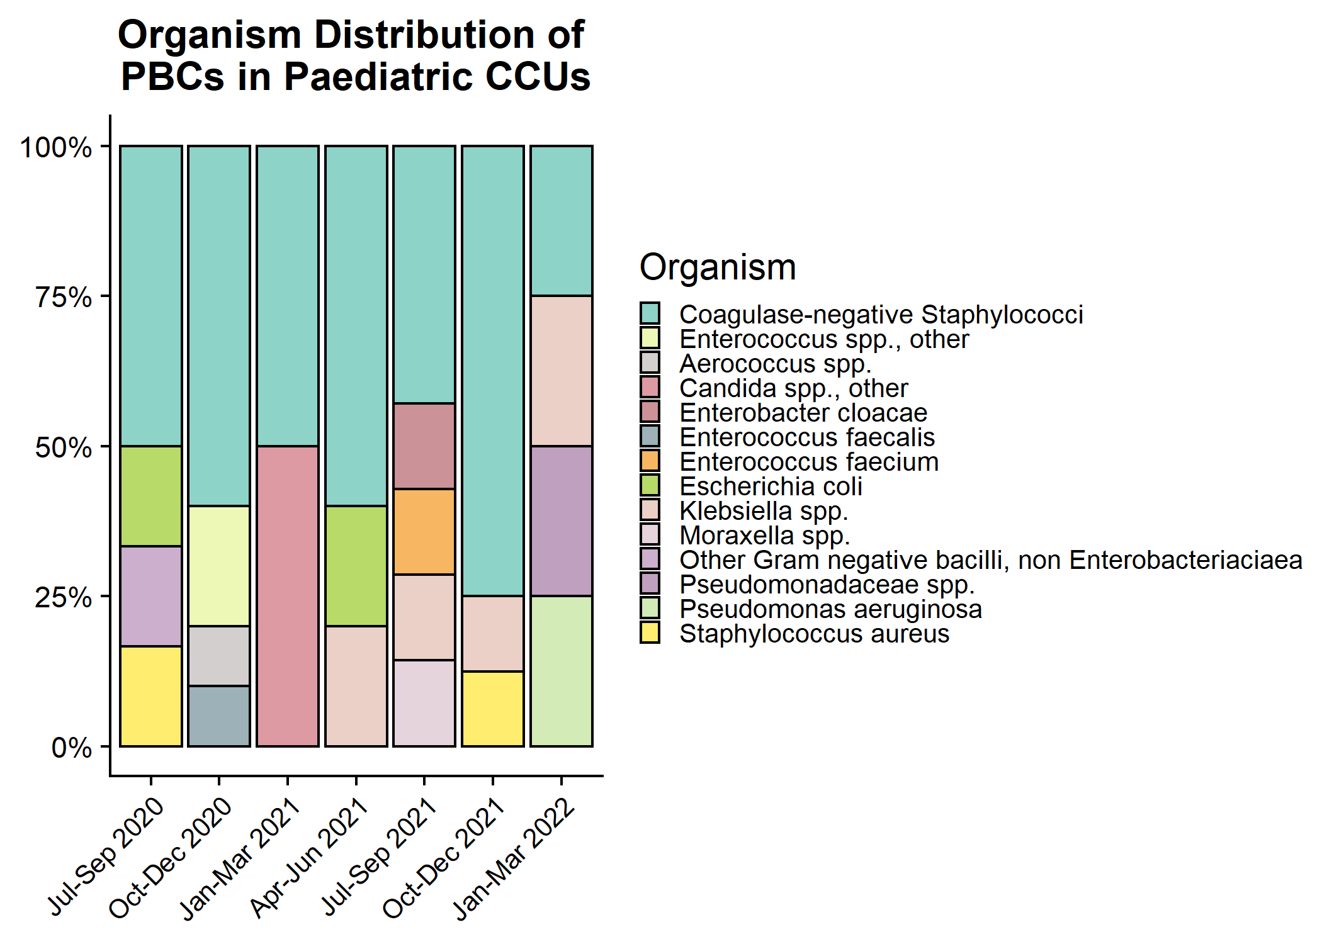
Organism distribution: all PBCs in Paediatric CCUs

Slide 17
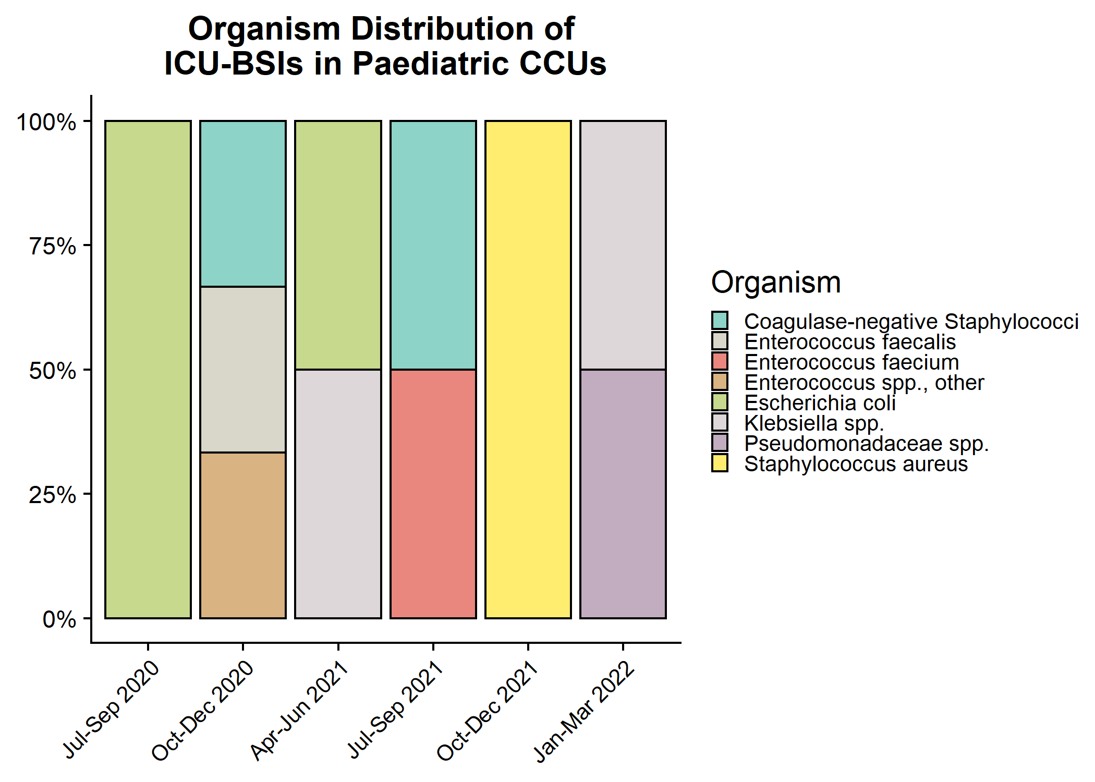
Organism distribution: ICU-associated BSIs in Paediatric CCUs

Slide 18
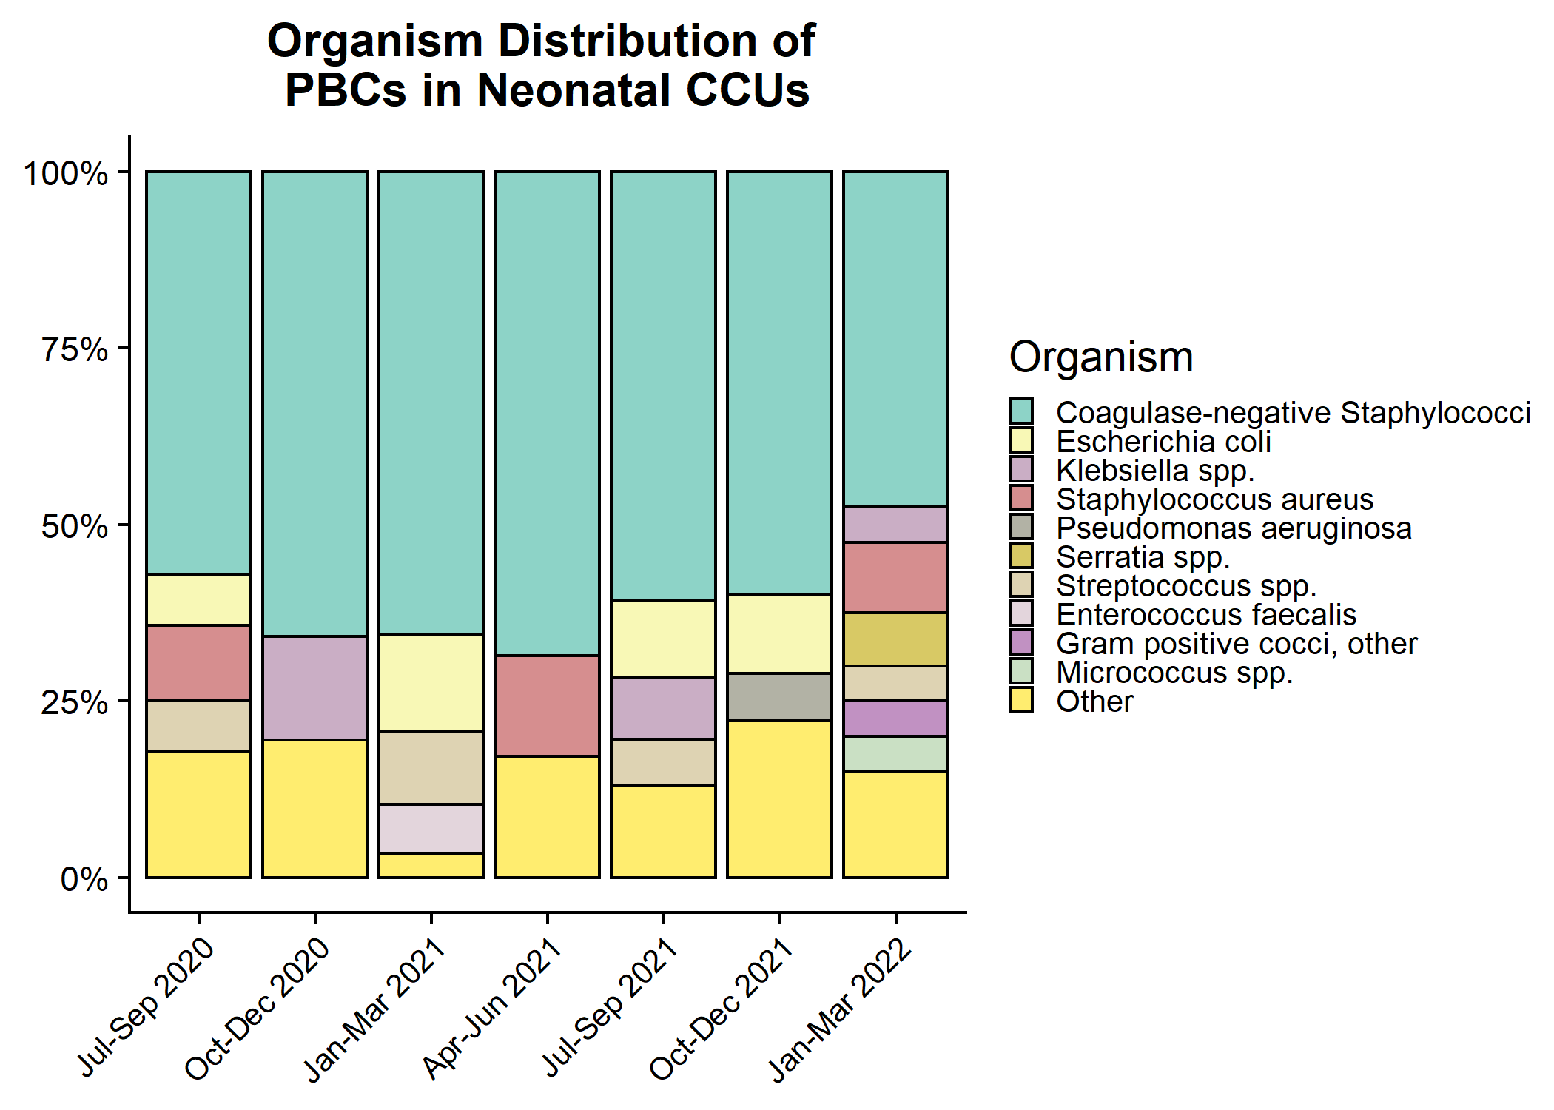
Organism distribution: all PBCs in Neonatal CCUs

Slide 19
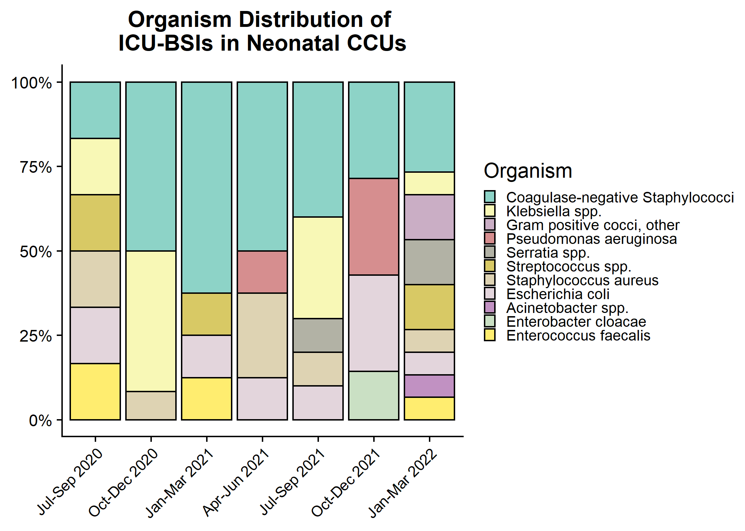
Organism distribution: ICU-associated BSIs in Neonatal CCUs

