Slide 1

ICCQIP Surveillance Update:Q19 Oct-Dec 2020 – Q25 Apr-Jun 2022
ICCQIP Surveillance Update: Q15 Oct-Dec 2019 – Q21 Apr-Jun 2021

Slide 2
Participation
 | Acute Trusts | All CCUs | Adult CCUs | Paediatric CCUs | Neonatal CCUs
Number in England | 139 | 428 | 240 | 25 | 163
Number registered on ICU Data Capture System | 131 | 284 | 236 | 21 | 27
Number with a registered Local Administrator | 96 | 161 | 143 | 4 | 14
Number which ever entered any data | 104 | 175 | 152 | 9 | 12
Number which have entered any data in last 7 quarters | 81 | 125 | 111 | 4 | 10
Number which have entered any data in Q25 Apr-Jun 2022 | 65 | 88 | 77 | 3 | 7

Slide 3
Active participation
Where units have submitted complete data for each quarter (both numerator and denominator)

Slide 4
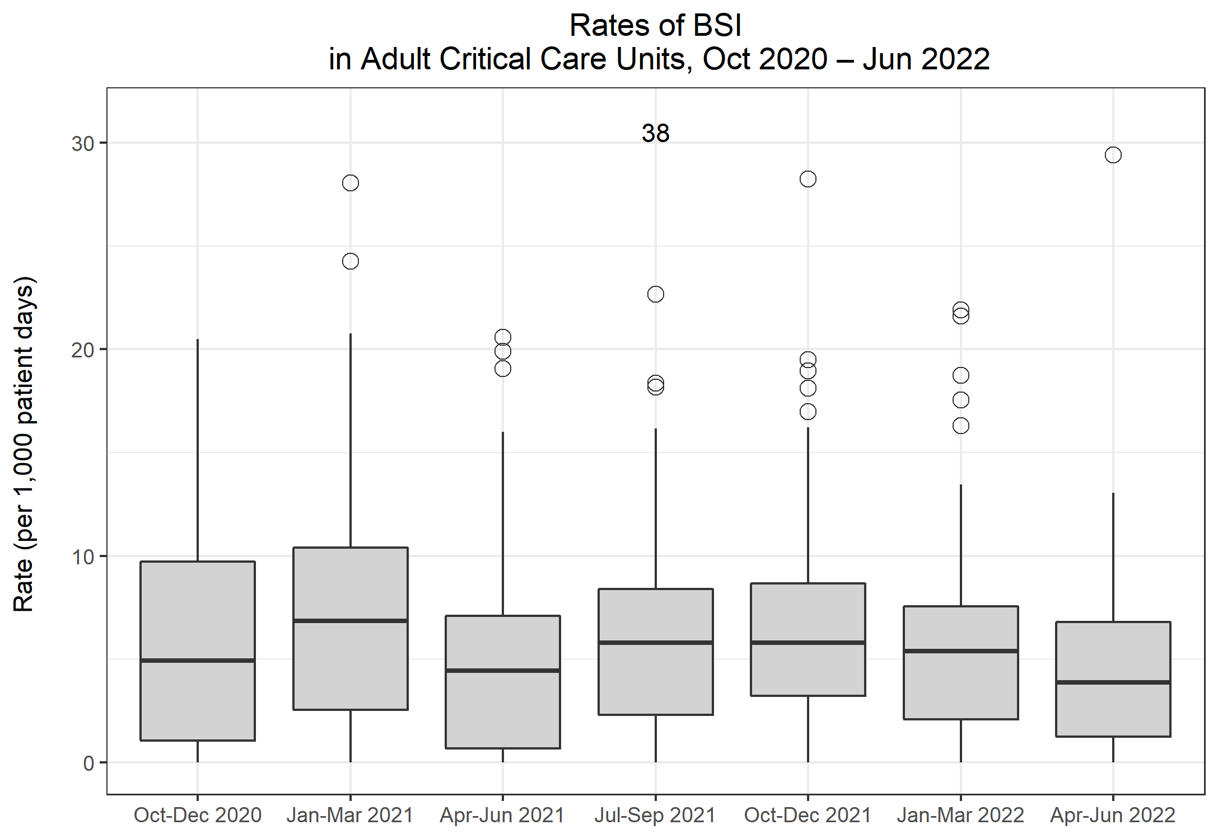
Rates of BSI in Adult CCUs
Metric | Q19 Oct-Dec 2020 | Q20 Jan-Mar 2021 | Q21 Apr-Jun 2021 | Q22 Jul-Sep 2021 | Q23 Oct-Dec 2021 | Q24 Jan-Mar 2022 | Q25 Apr-Jun 2022
Total number of positive blood cultures | 969 | 1,670 | 786 | 1,095 | 1,116 | 801 | 825
Total number of patient days | 94,374 | 117,810 | 90,388 | 96,520 | 98,133 | 87,979 | 92,237
Rate of positive blood cultures per 1,000 patient days | 10.3 | 14.2 | 8.7 | 11.3 | 11.4 | 9.1 | 8.9
Total number of positive blood cultures | 969 | 1,670 | 786 | 1,095 | 1,116 | 801 | 825
Total number of blood culture sets taken | 10,957 | 16,902 | 10,958 | 11,773 | 11,570 | 10,312 | 10,143
Rate of positive blood cultures per 1,000 blood culture sets taken | 88.4 | 98.8 | 71.7 | 93.0 | 96.5 | 77.7 | 81.3
Total number of BSIs | 589 | 962 | 484 | 653 | 673 | 487 | 462
Rate of BSI per 1,000 patient days | 6.2 | 8.2 | 5.4 | 6.8 | 6.9 | 5.5 | 5.0

Slide 5
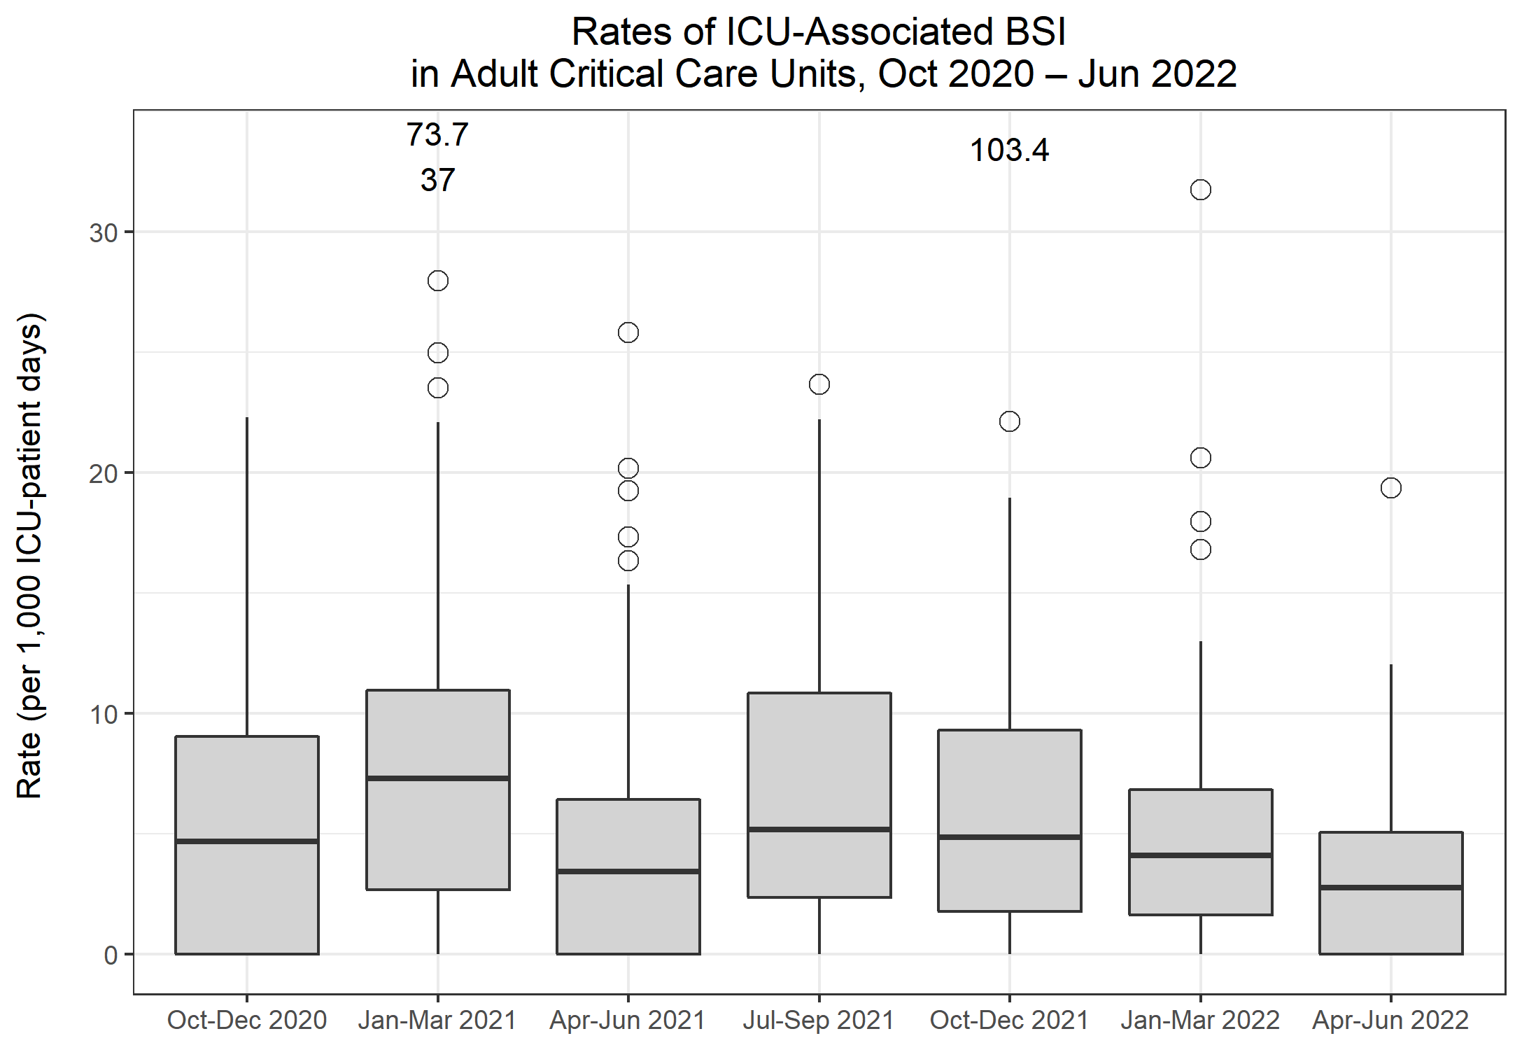
Rates of ICU-associated BSI in Adult CCUs
Metric | Q19 Oct-Dec 2020 | Q20 Jan-Mar 2021 | Q21 Apr-Jun 2021 | Q22 Jul-Sep 2021 | Q23 Oct-Dec 2021 | Q24 Jan-Mar 2022 | Q25 Apr-Jun 2022
Number of ICU-associated BSIs | 465 | 827 | 335 | 491 | 481 | 328 | 278
Number of patient days, amongst patients in the ICU>2 days | 70,568 | 95,461 | 65,959 | 71,734 | 74,410 | 64,983 | 67,404
Rate of ICU-associated BSI per 1,000 ICU-patient days | 6.6 | 8.7 | 5.1 | 6.8 | 6.5 | 5.0 | 4.1

Slide 6
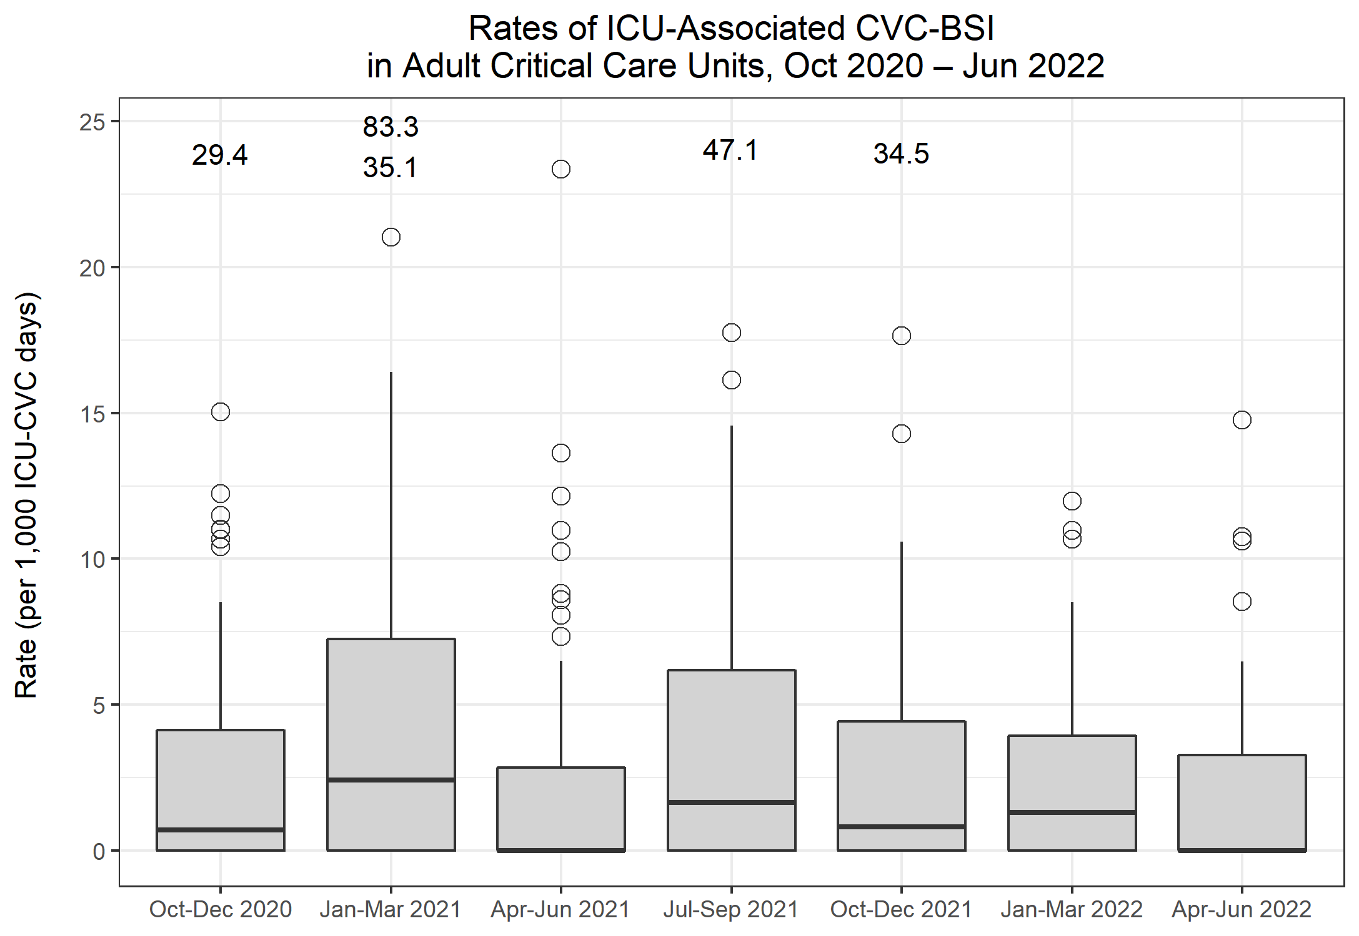
Rates of ICU-associated CVC-BSI in Adult CCUs
Metric | Q19 Oct-Dec 2020 | Q20 Jan-Mar 2021 | Q21 Apr-Jun 2021 | Q22 Jul-Sep 2021 | Q23 Oct-Dec 2021 | Q24 Jan-Mar 2022 | Q25 Apr-Jun 2022
Number of ICU-associated CABSI | 83 | 141 | 73 | 98 | 95 | 63 | 63
Number of CVC days, amongst patients in the ICU>2 days | 44,944 | 61,751 | 41,802 | 44,542 | 46,677 | 39,325 | 39,798
Rate of ICU-associated CABSI per 1,000 ICU-CVC days | 1.8 | 2.3 | 1.7 | 2.2 | 2.0 | 1.6 | 1.6
Number of ICU-associated CRBSI | 100 | 163 | 72 | 116 | 72 | 66 | 45
Rate of ICU-associated CRBSI per 1,000 ICU-CVC days | 2.2 | 2.6 | 1.7 | 2.6 | 1.5 | 1.7 | 1.1
Number of all ICU-associated CVC-BSI | 156 | 258 | 124 | 175 | 140 | 109 | 86
Rate of all ICU-associated CVC-BSI per 1,000 ICU-CVC days | 3.5 | 4.2 | 3.0 | 3.9 | 3.0 | 2.8 | 2.2
CVC utilisation | 63.7% | 64.7% | 63.4% | 62.1% | 62.7% | 60.5% | 59.0%

Slide 7
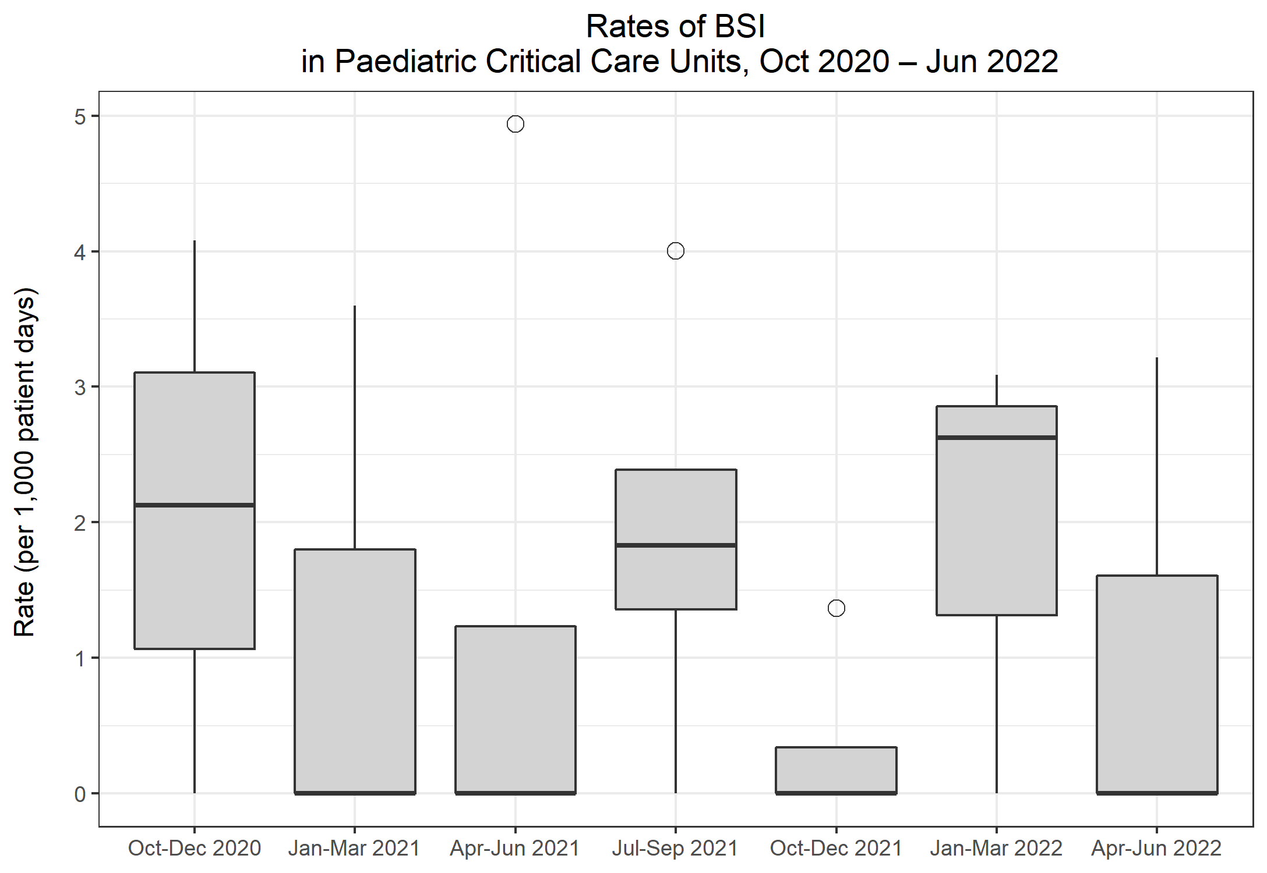
Rates of BSI in Paediatric CCUs
Metric | Q19 Oct-Dec 2020 | Q20 Jan-Mar 2021 | Q21 Apr-Jun 2021 | Q22 Jul-Sep 2021 | Q23 Oct-Dec 2021 | Q24 Jan-Mar 2022 | Q25 Apr-Jun 2022
Total number of positive blood cultures | 9 | 2 | 5 | 7 | 8 | 4 | 2
Total number of patient days | 1,705 | 1,030 | 1,151 | 2,224 | 1,623 | 1,155 | 1,120
Rate of positive blood cultures per 1,000 patient days | 5.3 | 1.9 | 4.3 | 3.1 | 4.9 | 3.5 | 1.8
Total number of positive blood cultures | 9 | 2 | 5 | 7 | 8 | 4 | 2
Total number of blood culture sets taken | 263 | 129 | 116 | 215 | 139 | 99 | 119
Rate of positive blood cultures per 1,000 blood culture sets taken | 34.2 | 15.5 | 43.1 | 32.6 | 57.6 | 40.4 | 16.8
Total number of BSIs | 3 | 1 | 2 | 6 | 1 | 3 | 2
Rate of BSI per 1,000 patient days | 1.8 | 1.0 | 1.7 | 2.7 | 0.6 | 2.6 | 1.8

Slide 8
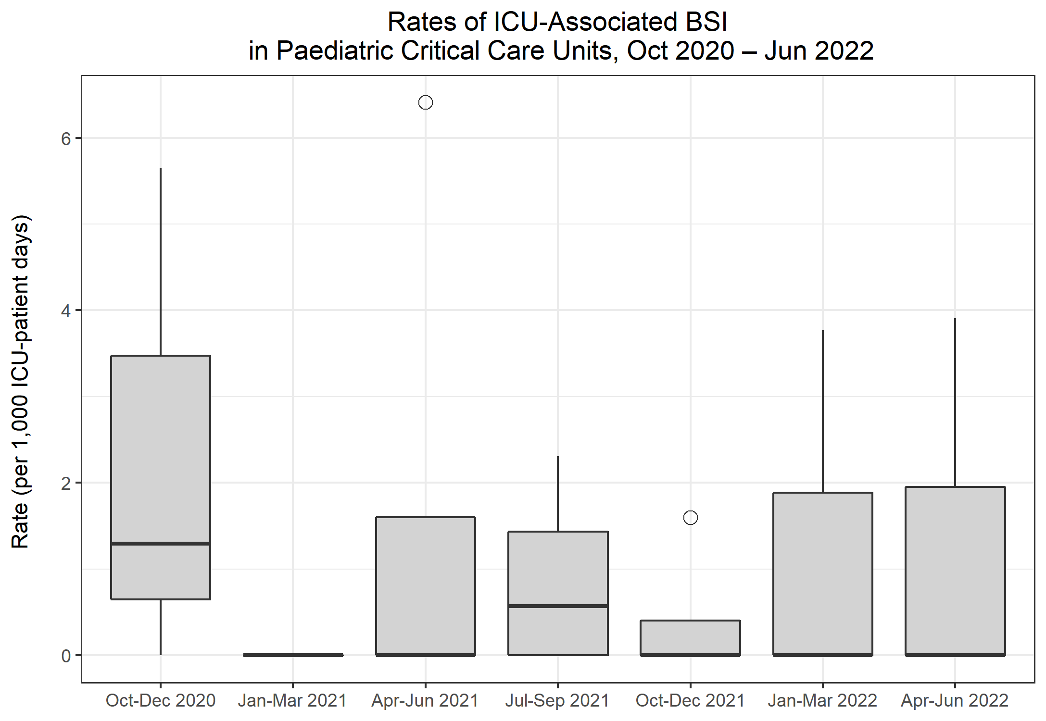
Rates of ICU-associated BSI in Paediatric CCUs
Metric | Q19 Oct-Dec 2020 | Q20 Jan-Mar 2021 | Q21 Apr-Jun 2021 | Q22 Jul-Sep 2021 | Q23 Oct-Dec 2021 | Q24 Jan-Mar 2022 | Q25 Apr-Jun 2022
Number of ICU-associated BSIs | 2 | 0 | 2 | 2 | 1 | 2 | 2
Number of patient days, amongst patients in the ICU>2 days | 1,377 | 826 | 857 | 1,708 | 1,276 | 871 | 846
Rate of ICU-associated BSI per 1,000 ICU-patient days | 1.5 | 0.0 | 2.3 | 1.2 | 0.8 | 2.3 | 2.4

Slide 9
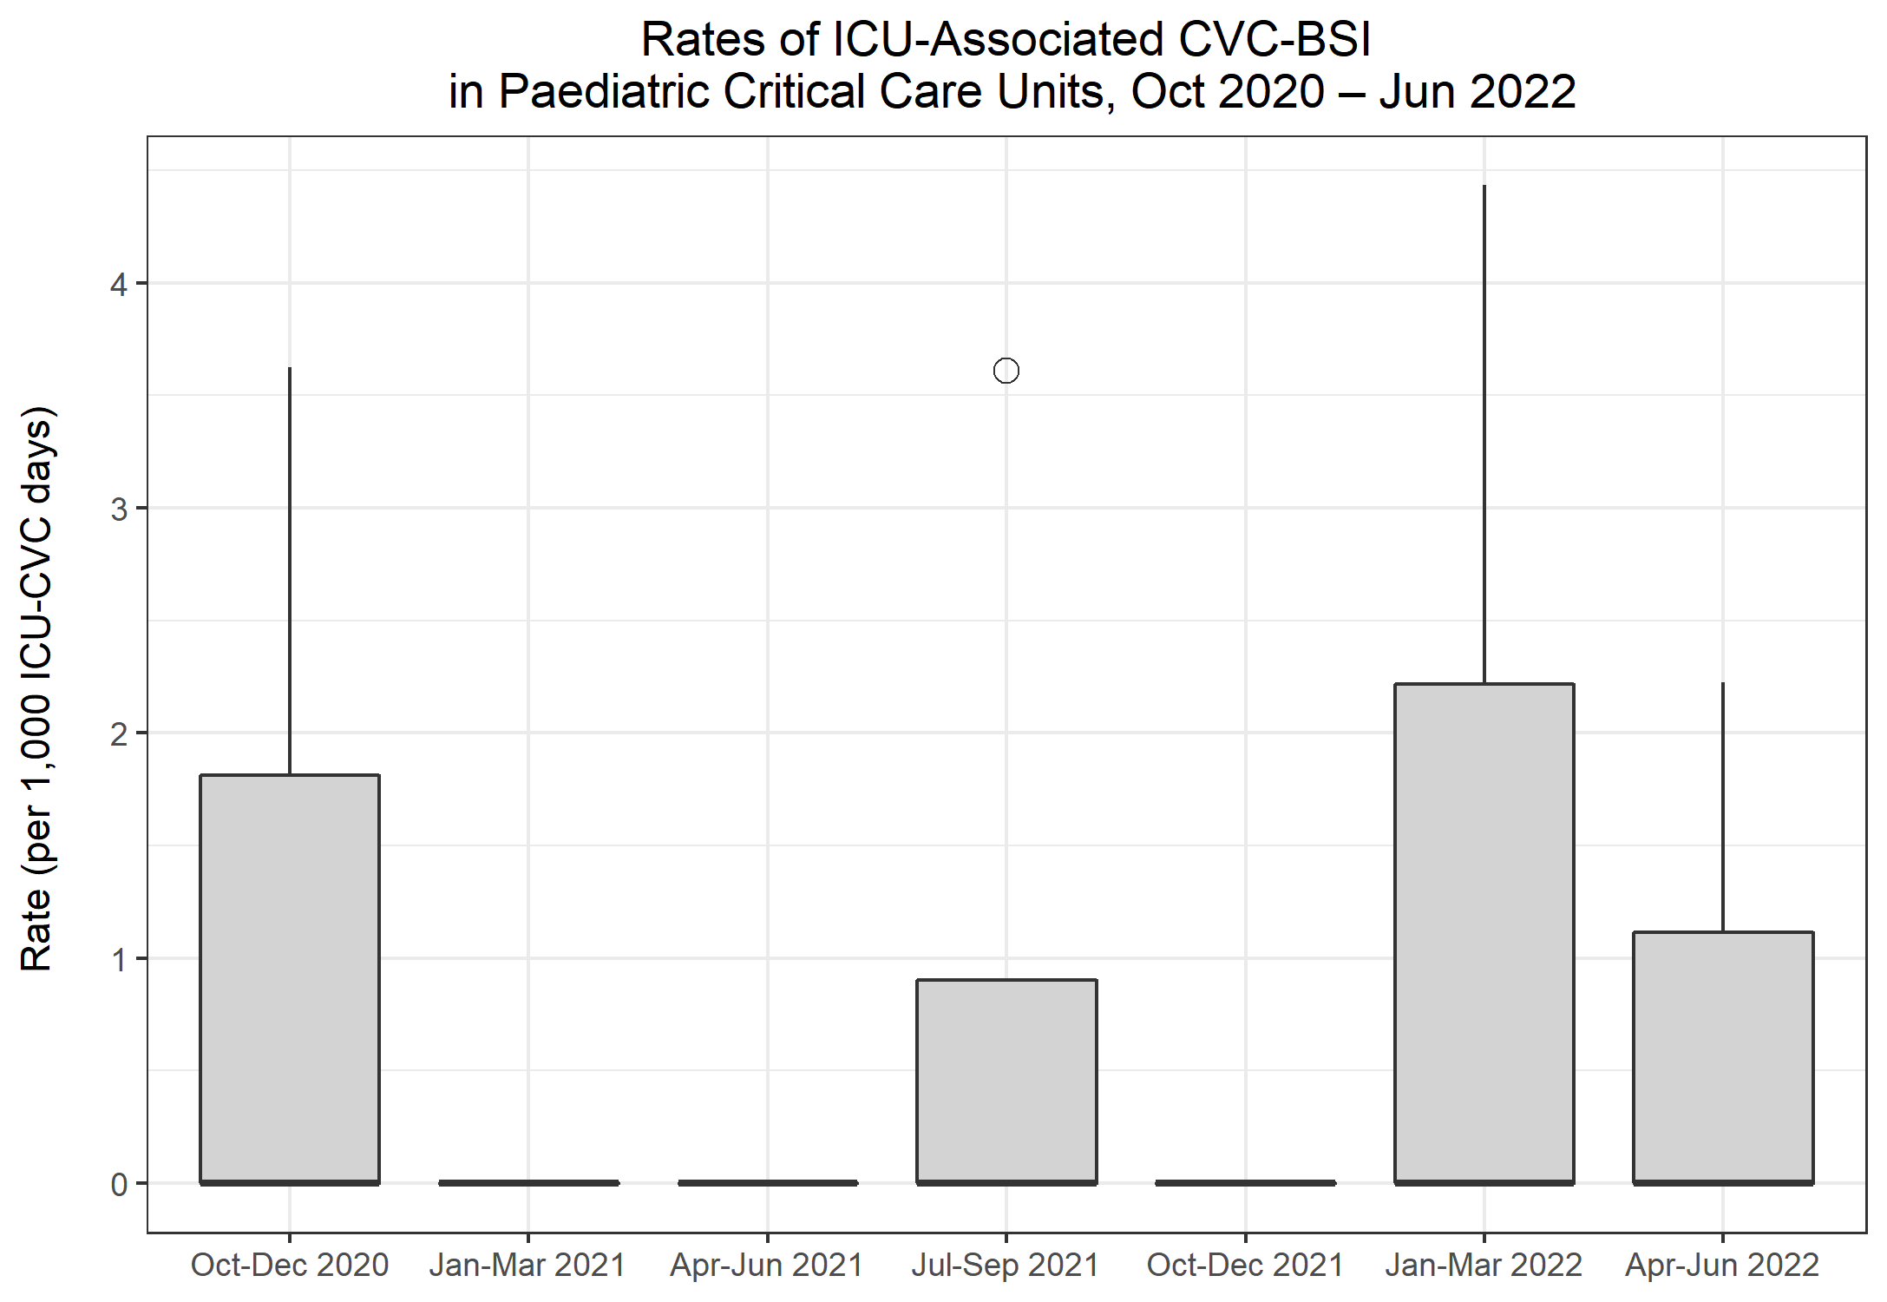
Rates of ICU-associated CVC-BSI in Paediatric CCUs
Metric | Q19 Oct-Dec 2020 | Q20 Jan-Mar 2021 | Q21 Apr-Jun 2021 | Q22 Jul-Sep 2021 | Q23 Oct-Dec 2021 | Q24 Jan-Mar 2022 | Q25 Apr-Jun 2022
Number of ICU-associated CABSI | 0 | 0 | 0 | 1 | 0 | 2 | 0
Number of CVC days, amongst patients in the ICU>2 days | 690 | 446 | 506 | 745 | 758 | 673 | 639
Rate of ICU-associated CABSI per 1,000 ICU-CVC days | 0.0 | 0.0 | 0.0 | 1.3 | 0.0 | 3.0 | 0.0
Number of ICU-associated CRBSI | 1 | 0 | 0 | 0 | 0 | 0 | 1
Rate of ICU-associated CRBSI per 1,000 ICU-CVC days | 1.4 | 0.0 | 0.0 | 0.0 | 0.0 | 0.0 | 1.6
Number of all ICU-associated CVC-BSI | 1 | 0 | 0 | 1 | 0 | 2 | 1
Rate of all ICU-associated CVC-BSI per 1,000 ICU-CVC days | 1.4 | 0.0 | 0.0 | 1.3 | 0.0 | 3.0 | 1.6
CVC utilisation | 50.1% | 54.0% | 59.0% | 43.6% | 59.4% | 77.3% | 75.5%

Slide 10
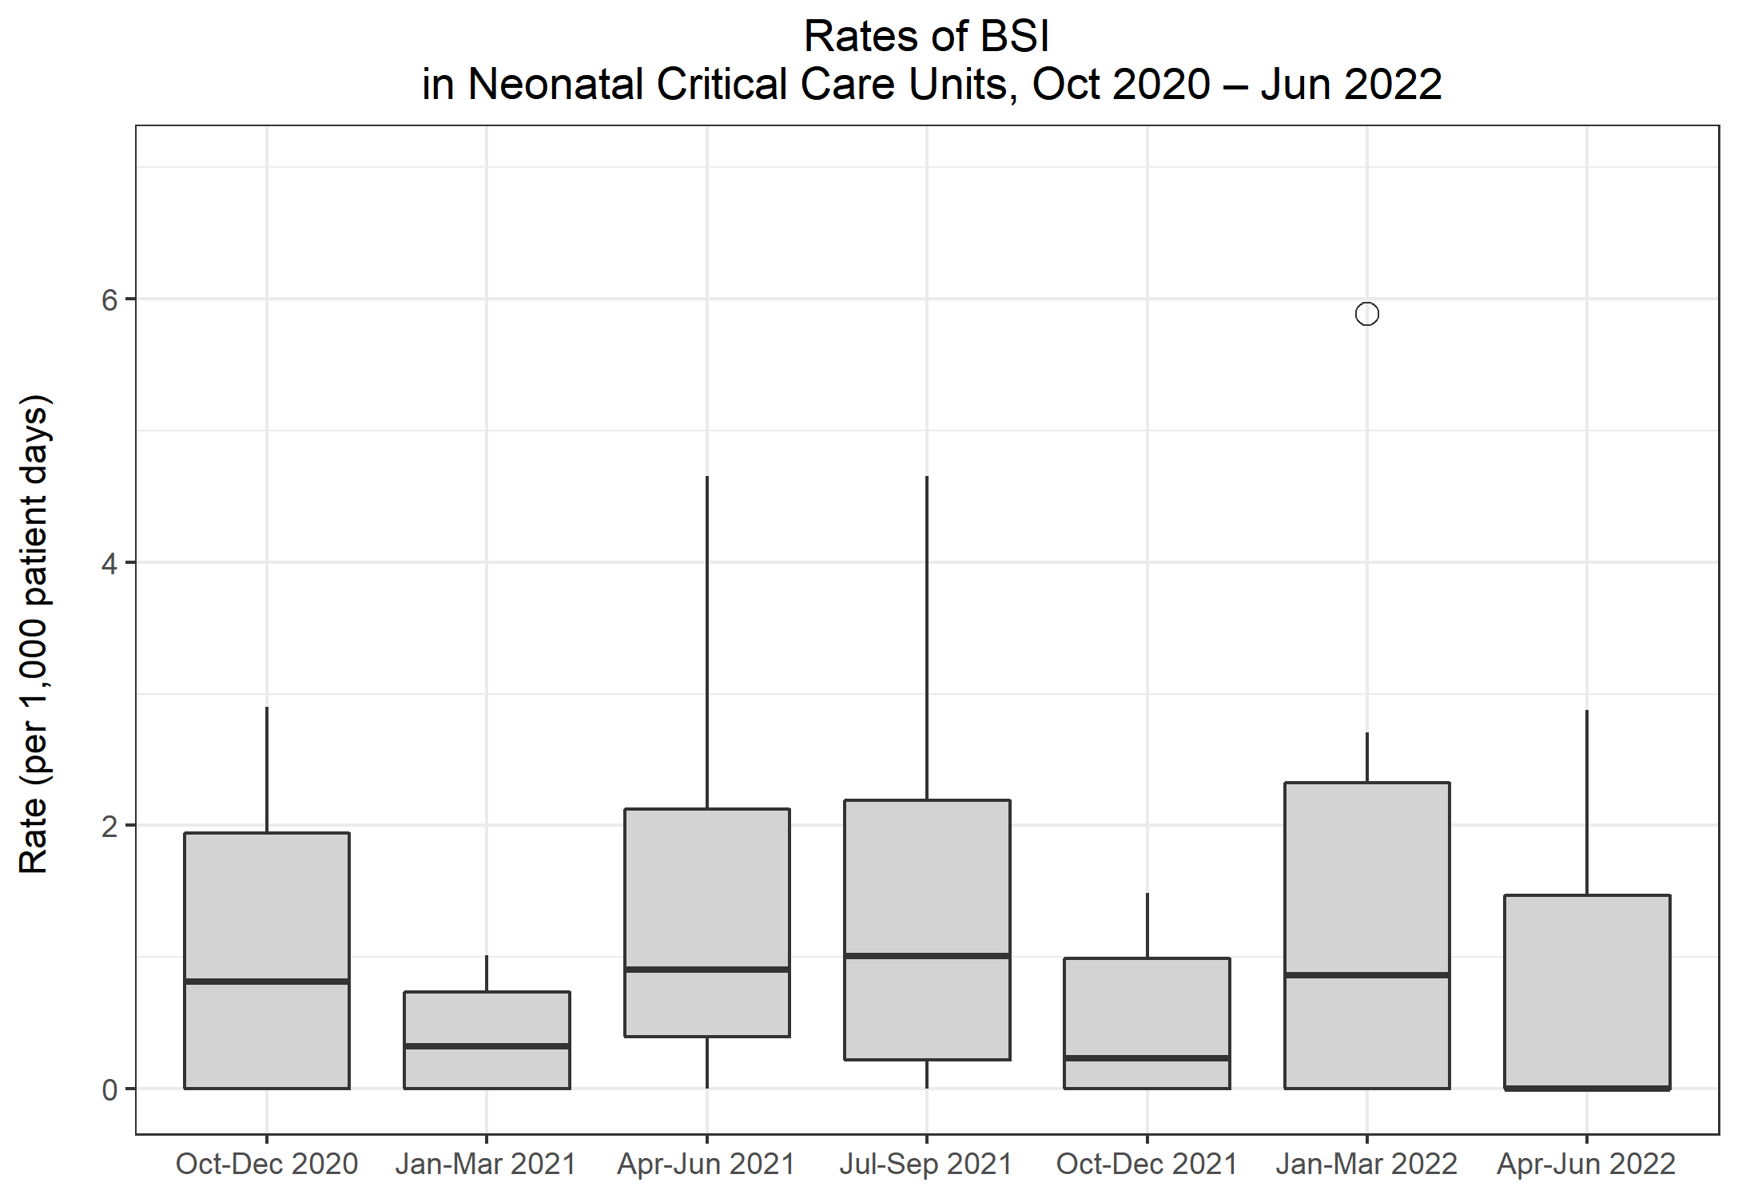
Rates of BSI in Neonatal CCUs
Metric | Q19 Oct-Dec 2020 | Q20 Jan-Mar 2021 | Q21 Apr-Jun 2021 | Q22 Jul-Sep 2021 | Q23 Oct-Dec 2021 | Q24 Jan-Mar 2022 | Q25 Apr-Jun 2022
Total number of positive blood cultures | 33 | 20 | 31 | 34 | 38 | 44 | 26
Total number of patient days | 8,220 | 8,283 | 7,772 | 9,490 | 9,999 | 10,067 | 9,731
Rate of positive blood cultures per 1,000 patient days | 4.0 | 2.4 | 4.0 | 3.6 | 3.8 | 4.4 | 2.7
Total number of positive blood cultures | 33 | 20 | 31 | 34 | 38 | 44 | 26
Total number of blood culture sets taken | 597 | 591 | 531 | 700 | 622 | 638 | 687
Rate of positive blood cultures per 1,000 blood culture sets taken | 55.3 | 33.8 | 58.4 | 48.6 | 61.1 | 69.0 | 37.8
Total number of BSIs | 11 | 3 | 7 | 10 | 8 | 14 | 9
Rate of BSI per 1,000 patient days | 1.3 | 0.4 | 0.9 | 1.1 | 0.8 | 1.4 | 0.9

Slide 11
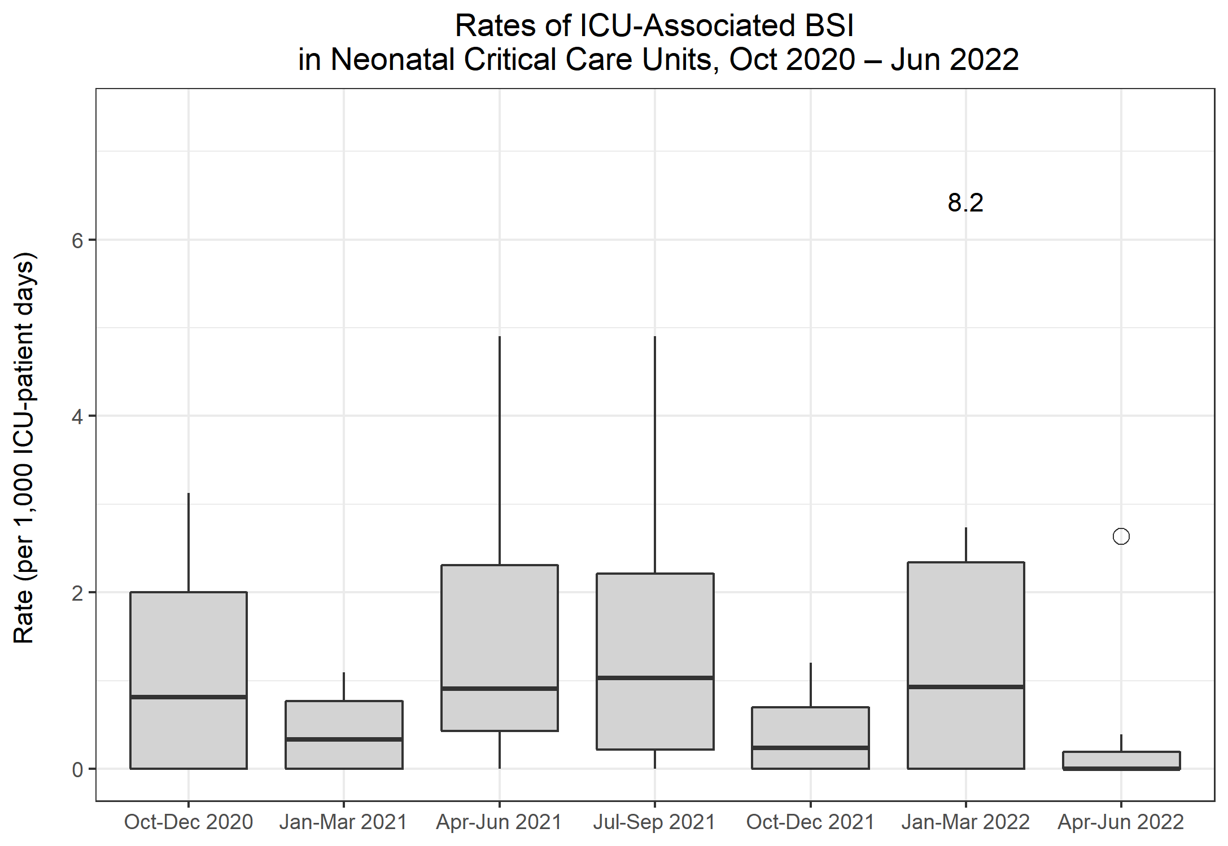
Rates of ICU-associated BSI in Neonatal CCUs
Metric | Q19 Oct-Dec 2020 | Q20 Jan-Mar 2021 | Q21 Apr-Jun 2021 | Q22 Jul-Sep 2021 | Q23 Oct-Dec 2021 | Q24 Jan-Mar 2022 | Q25 Apr-Jun 2022
Number of ICU-associated BSIs | 11 | 3 | 7 | 9 | 6 | 14 | 7
Number of patient days, amongst patients in the ICU>2 days | 7,837 | 7,905 | 7,384 | 8,883 | 9,608 | 9,675 | 8,958
Rate of ICU-associated BSI per 1,000 ICU-patient days | 1.4 | 0.4 | 0.9 | 1.0 | 0.6 | 1.4 | 0.8

Slide 12
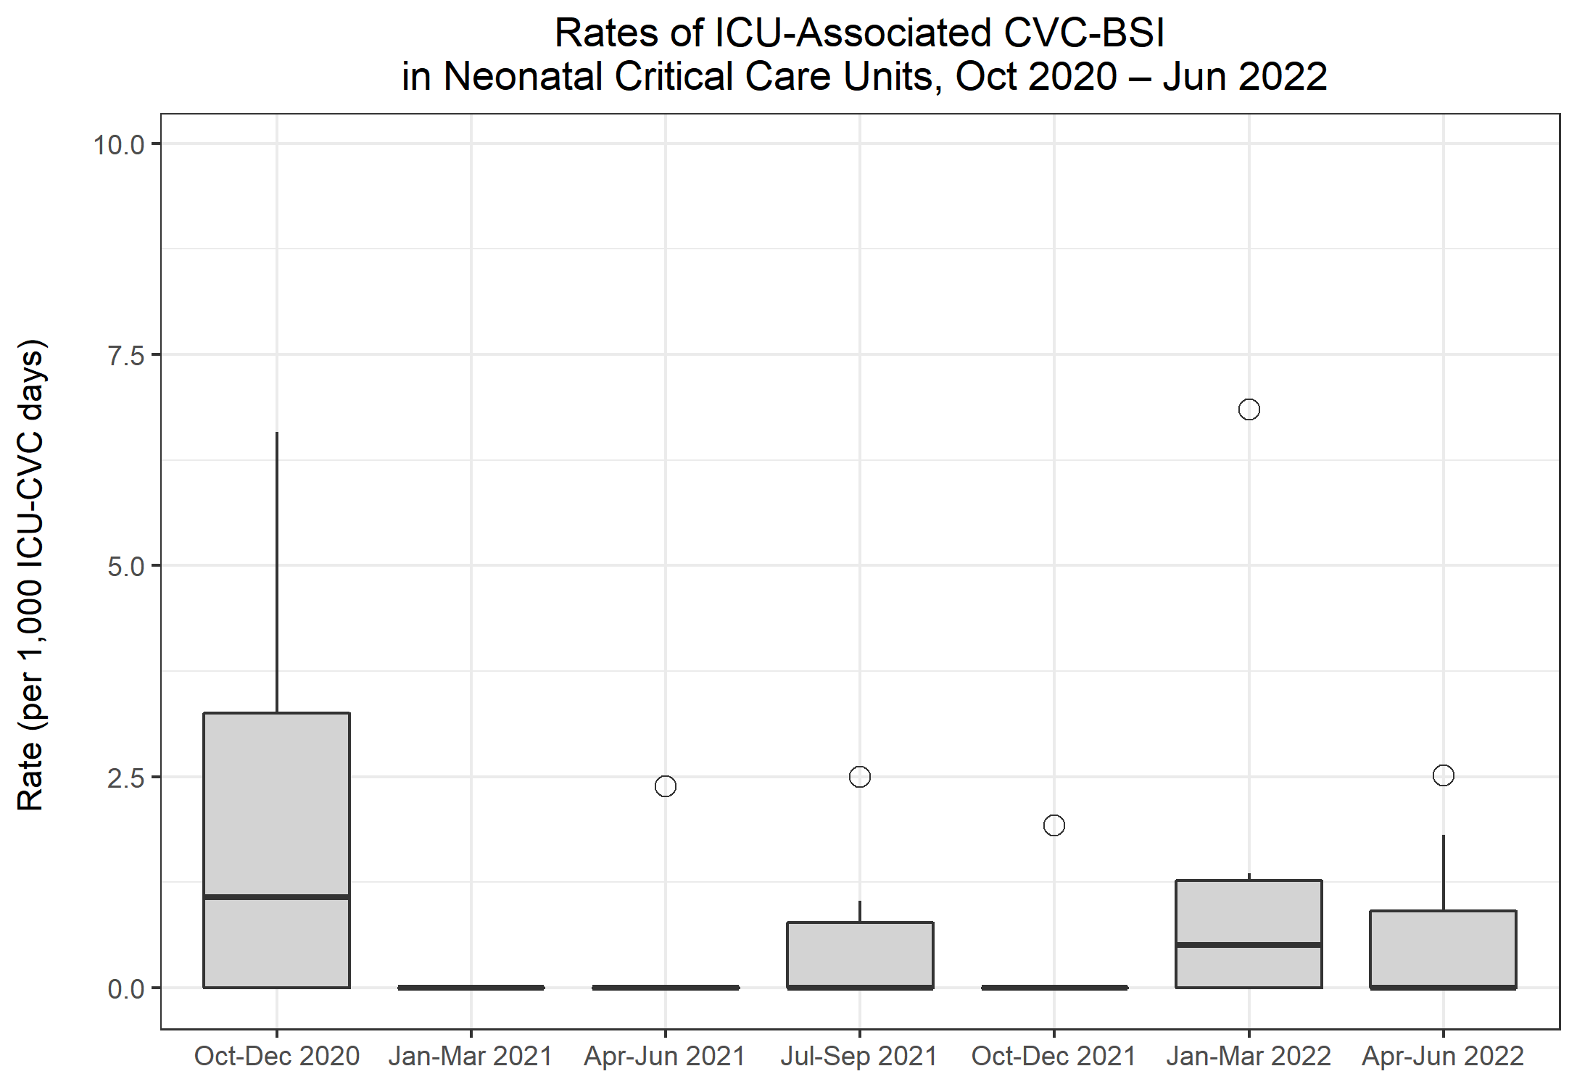
Rates of ICU-associated CVC-BSI in Neonatal CCUs
Metric | Q19 Oct-Dec 2020 | Q20 Jan-Mar 2021 | Q21 Apr-Jun 2021 | Q22 Jul-Sep 2021 | Q23 Oct-Dec 2021 | Q24 Jan-Mar 2022 | Q25 Apr-Jun 2022
Number of ICU-associated CABSI | 4 | 0 | 1 | 3 | 1 | 4 | 3
Number of CVC days, amongst patients in the ICU>2 days | 1,747 | 1,875 | 1,828 | 2,583 | 2,652 | 2,591 | 2,213
Rate of ICU-associated CABSI per 1,000 ICU-CVC days | 2.3 | 0.0 | 0.5 | 1.2 | 0.4 | 1.5 | 1.4
Number of ICU-associated CRBSI | 3 | 0 | 0 | 3 | 0 | 2 | 1
Rate of ICU-associated CRBSI per 1,000 ICU-CVC days | 1.7 | 0.0 | 0.0 | 1.2 | 0.0 | 0.8 | 0.5
Number of all ICU-associated CVC-BSI | 5 | 0 | 1 | 3 | 1 | 5 | 3
Rate of all ICU-associated CVC-BSI per 1,000 ICU-CVC days | 2.9 | 0.0 | 0.5 | 1.2 | 0.4 | 1.9 | 1.4
CVC utilisation | 22.3% | 23.7% | 24.8% | 29.1% | 27.6% | 26.8% | 24.7%

Slide 13
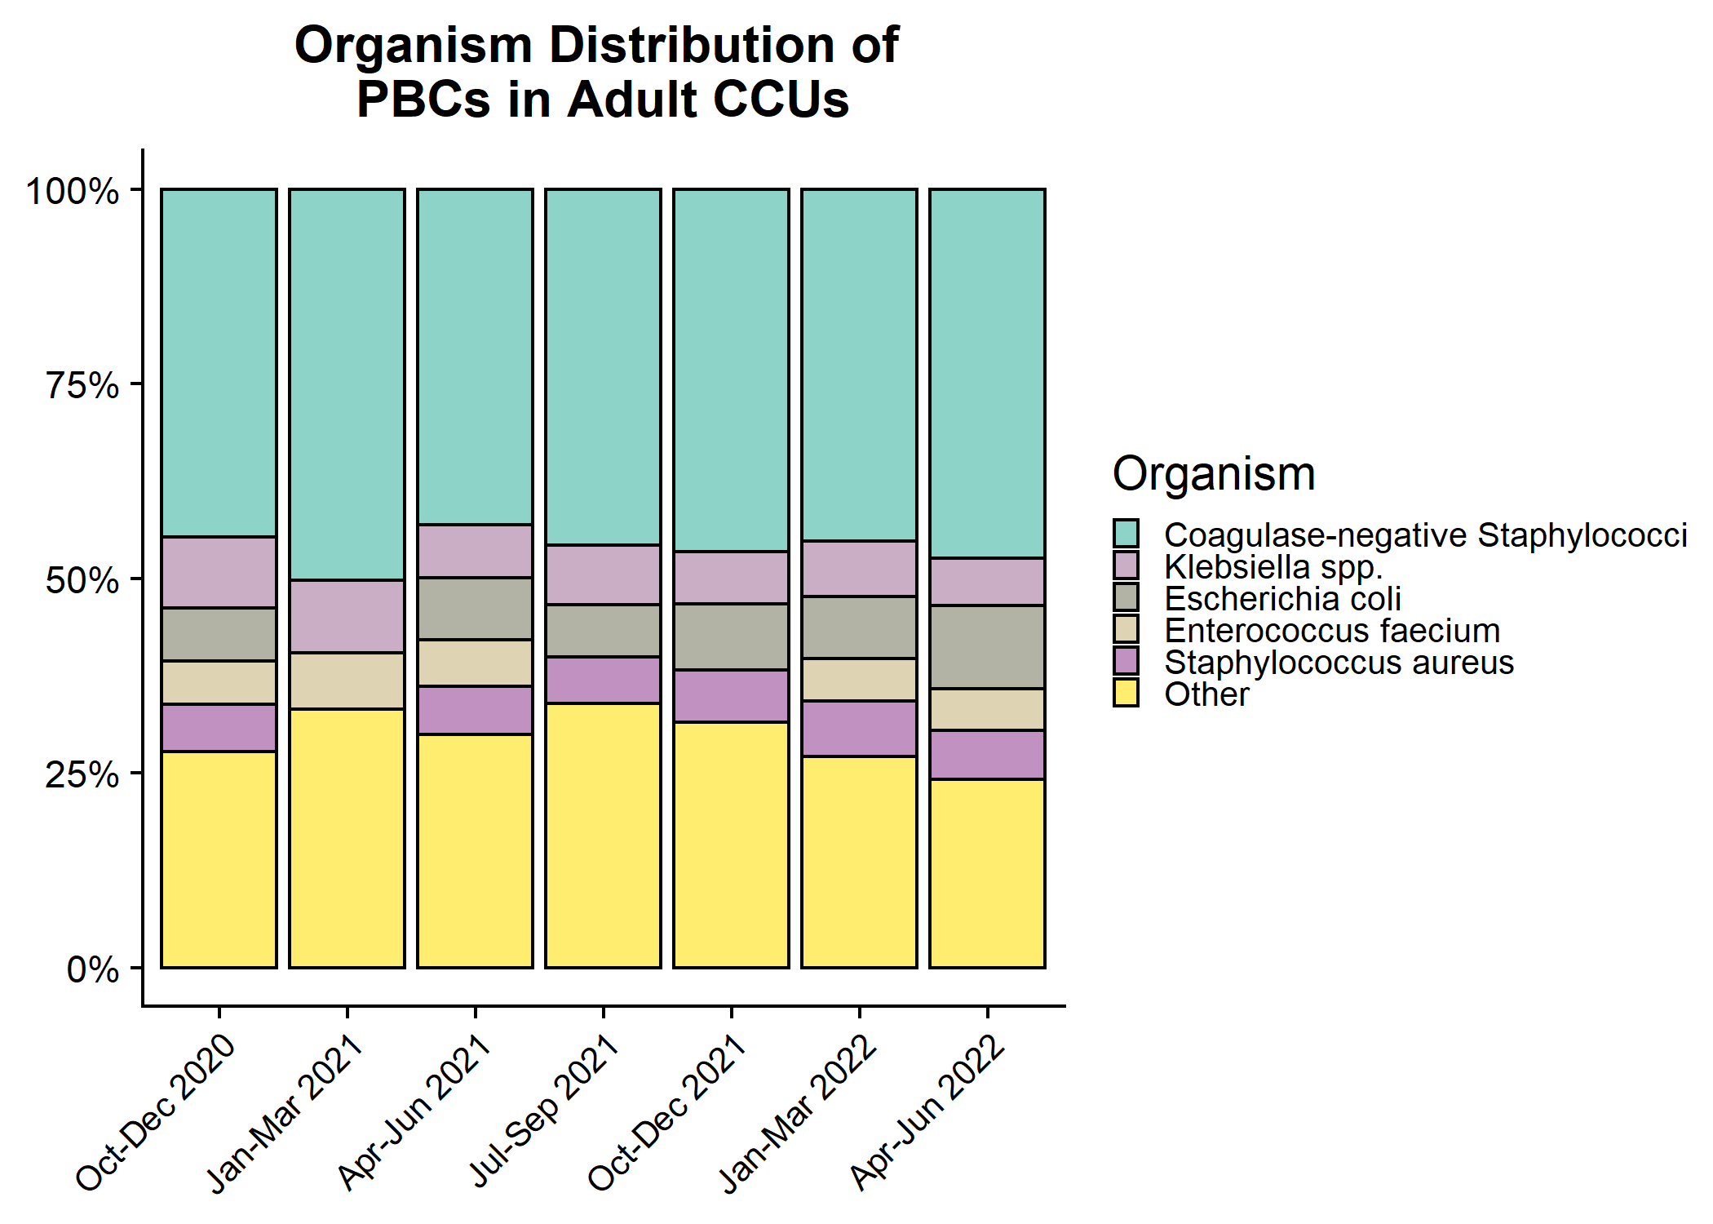
Organism distribution: all PBCs in Adult CCUs

Slide 14
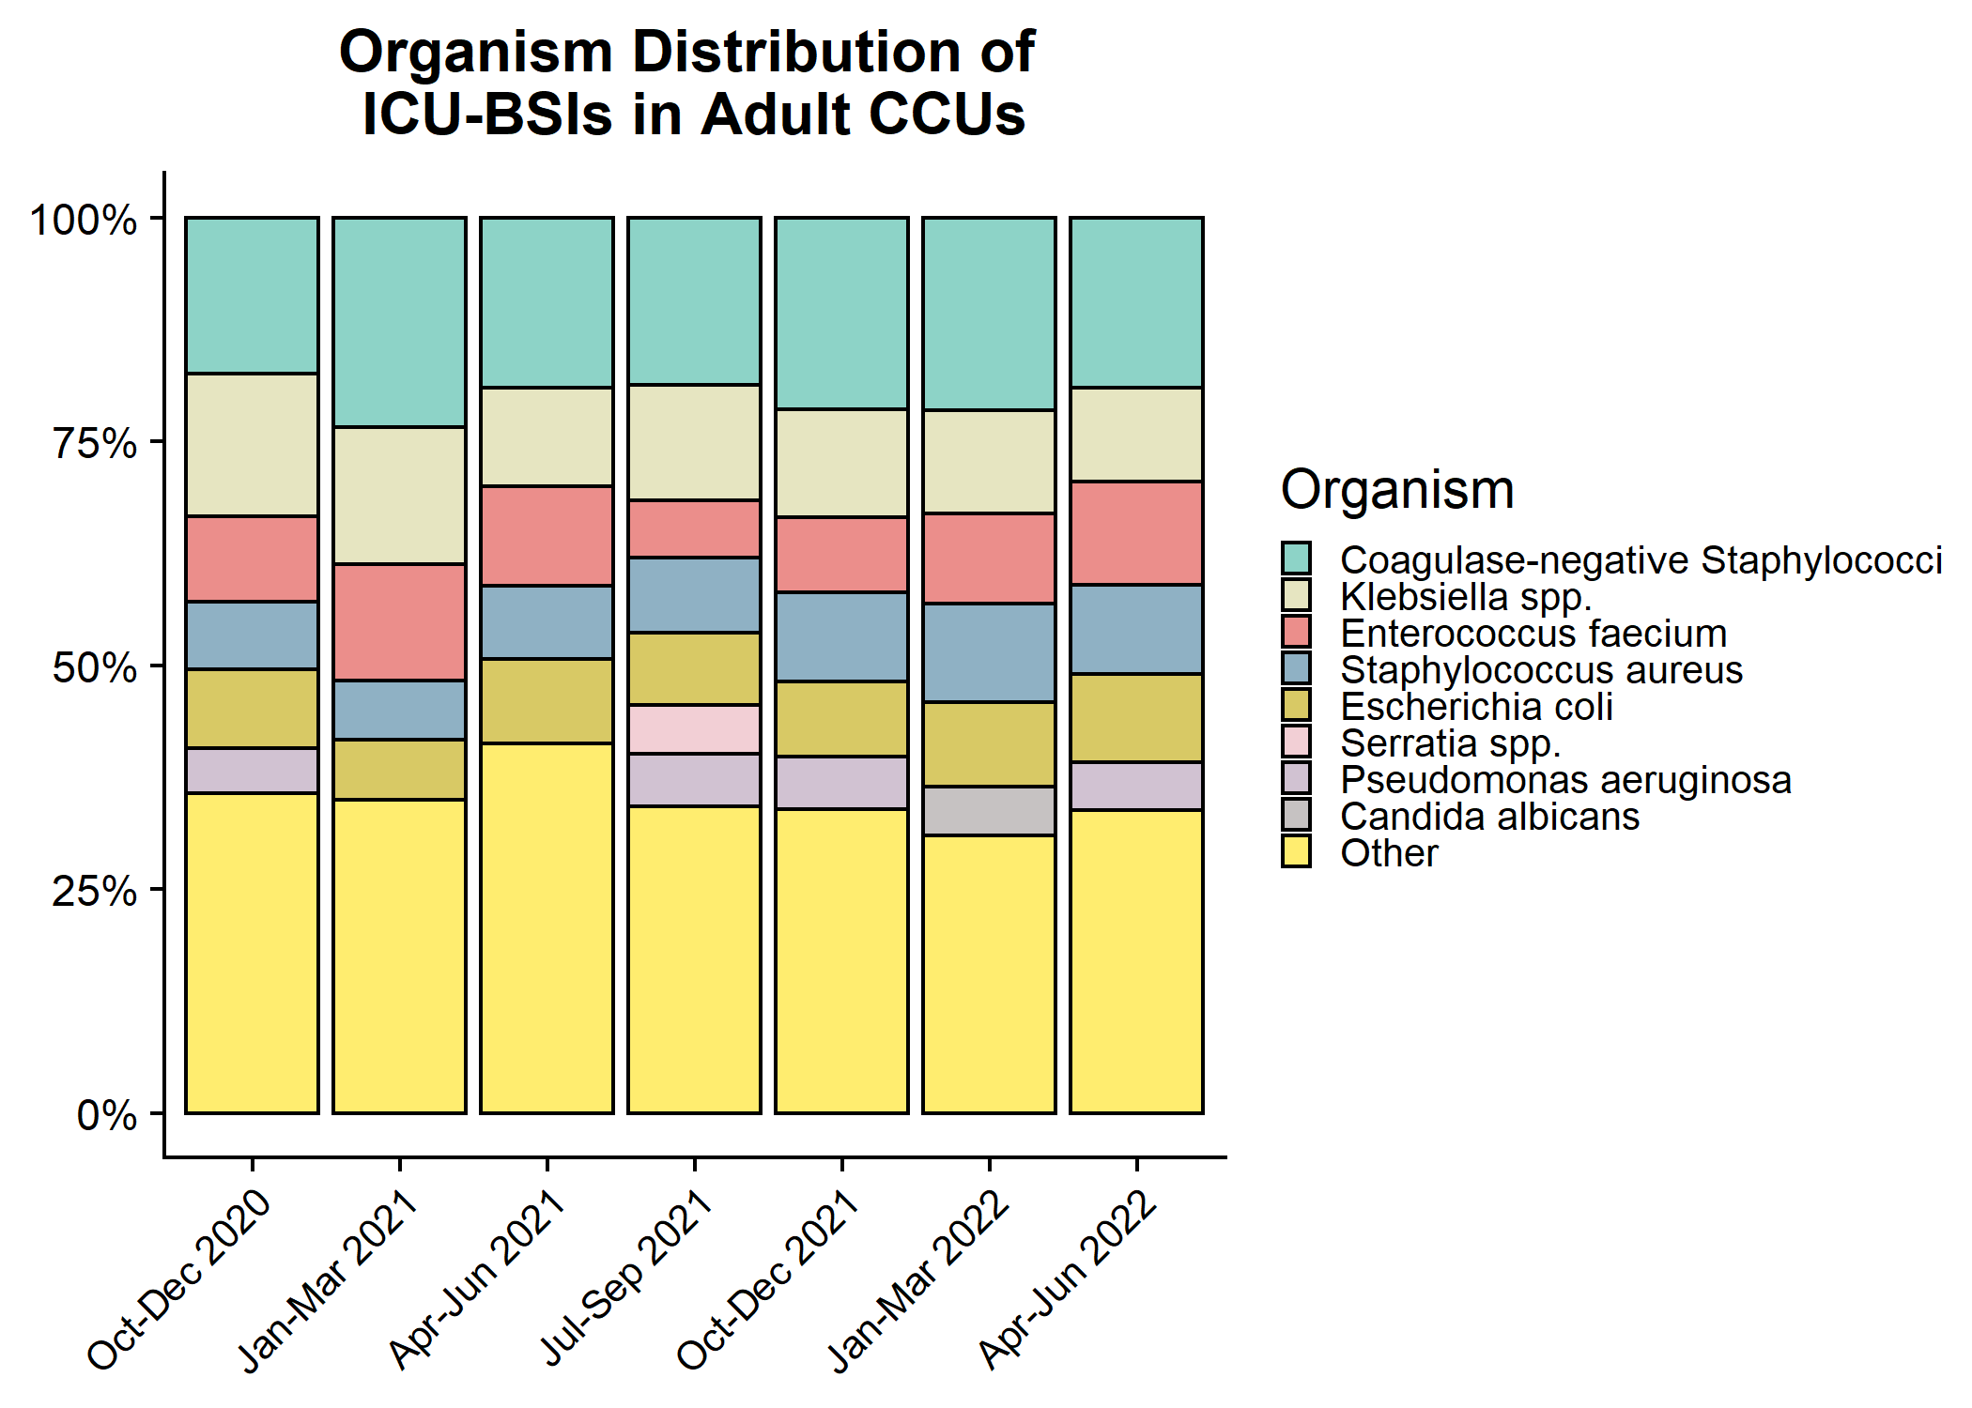
Organism distribution: ICU-associated BSIs in Adult CCUs

Slide 15
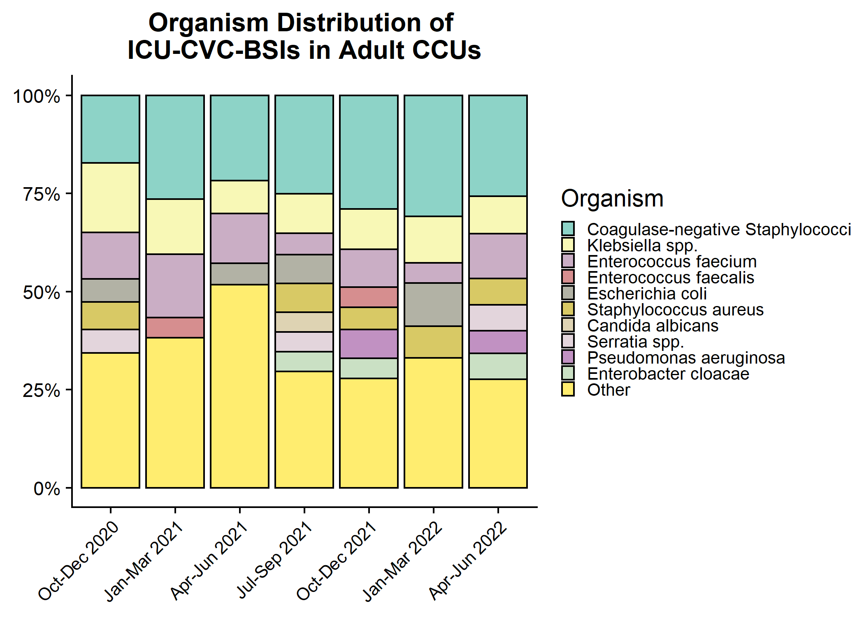
Organism distribution: ICU-CVC BSIs in Adult CCUs

Slide 16
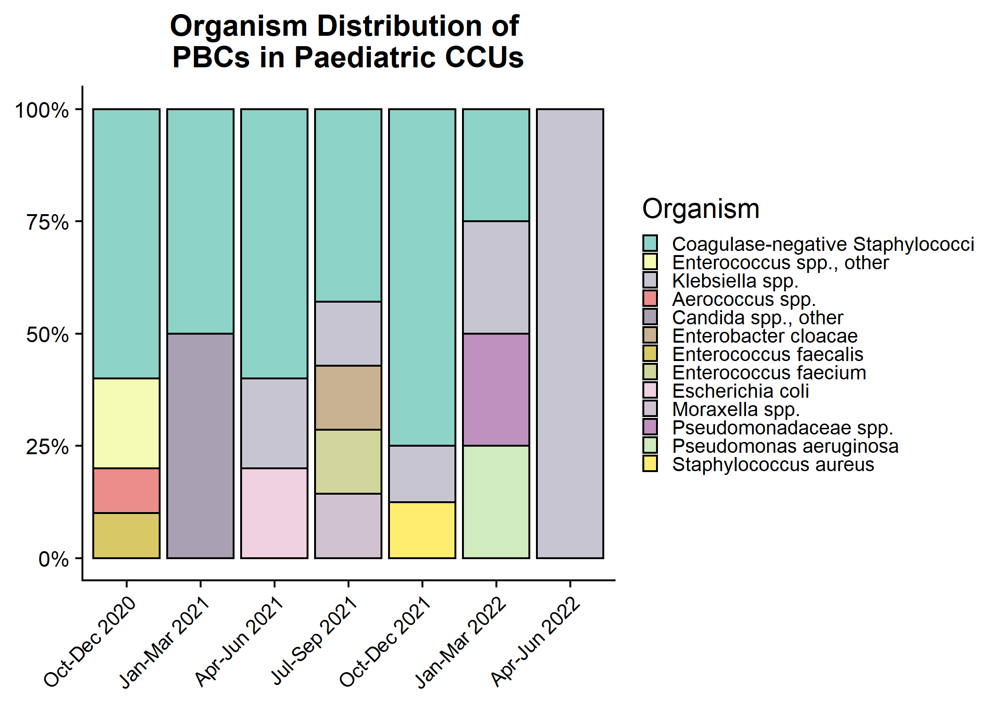
Organism distribution: all PBCs in Paediatric CCUs

Slide 17
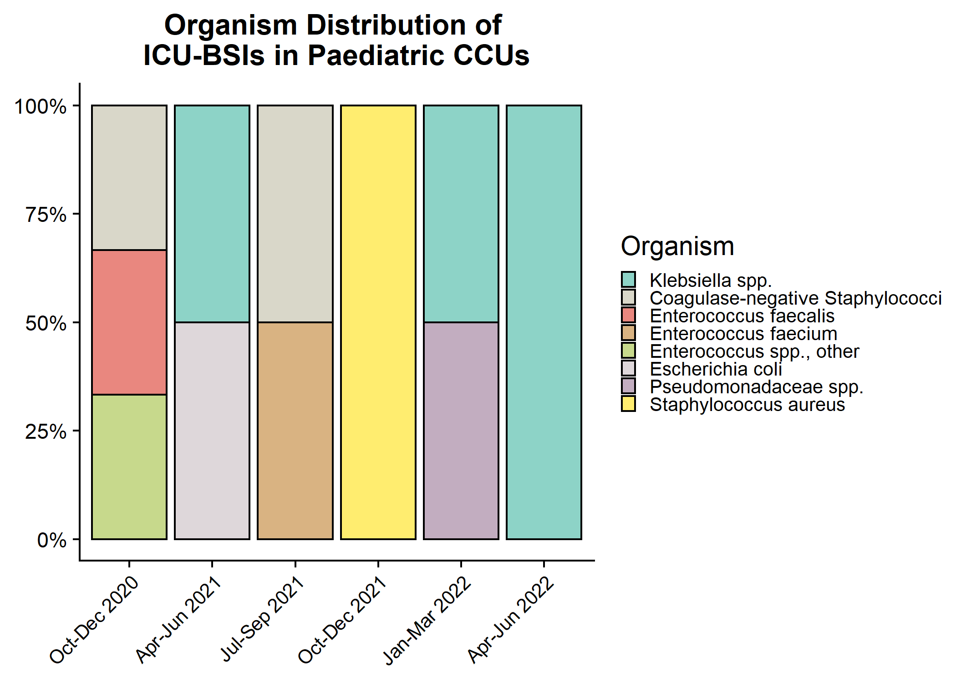
Organism distribution: ICU-associated BSIs in Paediatric CCUs

Slide 18
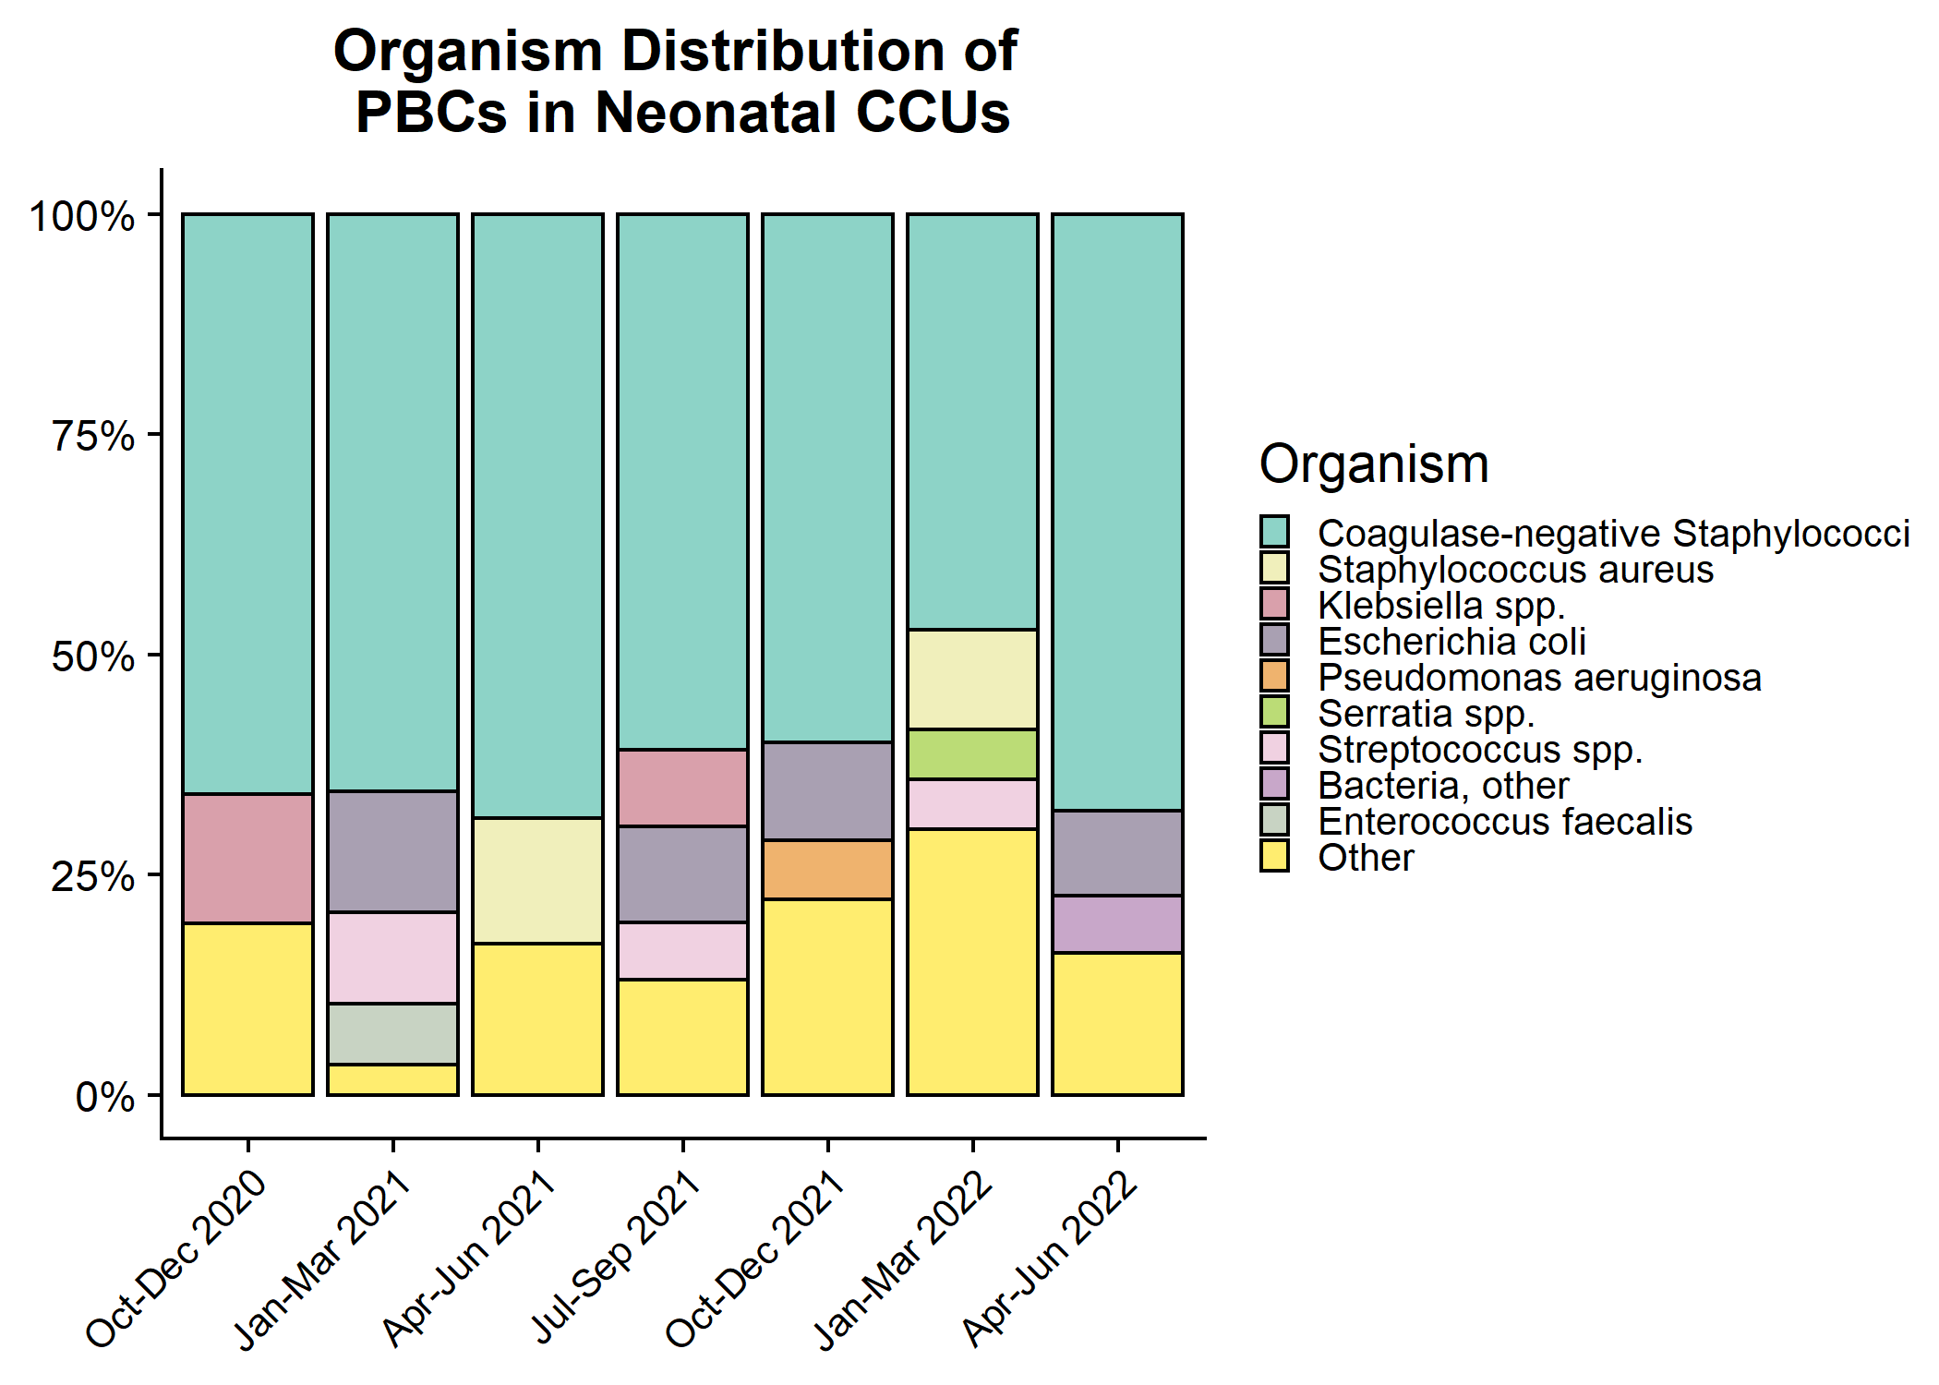
Organism distribution: all PBCs in Neonatal CCUs

Slide 19
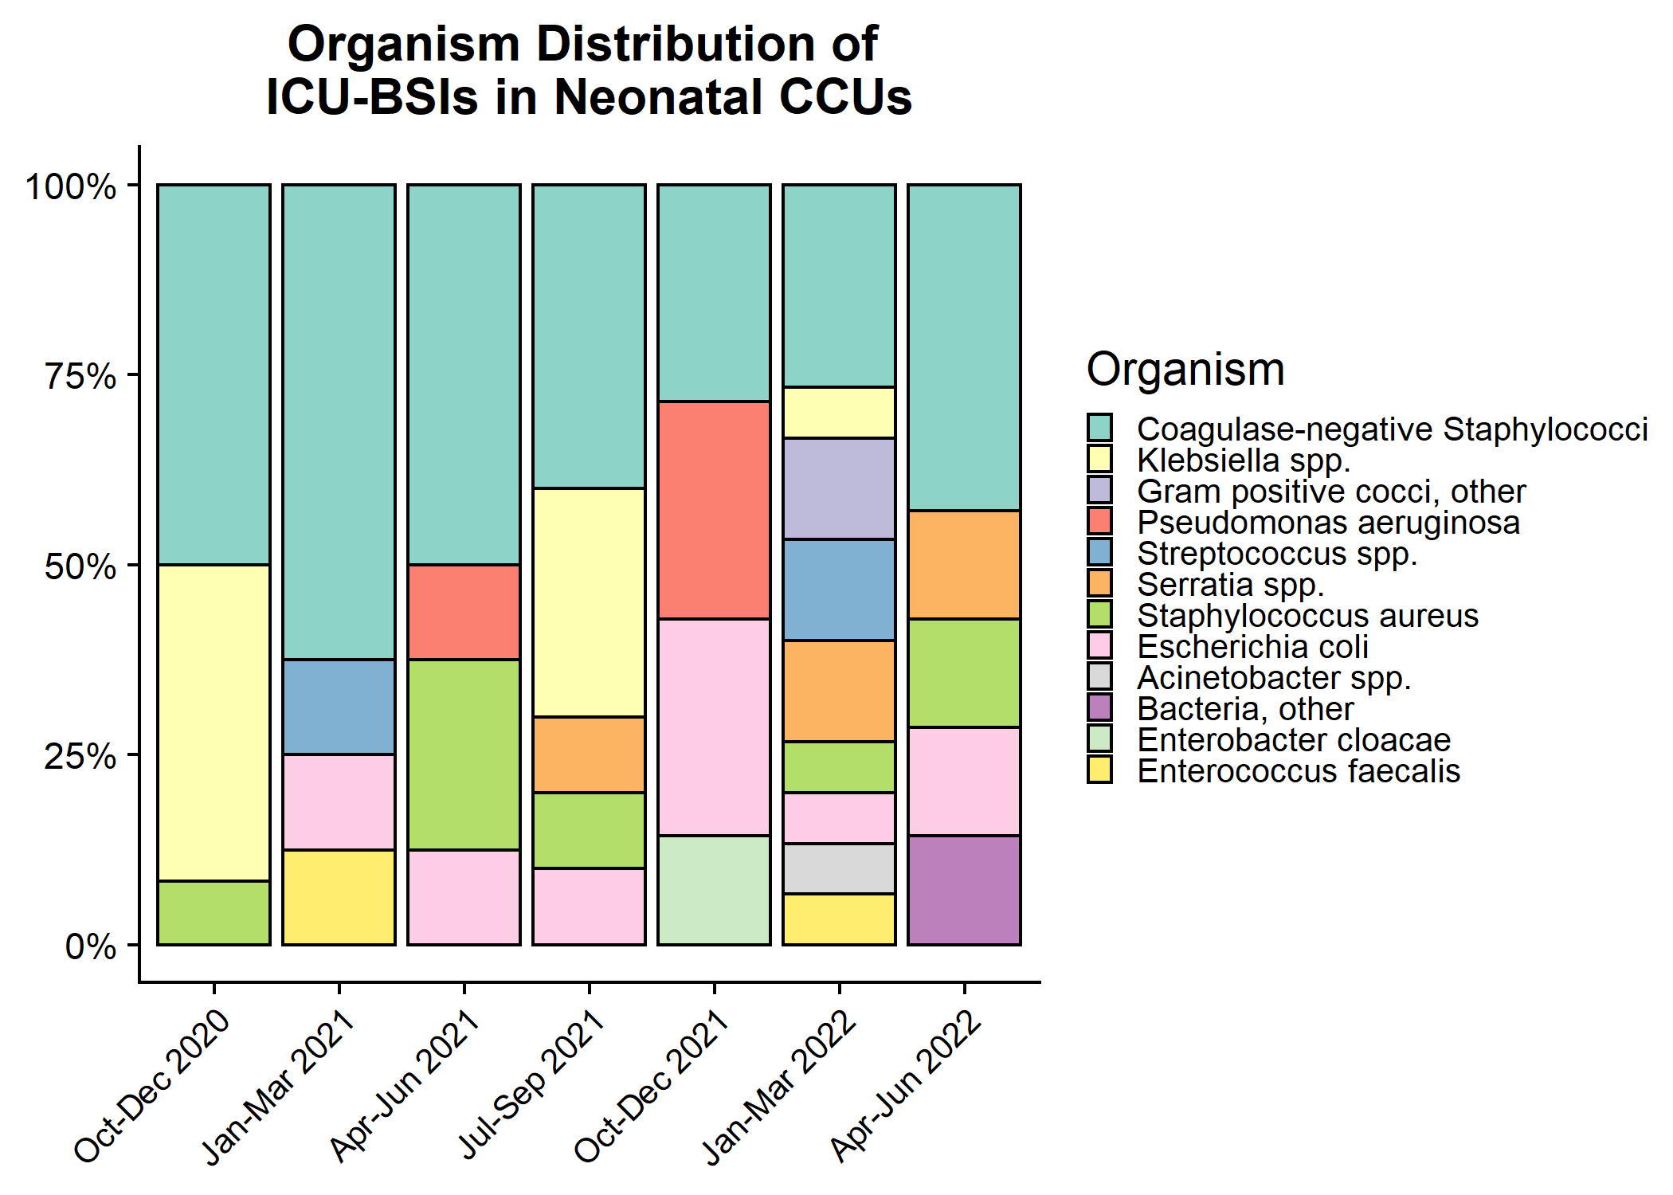
Organism distribution: ICU-associated BSIs in Neonatal CCUs

