Slide 1

ICU PATIENT

Slide 2
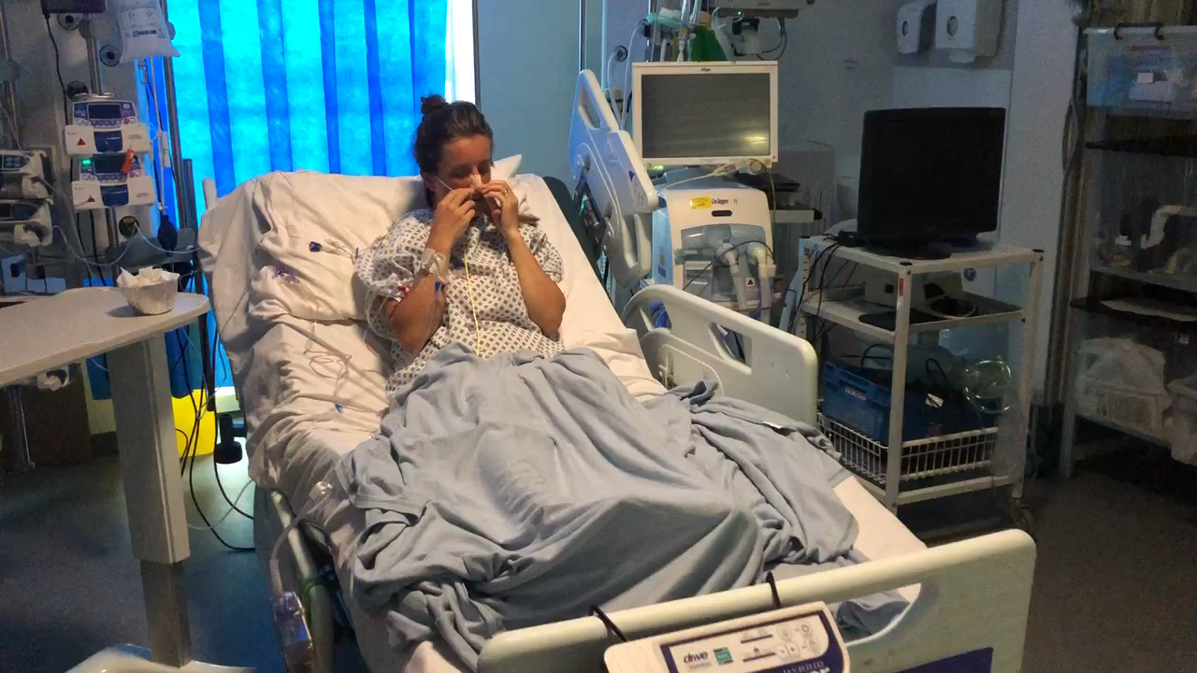
Delirium video 1
Notes:
icloud 1

Slide 3
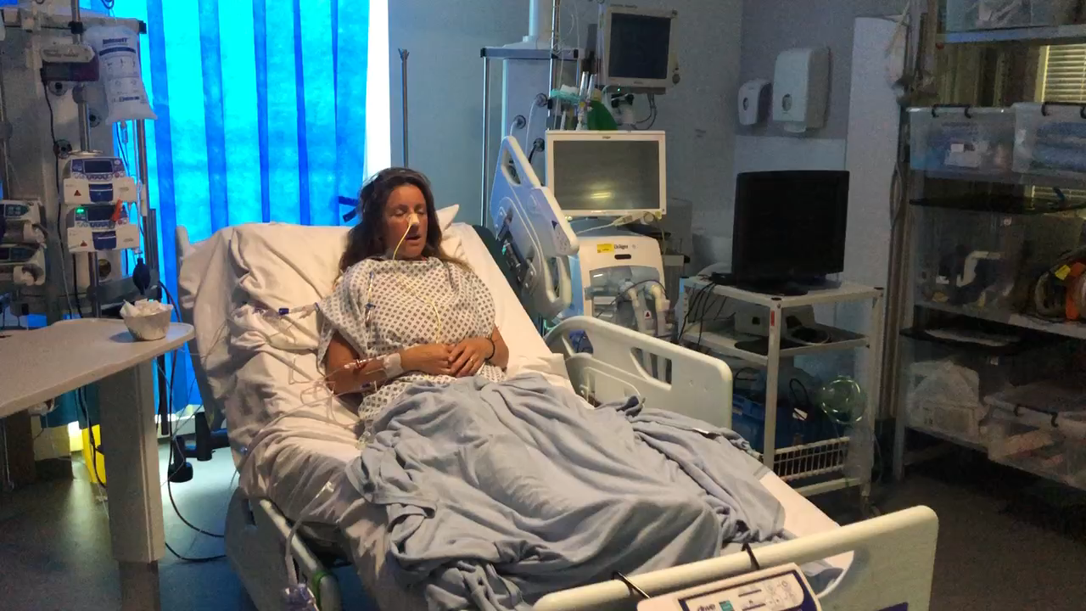
Delirium video 2

Slide 4
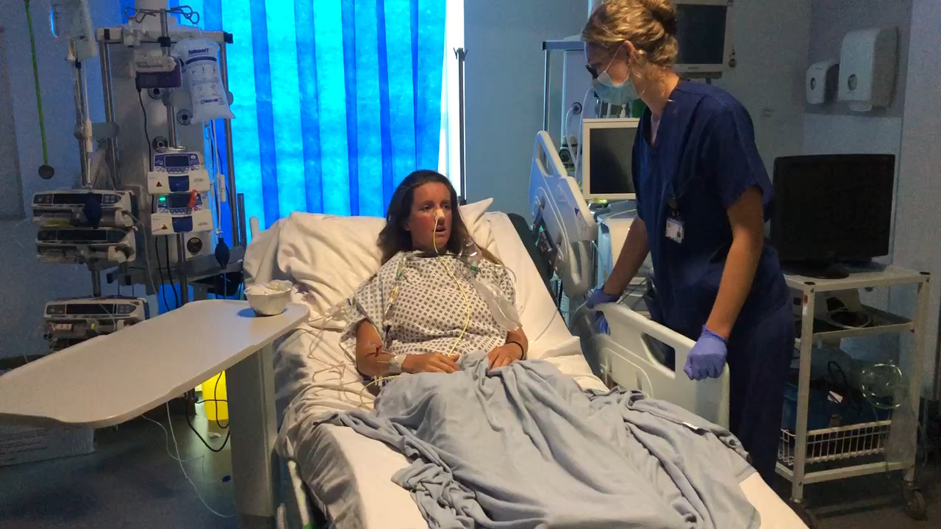
Delirium video 3

Slide 5
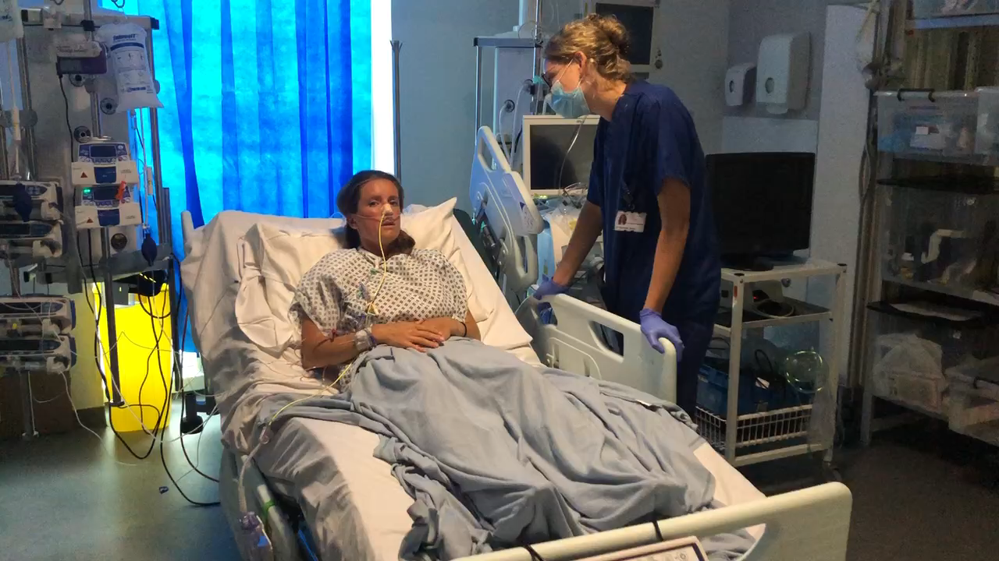
Delirium video 4

Slide 6
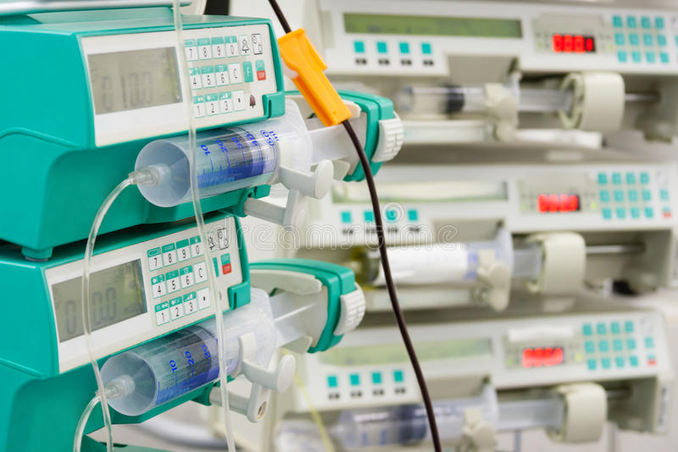
SEDATION
Notes:
Why do we need to sedate people on ICU?
Different reasons mean different levels of sedation and use of different drugs.
Ideal Sedative?
Provide sedation, anxiolysis, amnesia and analgesia
No tolerance or withdrawal
Facilitates invasive ventilation and painful procedures
Easy to store, prepare and administer
No side effects eg anaphylaxis, nausea, hypotension
Rapid onset
Rapid offset to facilitate sedation holds
Minimal metabolism so safe in patients with impaired physiology eg: renal impairment
Lack of accumulation during prolonged infusion
No drug interactions
Cheap
Widely available
GABA
Gamma amino butyric acid
Main inhibitory pathway
Will also cause hypotension
N-methyl D aspartatate
Acting on glutamate receptor –excitatory
Role in learning memory and neuronal cell function
Alpha 2 agonists
Reduce fight or flight by reducing norad release
Therefore reduce BP and alertness
Opioids
Aids ETT tolerance and invasive ventilation
Manages pain
Reduces sedation requirements and therefore hypotensive effects

Slide 7
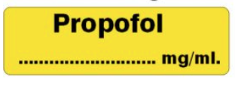
Notes:
Propofol
(Enhances GABA inhibitory action)
Provides amnesia and but no analgesia or airway reflex attenuation
Has soya bean and egg emulsion in it – caution with allergies (most egg allergies ok)
Easily titratable and effectively bolused at bedside
Usually needs additional agent to reduce rate required
Comes in two concentrations (1% 10mg/ml and 2% 20mg/ml)
Hypotension
Dose related but can be very significant in very sick people
Often requires vasopressor support
Propofol Infusion Syndrome
bradycardia, metabolic acidosis, and life-threatening arrhythmias
associated with lipaemic load
Generally associated with prolonged infusions (>48 hours) at >4mg/kg/hr
COVID-19
As COVID-19 patients needing many days of deep sedation and the move has been to using midazolam instead

Slide 8
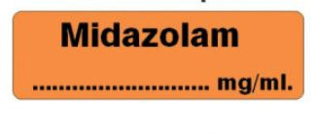
Notes:
Midazolam
(increases activity of GABA by binding to the benzodiazepine site linked to GABA-A receptors)
Provides amnesia and anxiolysis, also stops seizures
Although is short acting, once given as prolonged infusion in ICU, will take a lot longer to wake up from vs Propofol
Reversible (flumazenil)
Previously used as an adjunct in adult ICU, but with COVID drug shortages, has now become first line sedative
Use of benzodiazepines can increase delirium in ICU patients who are weaning from sedation

Slide 9
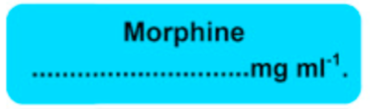
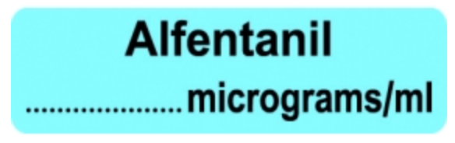
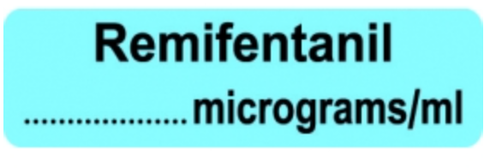
Notes:
Opiates
- Commonly used as part of sedative regime
- Reduce the amount of sedating agent required when used together
- Can all cause bradycardia
- Can all cause respiratory depression – this may be beneficial to facilitate ventilator synchrony
Morphine
Long acting (slow onset and offset)
Less titratable
Histamine release
Less potent
Previously not used due to length of action, but now used more due to COVID drug shortages
Alfentanil
More titratable, more potent
Good effect from bolus medications
Remifentanil
Very quick onset and offset
Used for light sedation with NIV/delirium/pre-extubation
Can cause bradycardias
Should not be bolused

Slide 10


Notes:
Clonidine
Acts as an α2 agonist (central receptors - cause reduce sympathetic outflow from CNS)
Analgesic, sedative and anxiolytic properties
Can cause hypotension (but useful for patients who are hypertensive)
Can be given as bolus or infusion
Can be given IV or enterally
Good for patients with/at risk of alcohol withdrawal, weaning from longterm ventilation.
Dexmedetomidine
More specific for α2 - less hypotension
Anxiolysis and sedation with no respiratory depression
Aids weaning from mechanical ventilation
Needs to be uptitrated to effect
Expensive so consultant only decision
Brand name Dexdor (sounds like ‘Death’s Door) so be careful with that use!
Both reduce delirium compared to benzodiazepines

Slide 11
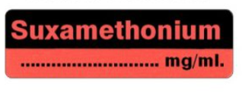
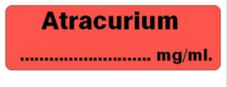
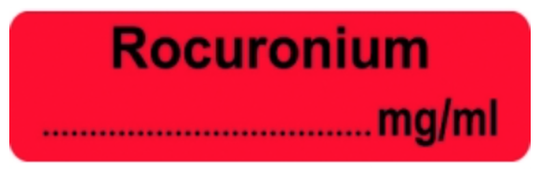
Notes:
Neuromuscular Blocking Agents
Usually a senior decision about starting these in ICU patients
Used for the following reasons
Intubation
Synchronisation with ventilator, improving ventilation
Prior to proning to prevent coughing/movement that could cause accidental extubation
Intubation
Discussed on another slide
Usually Rocuronium or Suxamethonium – but due to current drug shortages suxamethonium recommended as first line
Atracurium
Used for bolus or infusion doses on ICU
Relies less on good renal function for excretion
Can cause severe histamine release leading to bronchospasm and hypotension
With all NMB, must ensure that patients are well sedated before starting to reduce risk of awareness
Can contribute to critical care nueromyopathies

Slide 12
MANAGING SEDATION
Review agents daily
Sedation hold as appropriate
Minimise use of neuromuscular blockade
Assess sedation levels: RASS
Assess delirium: CAM-ICU
Titrate management as appropriate

Slide 13
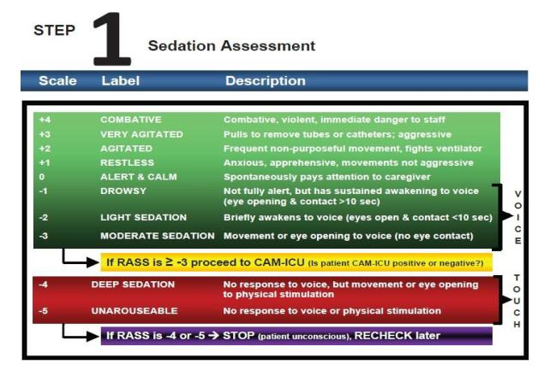
Notes:
Richmond Agitation Score
Used to assess level of sedation
Ideal level is -2 to 0 for most ICU patients, however with COVID proned and paralysed pateints, clearly sedation needs to be deeper in order to reduce risk of awareness (-4/-5)

Slide 14
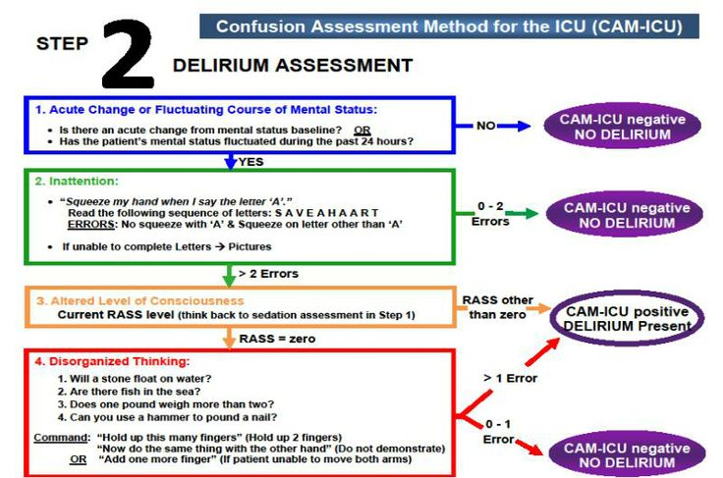
Notes:
CAM-ICU Confusion Assessment Method for ICU
Bedside tool to assess patients at risk of delirium
Need to assess sedation level first in order to be able to assess delirium (see previous slides)
Should be done 1-2 x per day (or more frequently if patient’s condition dictates it)
It’s difficult to do without confusing yourself!!

Slide 15

DELIRIUM
Notes:
Delirium
It is very very common (up to 80% of ICU patients)
Increases morbidity and mortality
Remember hypoactive delirium, not just hyperactive
Management of delirium is incredibly hard and very different to ward patients
Remember that agitation and pulling out of tubes and lines can be fatal in ICU patients, and therefore we may move to pharmacological or restraint management strategies earlier than you would on the ward
However, we try not to sedate people unless we have to as otherwise our patients will never get better!
Non-Pharmacological Management of Delirium
• Daily assessment using bedside tools (CAM-ICU)
• Repeated reorientation of patients
• Provisions of cognitively stimulating activities for the patient multiple times a day
• A non-pharmacological sleep protocol: lights down, alarm volumes reduced, eye mask, ear plugs (and ask patient what is effective!)
• Early mobilization activities
• Timely removal of catheters and physical restraints
• Use of eyeglasses and magnifying lenses, hearing aids and earwax removal
• Early correction of dehydration
• Use of a scheduled pain management protocol
• Minimization of unnecessary noise/stimulation/observations
• Ask patients each day if any concerns with hallucinations, confusion etc
• Explain it to family and encourage engagement with above
Pharmacological Measures
• Review current medications
▪ Remove daytime sedation agents
▪ Review opioid analgesia
▪ Review anticholinergic drugs
• Use of non-opioid analgesia
• Avoid benzodiazepines
• Melatonin
• Short term Zopiclone for sleep
• Haloperidol IV for rescue 0.5 – 2mg bolus (every 5 mins, up to 20mg – consider 10mg initially, and ensure you are told about it. Write ‘please tell Dr’ on drug chart)
• Quetiapine – commence if patient reports hallucinations, consider evening only initially so as not to sedate during day. Start at 25mg at 1800 or BD
Other medications used on ICU for light-moderate sedation, management of delirium and aiding sedation weaning:
• Clonidine
• Dexmedetomidine
• Remifentanil

Slide 16
DOLS and ICU
Treatment is first priority
Consent / capacity is situation specific
Best interest decision making
Restraint
DOLS is not relevant in life-saving treatment and often not applicable in ICU
Documentation is key
https://www.ficm.ac.uk/sites/default/files/updated_june_2017_-_ics_ficm_post_ferreira_briefing_note_on_mca_and_dol_final.pdf
Notes:
1. Treatment first - emergency treatment and clinical care should be the first priority.
2. Consent / capacity – for each relevant decision about medical treatment, an assessment of the patient’s capacity (per the MCA) will determine whether it is something to which they can consent / refuse, or whether it is a best interests decision.
3. Best interests decision making – where a patient lacks capacity for a particular medical treatment decision (and there is no effective ADRT to pre-determine this) then a best interests decision must be made. [Note that there is no particular special role or status in this for those designated in lay terms as “next of kin”]. In some cases an Independent Mental Capacity Advocate (IMCA) can assist.
4. Documentation - it is good practice, of course, to document assessments of capacity and best interests decisions, as appropriate.
5. Restraint – it is possible that a patient’s best interests can be served by the use of restraint to administer medical treatment. This is best interpreted widely, as including both physical restraint and pharmacological restraint by sedation, as the law doesn’t distinguish. Where restraint is used, in addition to being in the patient’s best interests it must be necessary to prevent harm and proportionate to the likelihood and seriousness of that harm. Any decision about the patient’s best interests should always be tested with the question – is there a less restrictive way to meet their best interests?
6. Deprivation of Liberty – The Court of Appeal (in Ferreira v Coroner of Inner South London, 26 January 2017, per Lady Justice Arden) is clear that “…any deprivation of liberty resulting from the administration of life-saving treatment to a person falls outside Article 5(1) [the right to liberty] … so long as [it is] rendered unavoidable as a result of circumstances beyond the control of the authorities and is necessary to avert a real risk of serious injury or damage, and [is] kept to the minimum required for that purpose”. “The treatment must be given in good faith and is materially the same treatment as would be given to a person of sound mind with the same physical illness” (para 93). This means that the procedural safeguards of Article 5 are not triggered in those circumstances – ie there is no need for a Deprivation of Liberty Safeguards referral. What exactly amounts to “life saving treatment”? This is not addressed but Court of Appeal clearly considered that treatment in ICU should not raise issues of deprivation of liberty, save in exceptional circumstances.
https://www.ficm.ac.uk/sites/default/files/updated_june_2017_-_ics_ficm_post_ferreira_briefing_note_on_mca_and_dol_final.pdf

