Slide 1

END OF DAY

Slide 2
THINGS TO REMEMBER
Different environment
Different experiences
Senior Led
Exposed

Slide 3
JUST REMEMBER
Everyone started from where you guys are now!
Where to find support:
Each other, senior doctors, nurses,
Educational Supervisor, mentors, WARD
Perfect doesn’t need to happen, sometimes good enough is ok

Slide 4
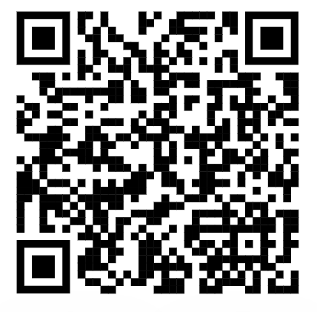
POST-COURSE CONFIDENCE QUESTIONNAIRE
Notes:
https://forms.gle/qHpjf9Y7eCmLgrCz6

Slide 5
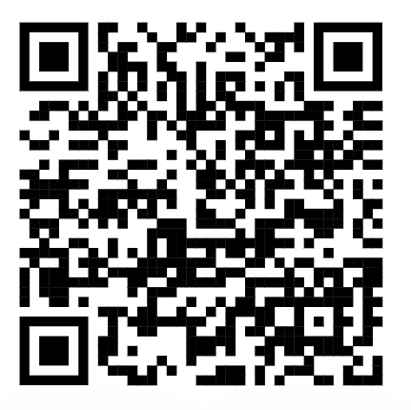
COURSE FEEDBACK
Notes:
https://forms.gle/VehpXE8fJEUKPQe66

Slide 6
FOR FACULTY…
NEXT COURSE DATE IS insert date here
REQUEST YOUR STUDY LEAVE!!

Slide 7
QUESTIONS?

Slide 8
THANK YOU!
POST-COURSE
FEEDBACK
SAFE TRAVELS HOME AND ENJOY ICU!
Notes:
https://www.the-qrcode-generator.com/

