Slide 1

ICCQIP Surveillance Update:Q16 Jan-Mar 2020 – Q22 Jul-Sep 2021
ICCQIP Surveillance Update:
Q15 Oct-Dec 2019 – Q21 Apr-Jun 2021

Slide 2
Participation
 | Trusts | All CCUs | Adult CCUs | Paediatric CCUs | Neonatal CCUs
Number in England | 140 | 428 | 240 | 25 | 163
Number registered on ICU Data Capture System | 132 | 281 | 234 | 21 | 26
Number with a registered Local Administrator | 95 | 154 | 137 | 4 | 13
Number which ever entered any data | 103 | 172 | 152 | 9 | 11
Number which have entered any data in FY 2020/2021 | 80 | 124 | 111 | 5 | 8
Number which have entered any data in Q21 Apr-Jun 2021 | 68 | 99 | 88 | 4 | 7

Slide 3
Active participation
Where units have submitted complete data for each quarter

Slide 4
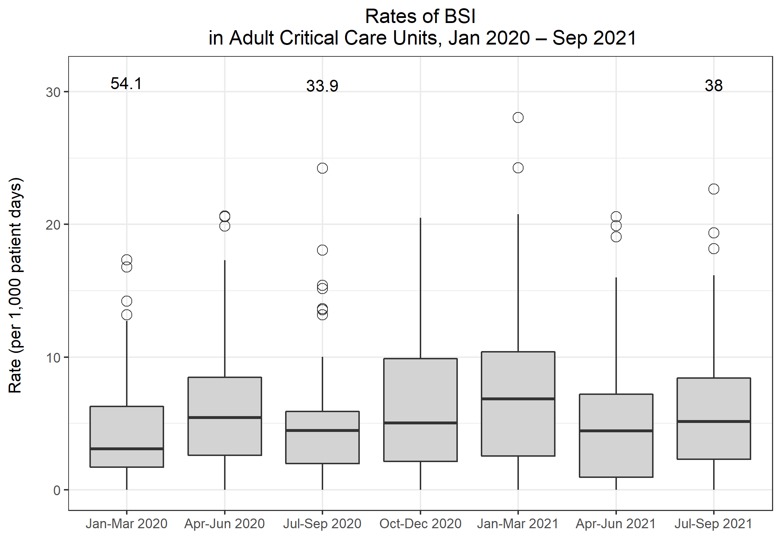
Rates of BSI in Adult CCUs
Metric | Q16 Jan-Mar 2020 | Q17 Apr-Jun 2020 | Q18 Jul-Sep 2020 | Q19 Oct-Dec 2020 | Q20 Jan-Mar 2021 | Q21 Apr-Jun 2021 | Q22 Jul-Sep 2021
Total number of positive blood cultures | 696 | 943 | 569 | 969 | 1,670 | 786 | 1,098
Total number of patient days | 93,480 | 85,471 | 67,411 | 93,987 | 117,572 | 90,279 | 101,778
Rate of positive blood cultures per 1,000 patient days | 7.4 | 11.0 | 8.4 | 10.3 | 14.2 | 8.7 | 10.8
Total number of positive blood cultures | 696 | 943 | 569 | 969 | 1,670 | 786 | 1,098
Total number of blood culture sets taken | 11,613 | 11,653 | 7,853 | 10,922 | 16,881 | 10,950 | 12,665
Rate of positive blood cultures per 1,000 blood culture sets taken | 59.9 | 80.9 | 72.5 | 88.7 | 98.9 | 71.8 | 86.7
Total number of BSIs | 414 | 552 | 350 | 589 | 962 | 484 | 653
Rate of BSI per 1,000 patient days | 4.4 | 6.5 | 5.2 | 6.3 | 8.2 | 5.4 | 6.4

Slide 5
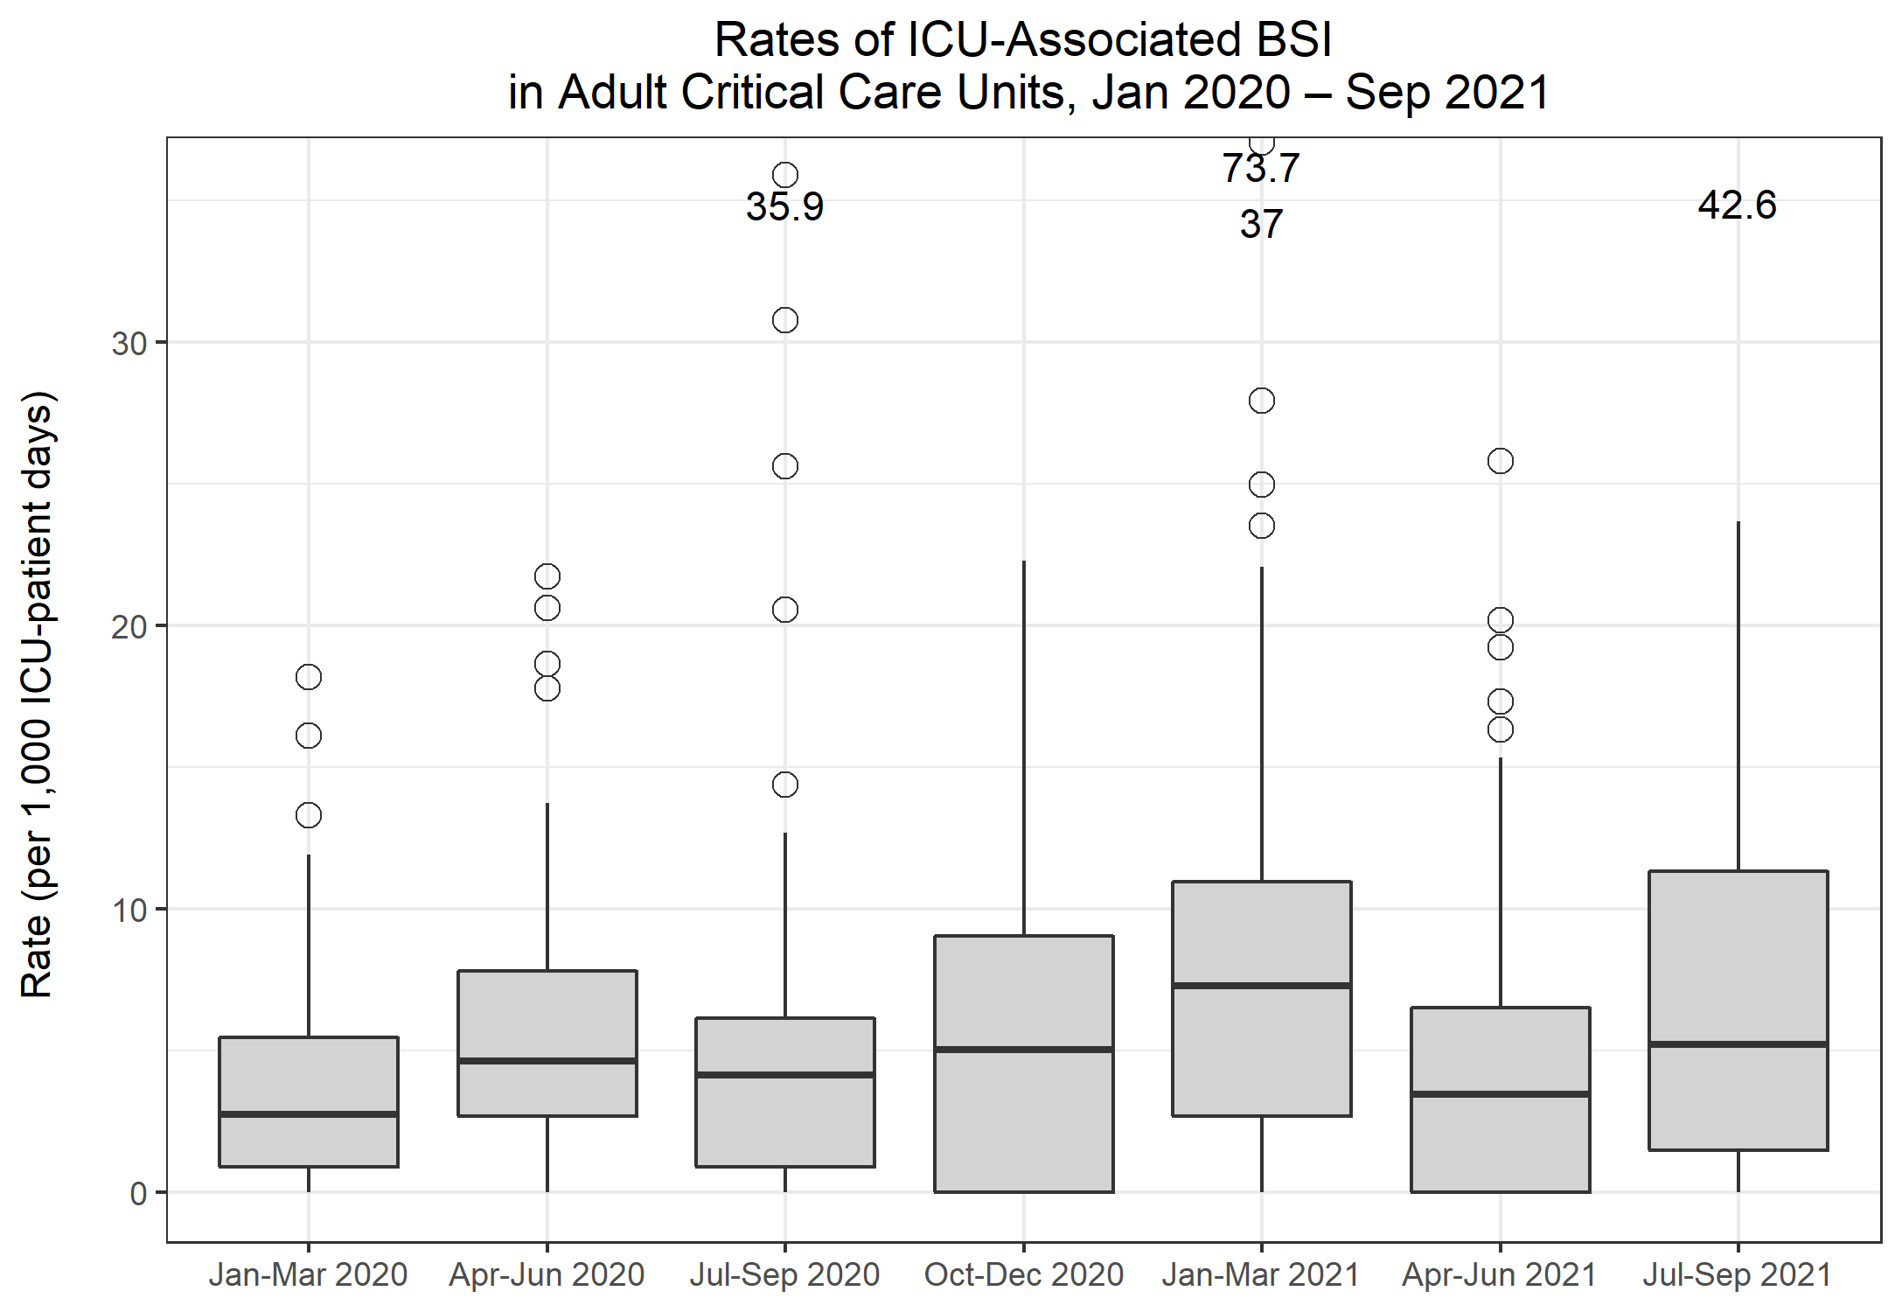
Rates of ICU-associated BSI in Adult CCUs
Metric | Q16 Jan-Mar 2020 | Q17 Apr-Jun 2020 | Q18 Jul-Sep 2020 | Q19 Oct-Dec 2020 | Q20 Jan-Mar 2021 | Q21 Apr-Jun 2021 | Q22 Jul-Sep 2021
Number of ICU-associated BSIs | 269 | 433 | 240 | 465 | 827 | 335 | 491
Number of patient days, amongst patients in the ICU>2 days | 67,711 | 68,697 | 46,858 | 70,475 | 95,413 | 65,907 | 75,245
Rate of ICU-associated BSI per 1,000 ICU-patient days | 4.0 | 6.3 | 5.1 | 6.6 | 8.7 | 5.1 | 6.5

Slide 6
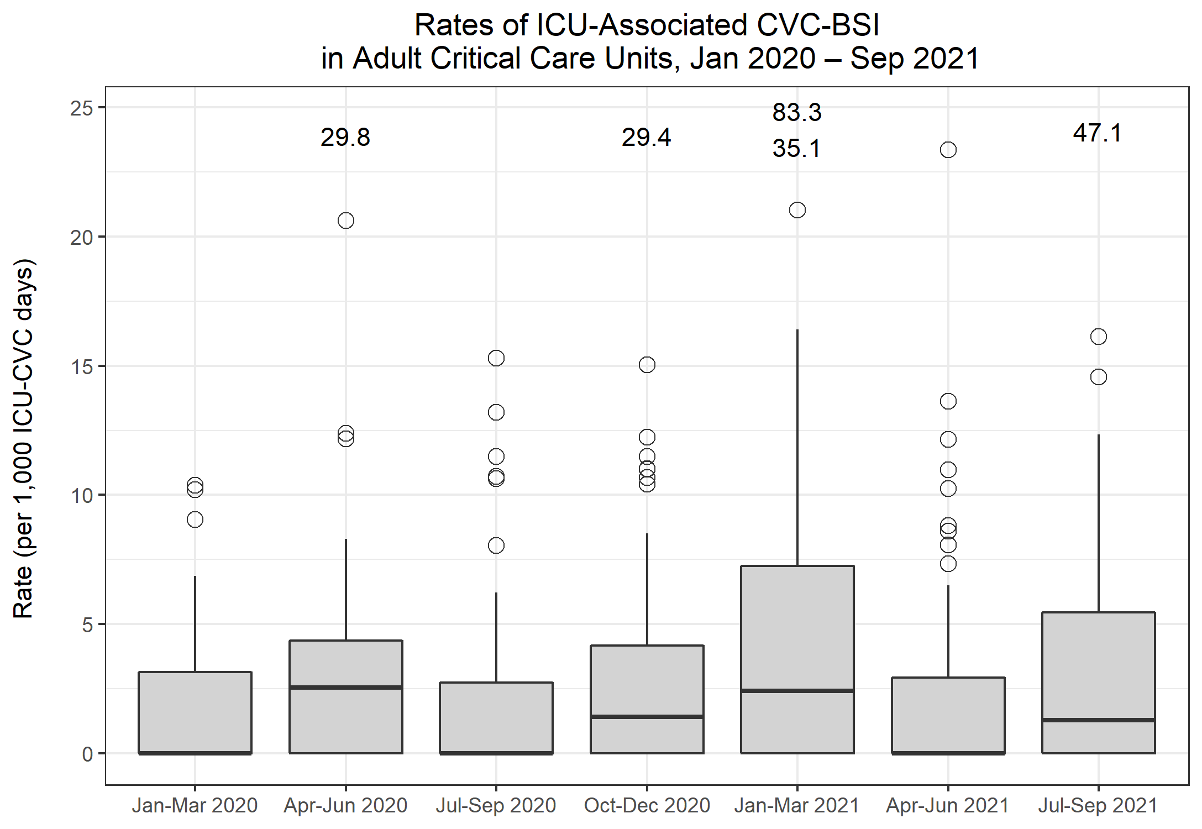
Rates of ICU-associated CVC-BSI in Adult CCUs
Metric | Q16 Jan-Mar 2020 | Q17 Apr-Jun 2020 | Q18 Jul-Sep 2020 | Q19 Oct-Dec 2020 | Q20 Jan-Mar 2021 | Q21 Apr-Jun 2021 | Q22 Jul-Sep 2021
Number of ICU-associated CABSI | 60 | 129 | 43 | 83 | 141 | 73 | 94
Number of CVC days, amongst patients in the ICU>2 days | 42,121 | 47,797 | 30,216 | 44,851 | 61,703 | 41,341 | 46,379
Rate of ICU-associated CABSI per 1,000 ICU-CVC days | 1.4 | 2.7 | 1.4 | 1.9 | 2.3 | 1.8 | 2.0
Number of ICU-associated CRBSI | 49 | 90 | 48 | 100 | 163 | 72 | 109
Rate of ICU-associated CRBSI per 1,000 ICU-CVC days | 1.2 | 1.9 | 1.6 | 2.2 | 2.6 | 1.7 | 2.4
Number of all ICU-associated CVC-BSI | 91 | 186 | 75 | 156 | 258 | 124 | 167
Rate of all ICU-associated CVC-BSI per 1,000 ICU-CVC days | 2.2 | 3.9 | 2.5 | 3.5 | 4.2 | 3.0 | 3.6
CVC utilisation | 62.2% | 69.6% | 64.5% | 63.6% | 64.7% | 62.7% | 61.6%

Slide 7
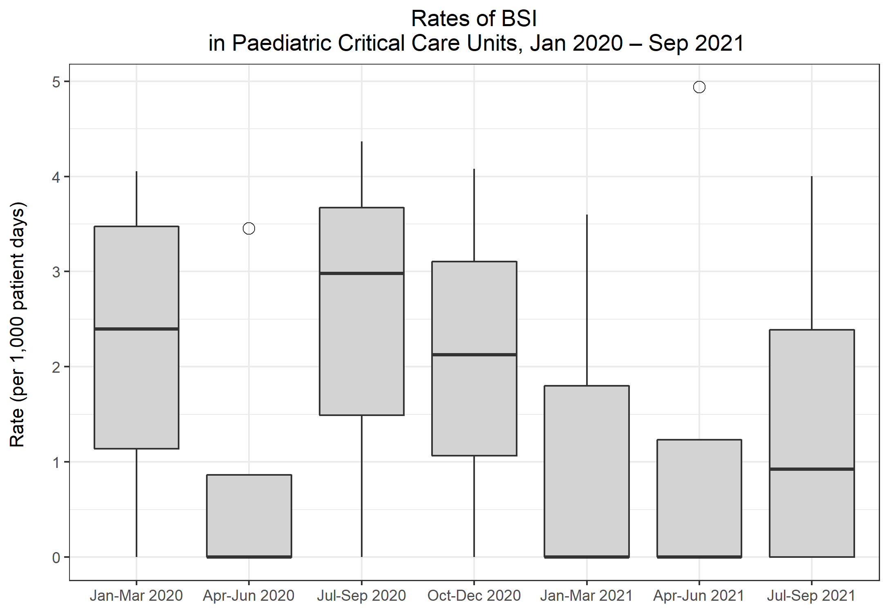
Rates of BSI in Paediatric CCUs
Metric | Q16 Jan-Mar 2020 | Q17 Apr-Jun 2020 | Q18 Jul-Sep 2020 | Q19 Oct-Dec 2020 | Q20 Jan-Mar 2021 | Q21 Apr-Jun 2021 | Q22 Jul-Sep 2021
Total number of positive blood cultures | 22 | 12 | 6 | 9 | 2 | 5 | 6
Total number of patient days | 4,578 | 3,045 | 1,479 | 1,705 | 1,030 | 1,050 | 2,169
Rate of positive blood cultures per 1,000 patient days | 4.8 | 3.9 | 4.1 | 5.3 | 1.9 | 4.8 | 2.8
Total number of positive blood cultures | 22 | 12 | 6 | 9 | 2 | 5 | 6
Total number of blood culture sets taken | 399 | 283 | 186 | 263 | 129 | 115 | 215
Rate of positive blood cultures per 1,000 blood culture sets taken | 55.1 | 42.4 | 32.3 | 34.2 | 15.5 | 43.5 | 27.9
Total number of BSIs | 10 | 6 | 3 | 3 | 1 | 2 | 5
Rate of BSI per 1,000 patient days | 2.2 | 2.0 | 2.0 | 1.8 | 1.0 | 1.9 | 2.3

Slide 8
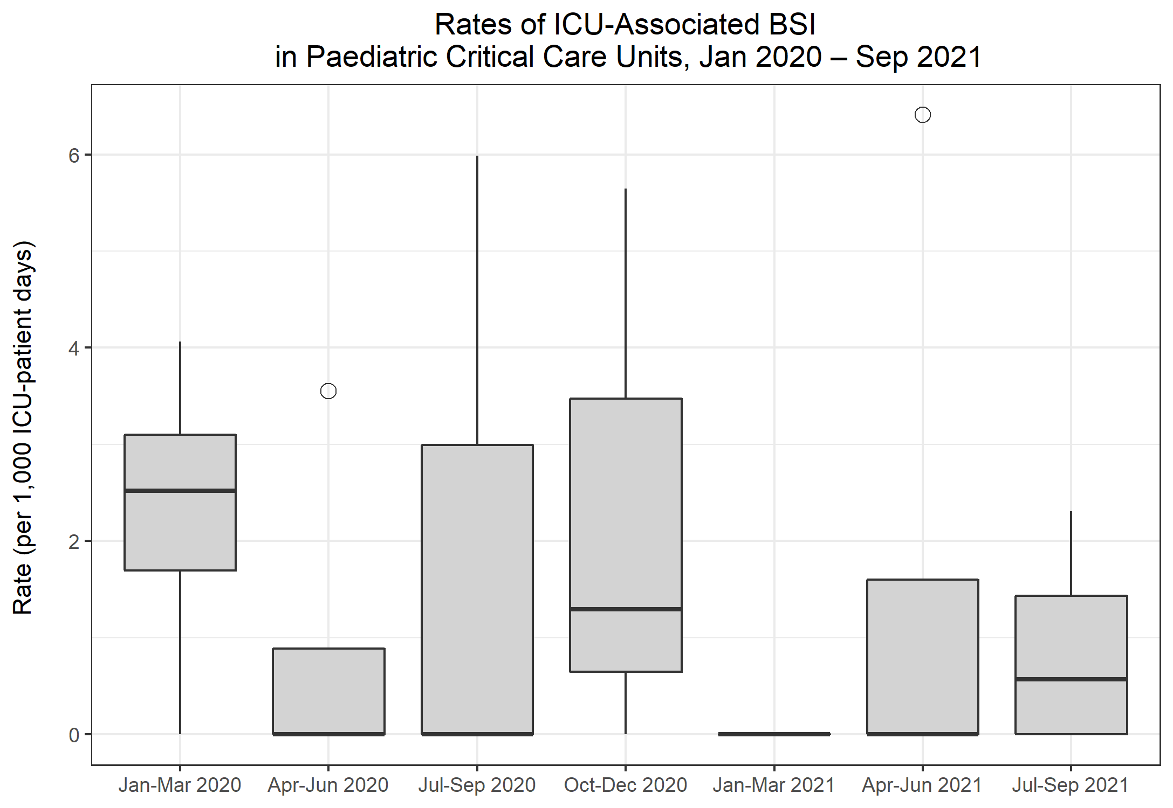
Rates of ICU-associated BSI in Paediatric CCUs
Metric | Q16 Jan-Mar 2020 | Q17 Apr-Jun 2020 | Q18 Jul-Sep 2020 | Q19 Oct-Dec 2020 | Q20 Jan-Mar 2021 | Q21 Apr-Jun 2021 | Q22 Jul-Sep 2021
Number of ICU-associated BSIs | 7 | 3 | 1 | 2 | 0 | 2 | 2
Number of patient days, amongst patients in the ICU>2 days | 2,705 | 1,969 | 1,238 | 1,377 | 826 | 823 | 1,688
Rate of ICU-associated BSI per 1,000 ICU-patient days | 2.6 | 1.5 | 0.8 | 1.5 | 0.0 | 2.4 | 1.2

Slide 9
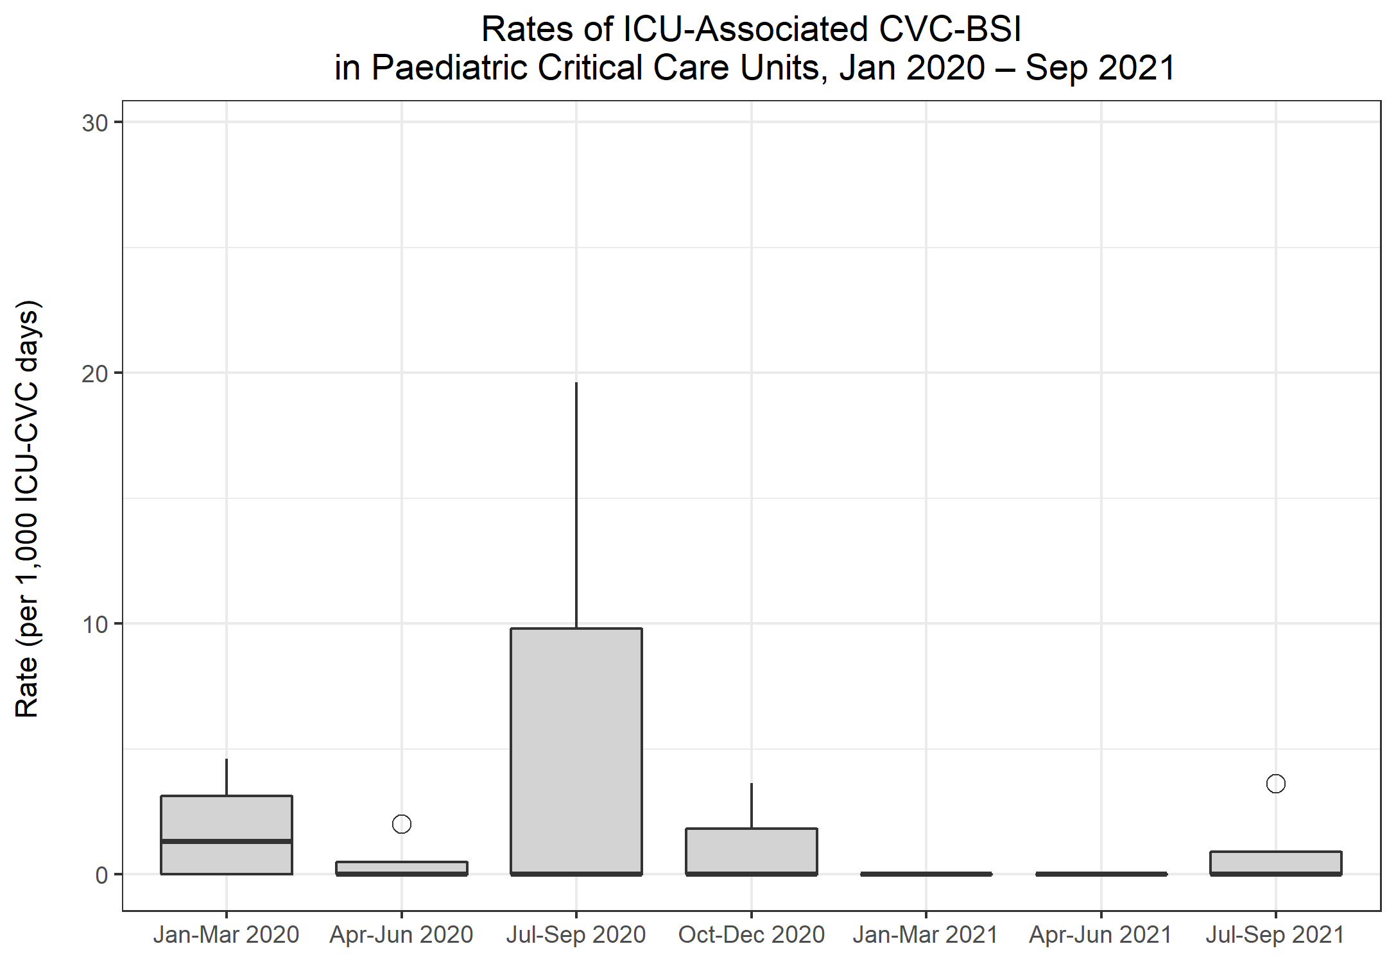
Rates of ICU-associated CVC-BSI in Paediatric CCUs
Metric | Q16 Jan-Mar 2020 | Q17 Apr-Jun 2020 | Q18 Jul-Sep 2020 | Q19 Oct-Dec 2020 | Q20 Jan-Mar 2021 | Q21 Apr-Jun 2021 | Q22 Jul-Sep 2021
Number of ICU-associated CABSI | 4 | 1 | 1 | 0 | 0 | 0 | 1
Number of CVC days, amongst patients in the ICU>2 days | 1,550 | 1,073 | 687 | 690 | 446 | 491 | 745
Rate of ICU-associated CABSI per 1,000 ICU-CVC days | 2.6 | 0.9 | 1.5 | 0.0 | 0.0 | 0.0 | 1.3
Number of ICU-associated CRBSI | 1 | 0 | 0 | 1 | 0 | 0 | 0
Rate of ICU-associated CRBSI per 1,000 ICU-CVC days | 0.6 | 0.0 | 0.0 | 1.4 | 0.0 | 0.0 | 0.0
Number of all ICU-associated CVC-BSI | 4 | 1 | 1 | 1 | 0 | 0 | 1
Rate of all ICU-associated CVC-BSI per 1,000 ICU-CVC days | 2.6 | 0.9 | 1.5 | 1.4 | 0.0 | 0.0 | 1.3
CVC utilisation | 57.3% | 54.5% | 55.5% | 50.1% | 54.0% | 59.7% | 44.1%

Slide 10
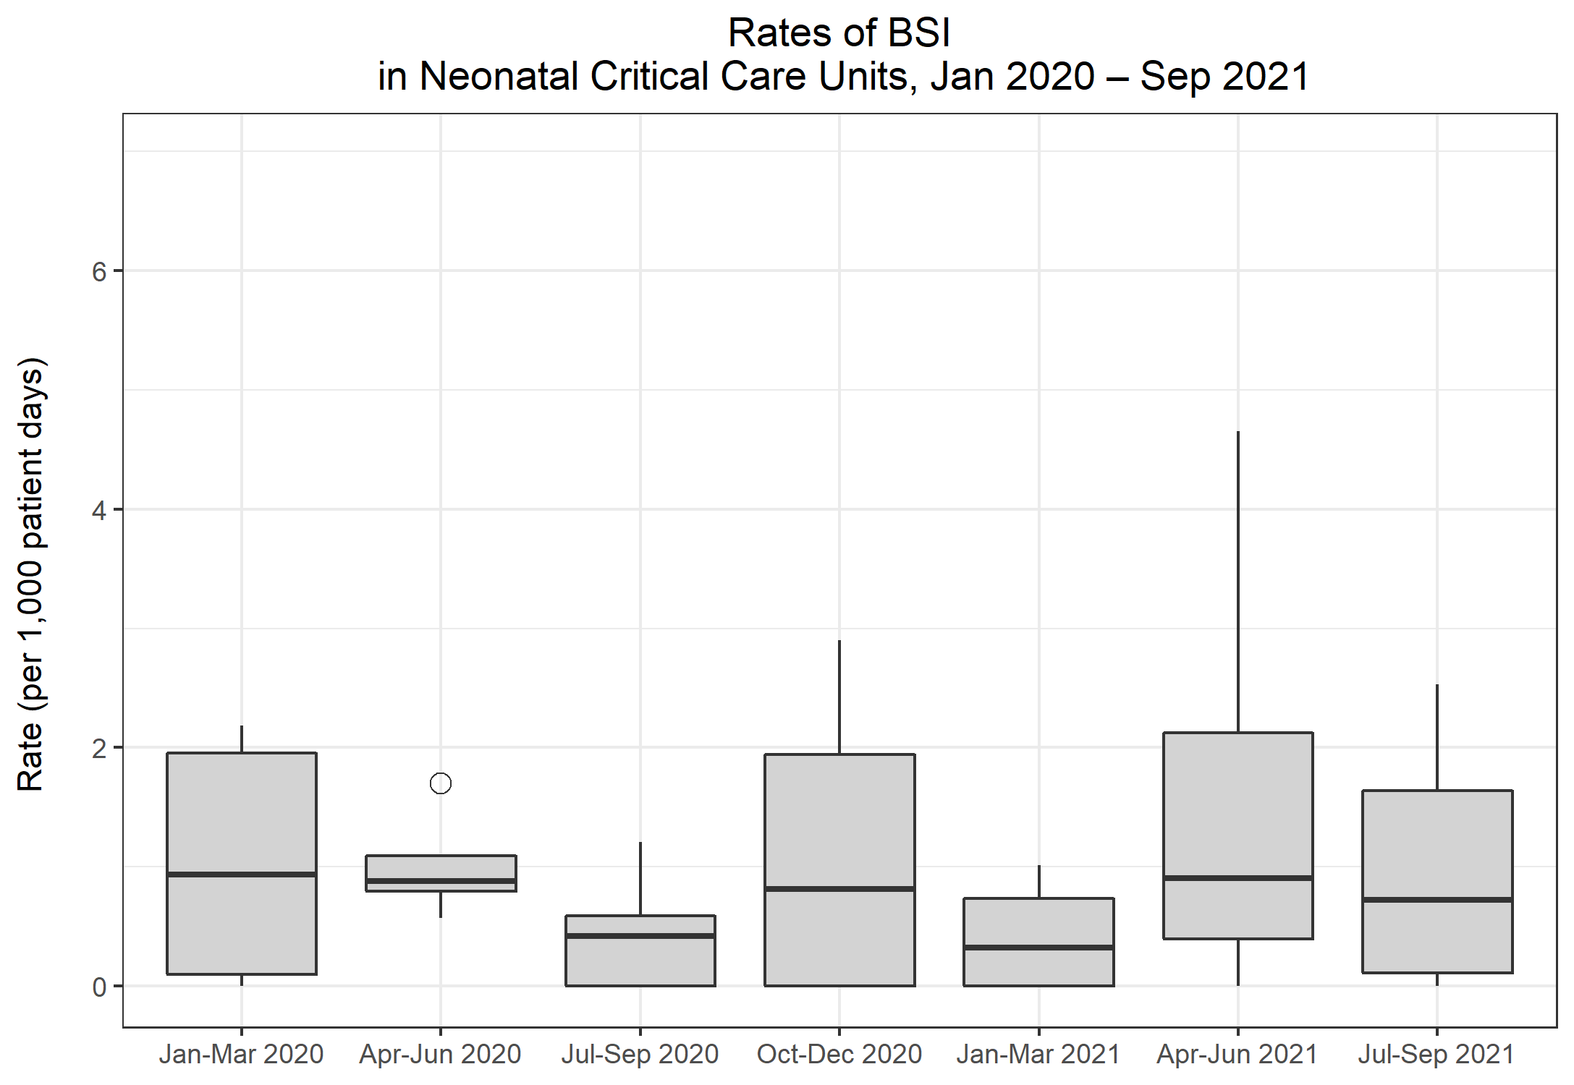
Rates of BSI in Neonatal CCUs
Metric | Q16 Jan-Mar 2020 | Q17 Apr-Jun 2020 | Q18 Jul-Sep 2020 | Q19 Oct-Dec 2020 | Q20 Jan-Mar 2021 | Q21 Apr-Jun 2021 | Q22 Jul-Sep 2021
Total number of positive blood cultures | 31 | 29 | 27 | 33 | 20 | 31 | 33
Total number of patient days | 9,706 | 8,645 | 9,103 | 8,220 | 8,283 | 7,772 | 9,275
Rate of positive blood cultures per 1,000 patient days | 3.2 | 3.4 | 3.0 | 4.0 | 2.4 | 4.0 | 3.6
Total number of positive blood cultures | 25 | 21 | 22 | 26 | 14 | 24 | 27
Total number of blood culture sets taken | 562 | 558 | 531 | 496 | 492 | 431 | 585
Rate of positive blood cultures per 1,000 blood culture sets taken | 44.5 | 37.6 | 41.4 | 52.4 | 28.5 | 55.7 | 46.2
Total number of BSIs | 10 | 9 | 5 | 11 | 3 | 7 | 9
Rate of BSI per 1,000 patient days | 1.0 | 1.0 | 0.5 | 1.3 | 0.4 | 0.9 | 1.0

Slide 11
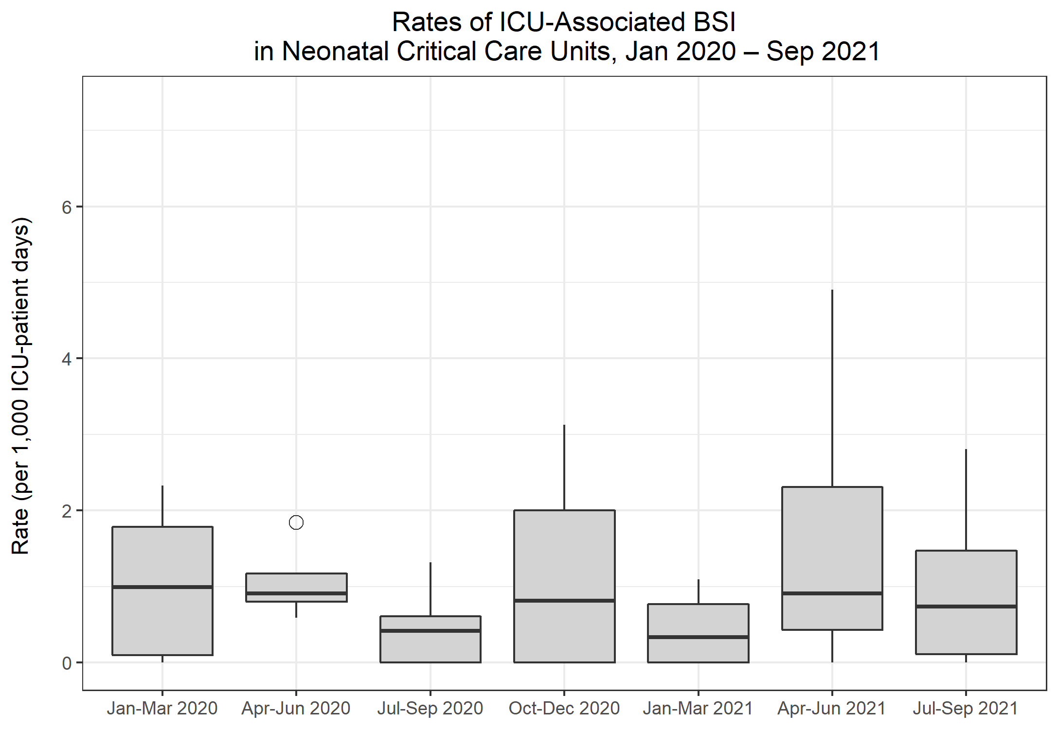
Rates of ICU-associated BSI in Neonatal CCUs
Metric | Q16 Jan-Mar 2020 | Q17 Apr-Jun 2020 | Q18 Jul-Sep 2020 | Q19 Oct-Dec 2020 | Q20 Jan-Mar 2021 | Q21 Apr-Jun 2021 | Q22 Jul-Sep 2021
Number of ICU-associated BSIs | 9 | 9 | 5 | 11 | 3 | 7 | 8
Number of patient days, amongst patients in the ICU>2 days | 9,289 | 8,272 | 8,685 | 7,837 | 7,905 | 7,384 | 8,679
Rate of ICU-associated BSI per 1,000 ICU-patient days | 1.0 | 1.1 | 0.6 | 1.4 | 0.4 | 0.9 | 0.9

Slide 12
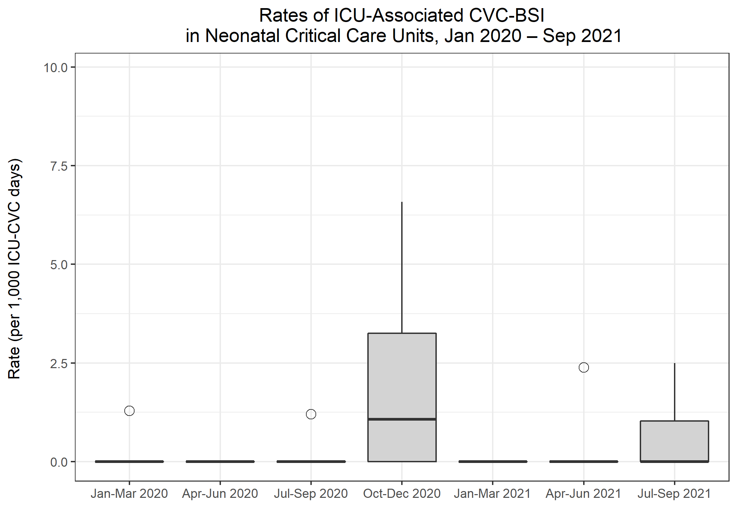
Rates of ICU-associated CVC-BSI in Neonatal CCUs
Metric | Q16 Jan-Mar 2020 | Q17 Apr-Jun 2020 | Q18 Jul-Sep 2020 | Q19 Oct-Dec 2020 | Q20 Jan-Mar 2021 | Q21 Apr-Jun 2021 | Q22 Jul-Sep 2021
Number of ICU-associated CABSI | 0 | 0 | 1 | 4 | 0 | 1 | 3
Number of CVC days, amongst patients in the ICU>2 days | 1,776 | 1,495 | 1,759 | 1,747 | 1,875 | 1,828 | 2,560
Rate of ICU-associated CABSI per 1,000 ICU-CVC days | 0.0 | 0.0 | 0.6 | 2.3 | 0.0 | 0.5 | 1.2
Number of ICU-associated CRBSI | 1 | 0 | 0 | 3 | 0 | 0 | 3
Rate of ICU-associated CRBSI per 1,000 ICU-CVC days | 0.6 | 0.0 | 0.0 | 1.7 | 0.0 | 0.0 | 1.2
Number of all ICU-associated CVC-BSI | 1 | 0 | 1 | 5 | 0 | 1 | 3
Rate of all ICU-associated CVC-BSI per 1,000 ICU-CVC days | 0.6 | 0.0 | 0.6 | 2.9 | 0.0 | 0.5 | 1.2
CVC utilisation | 19.1% | 18.1% | 20.3% | 22.3% | 23.7% | 24.8% | 29.5%

Slide 13
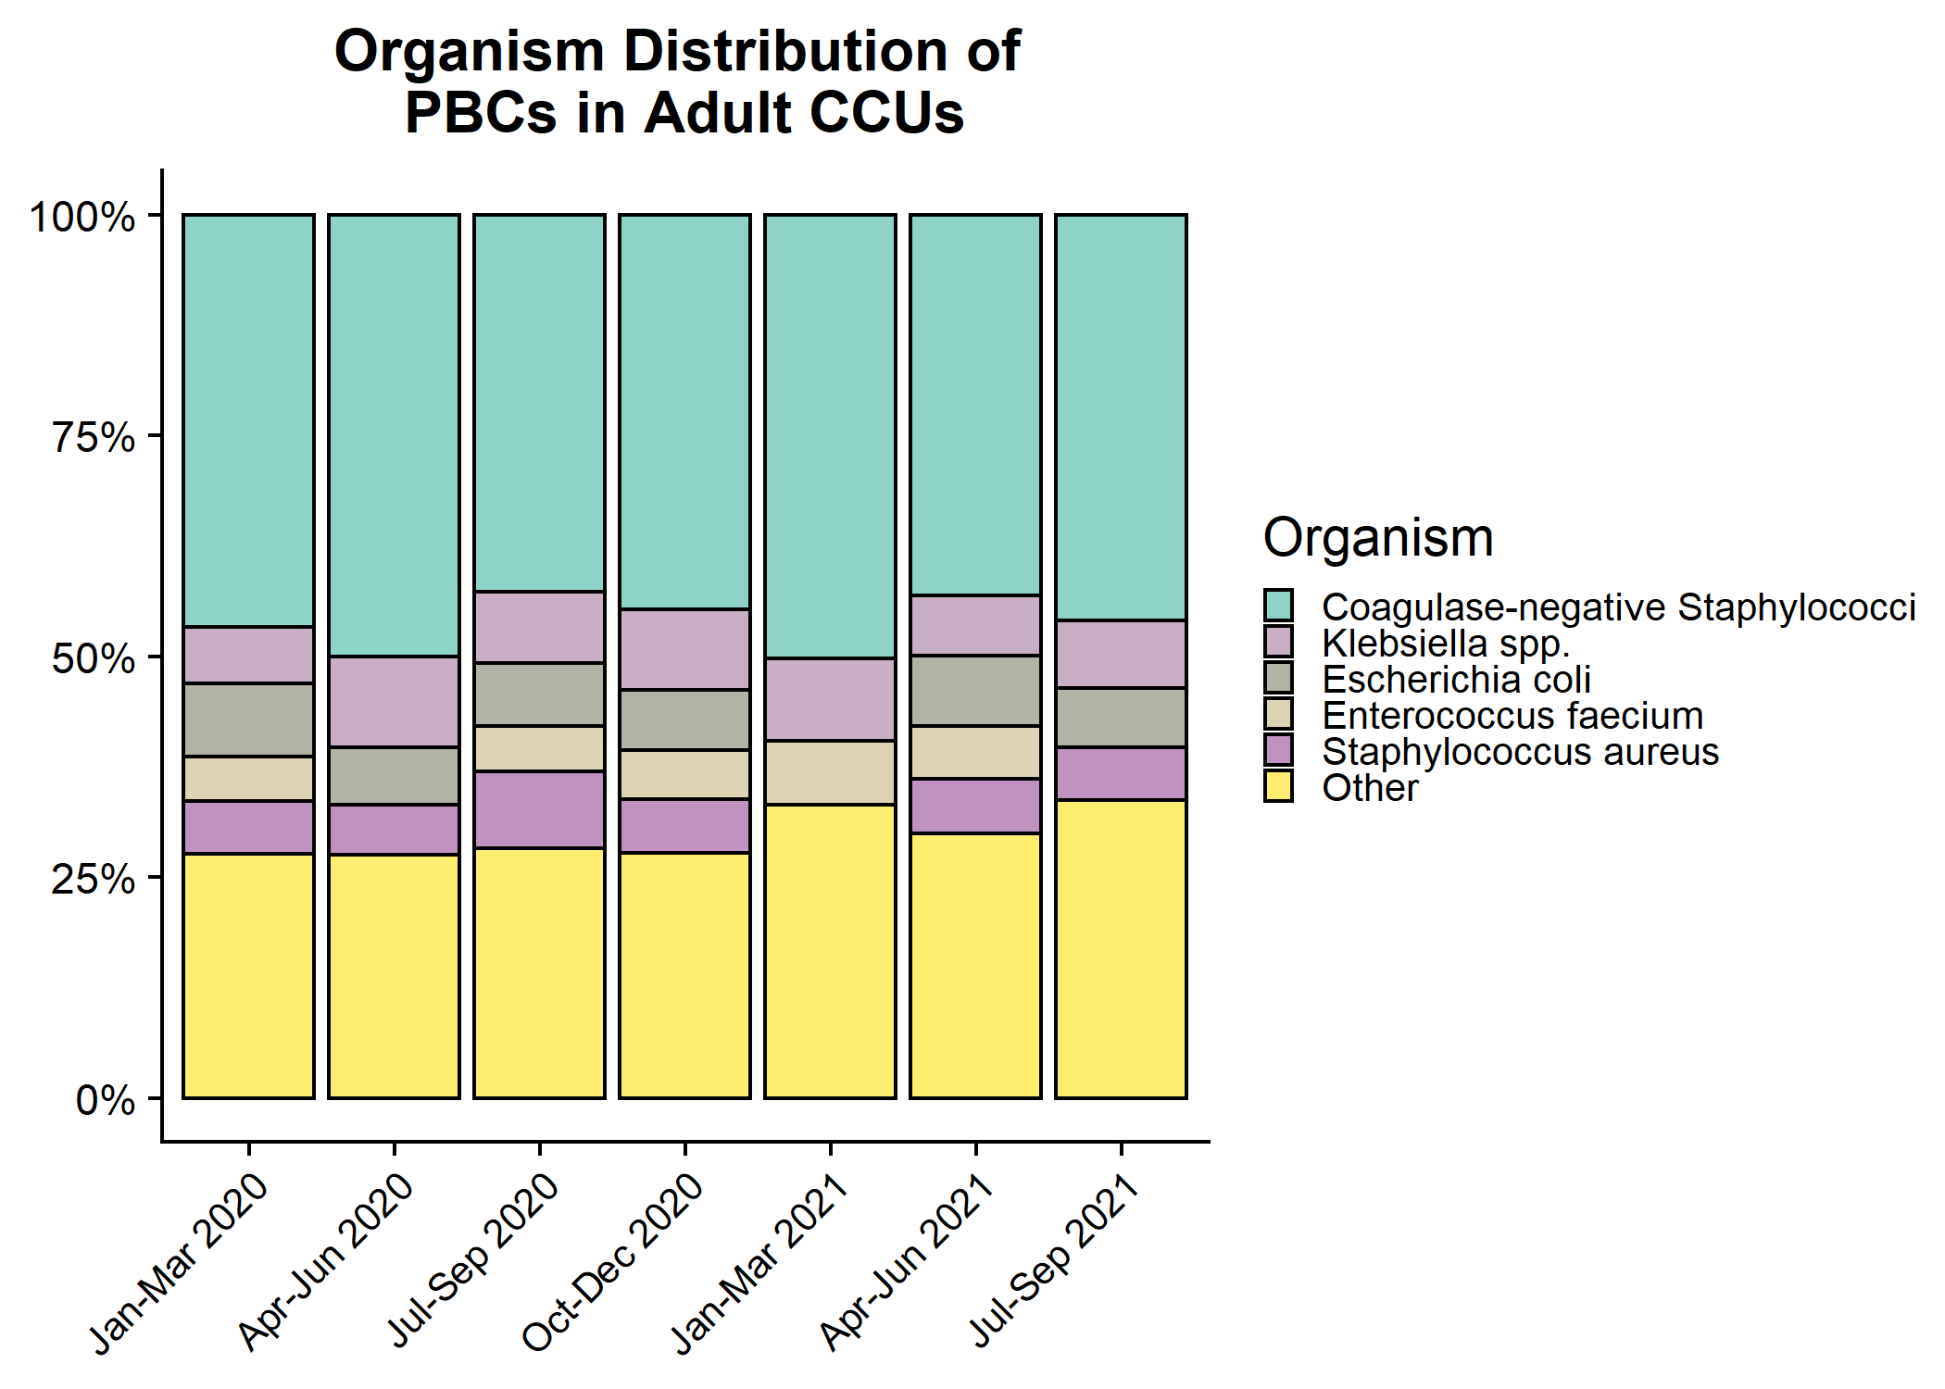
Organism distribution: all PBCs in Adult CCUs

Slide 14
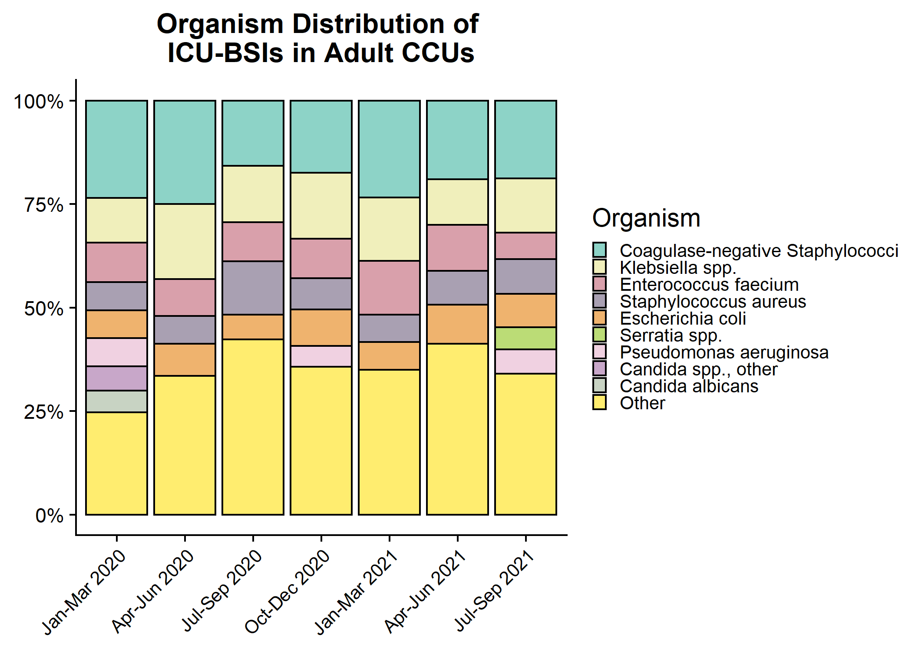
Organism distribution: ICU-associated BSIs in Adult CCUs

Slide 15
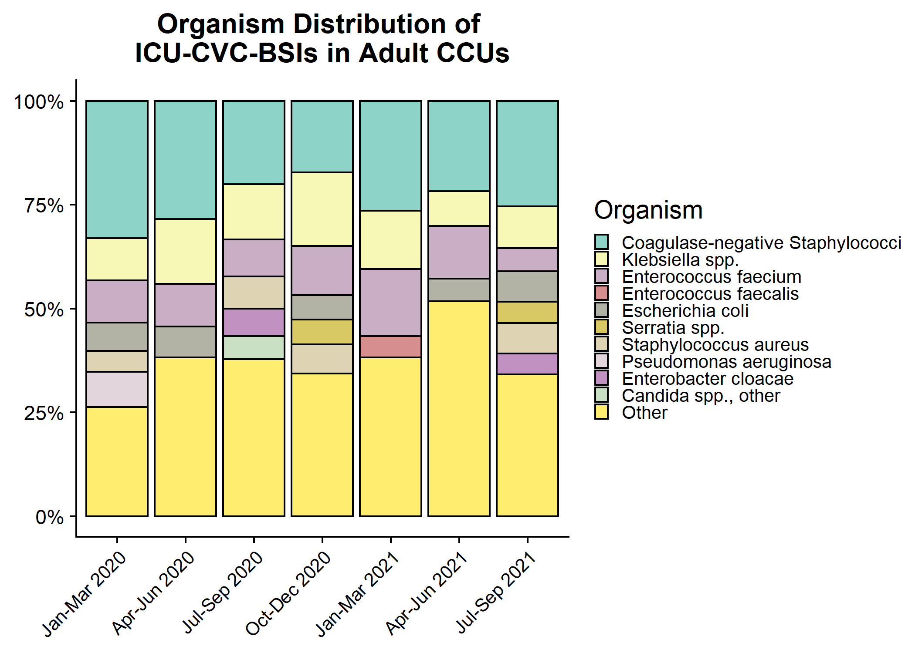
Organism distribution: ICU-CVC BSIs in Adult CCUs

Slide 16
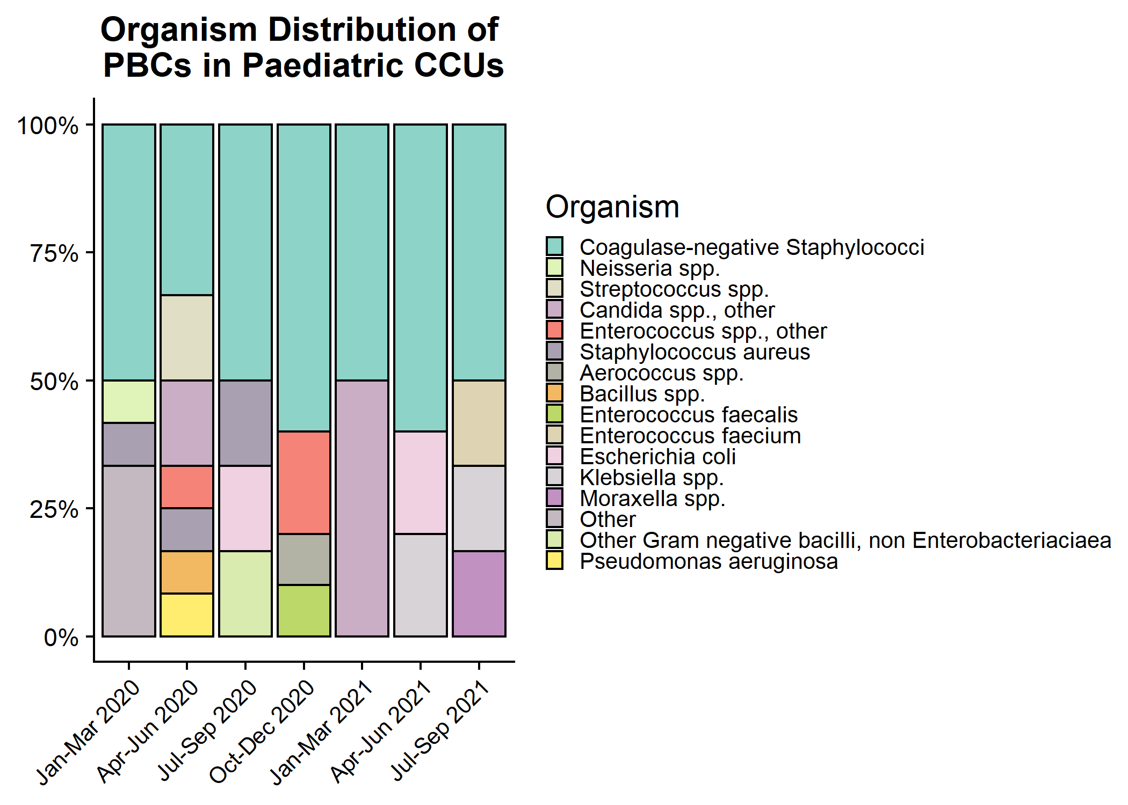
Organism distribution: all PBCs in Paediatric CCUs

Slide 17
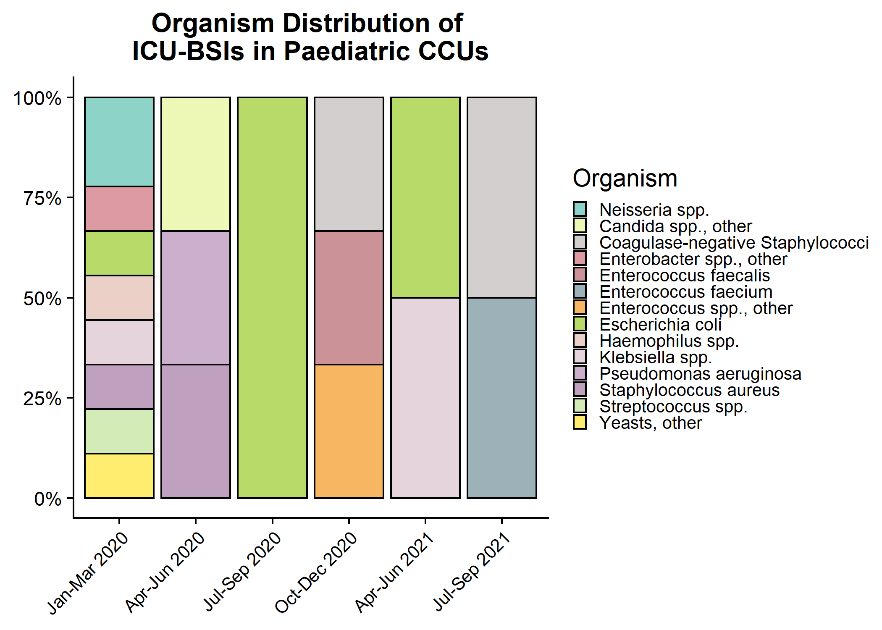
Organism distribution: ICU-associated BSIs in Paediatric CCUs

Slide 18
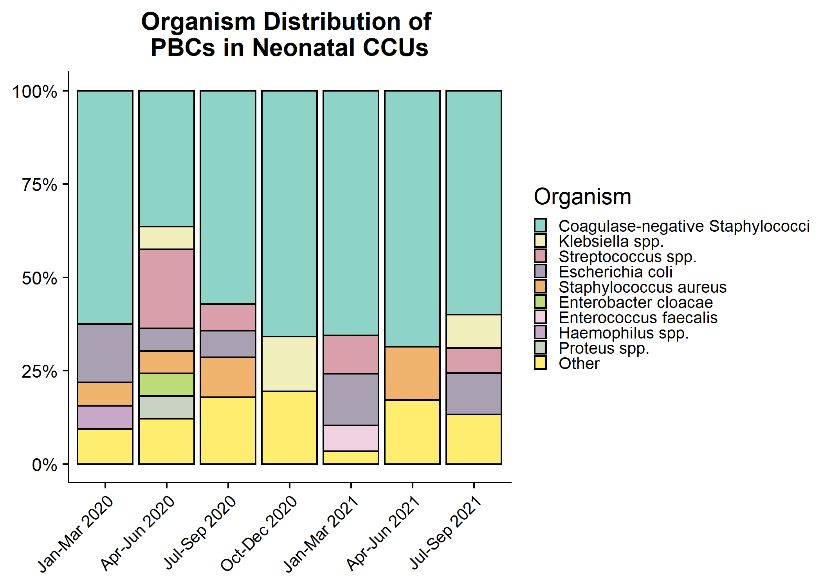
Organism distribution: all PBCs in Neonatal CCUs

Slide 19
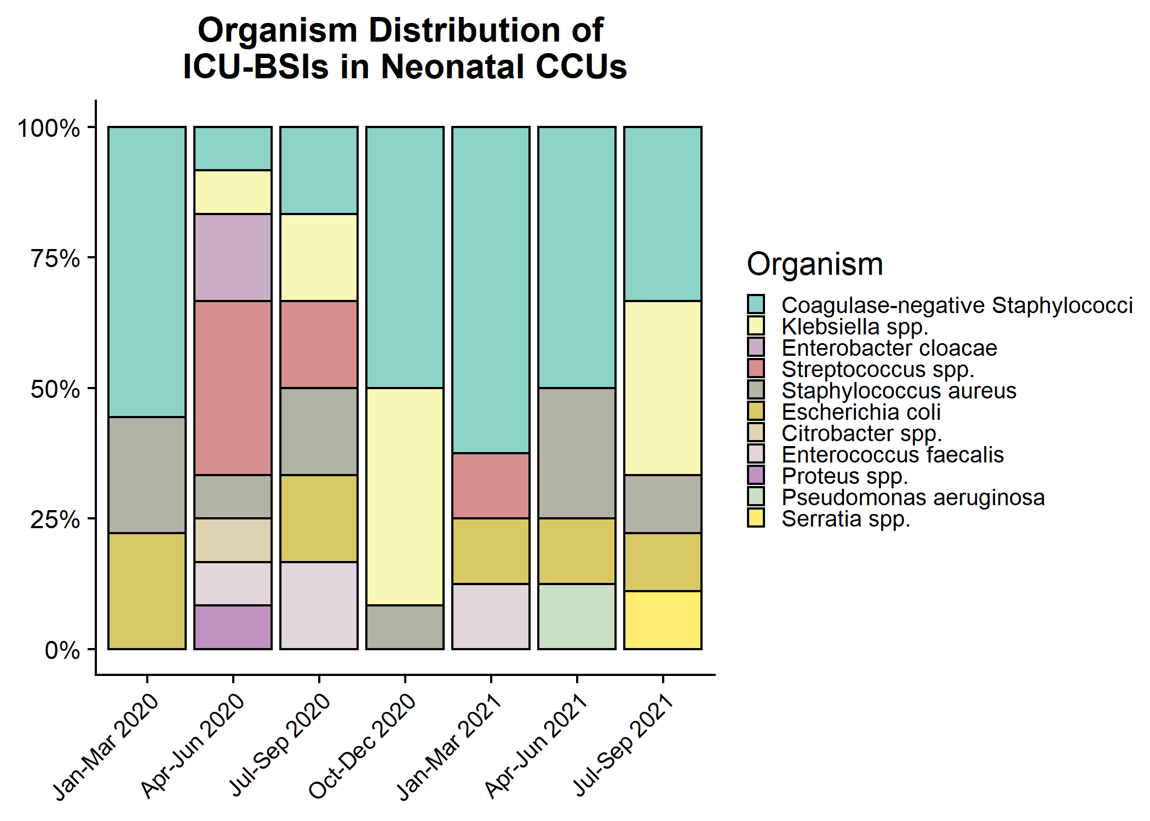
Organism distribution: ICU-associated BSIs in Neonatal CCUs

