Slide 1

AIRWAY AND BREATHING

Slide 2
BAG – VALVE – MASK VENTILATION

Slide 3
DRILL 1

Slide 4
PREPARING FOR ICU INTUBATION
Call for help
Optimize oxygenation
Videolaryngoscope
Airway Trolley
Checklist
Drugs
Anaesthetic Chart
OXYGENATE
Notes:
Help: : senior ICU/Anaesthetic reg, difficult airway team, consider ENT

Slide 5
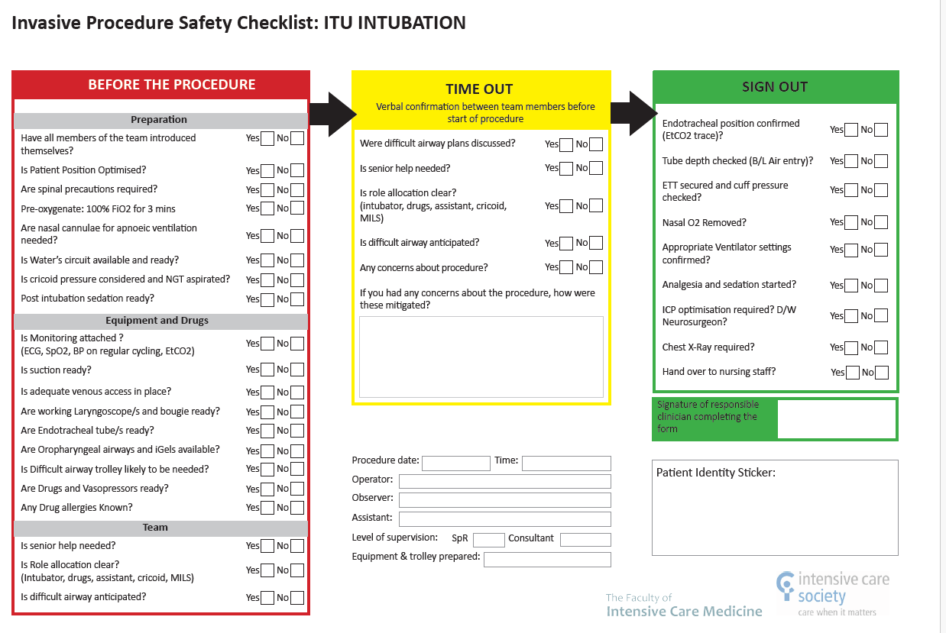

Slide 6
DRILL 2

Slide 7
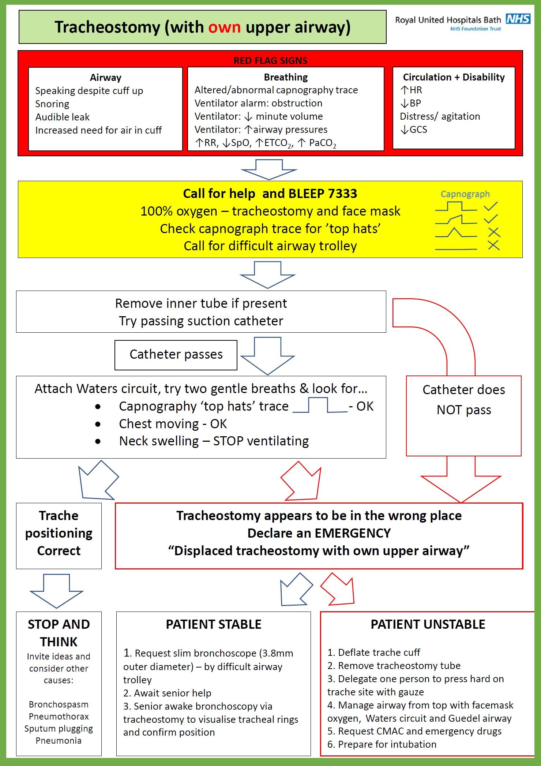
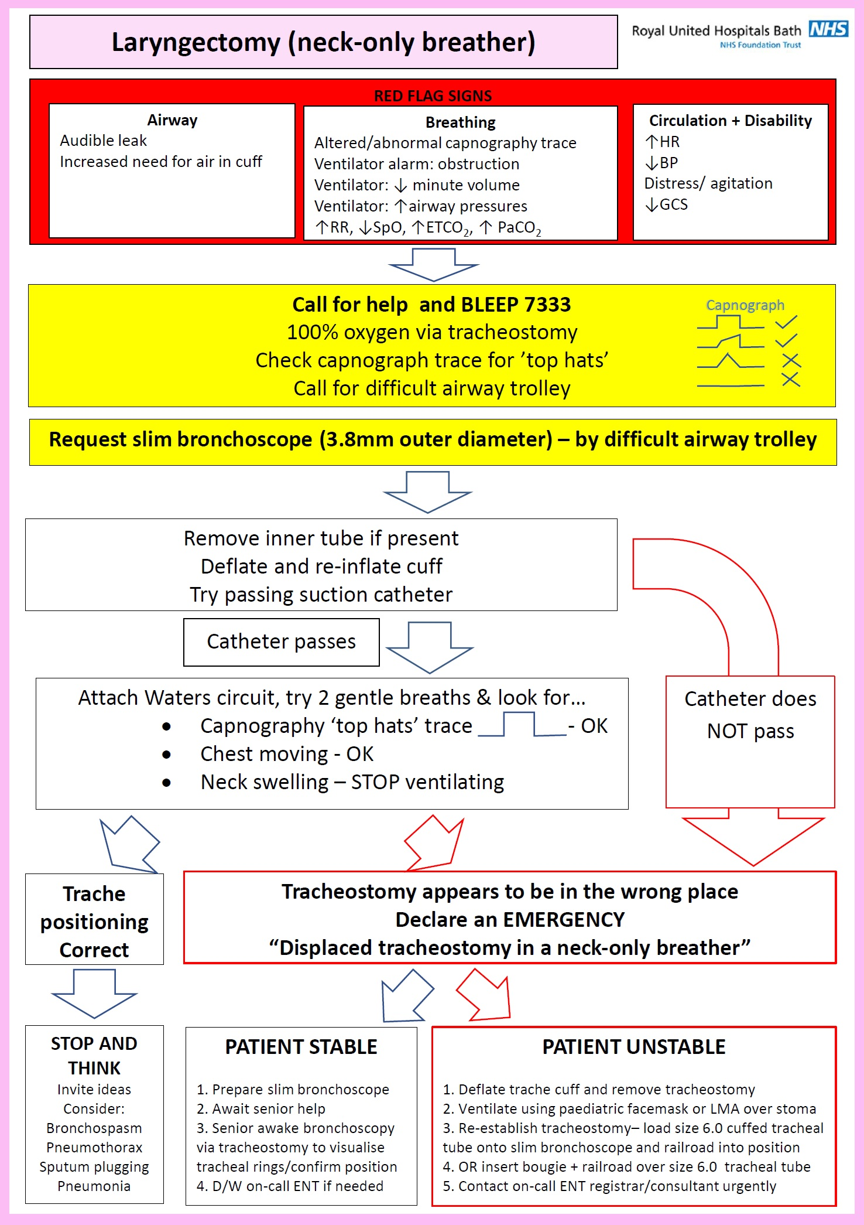
Notes:
We have to at least reference these but they are hard to follow and are not in widespread use around the region.
Therefore we will use the NTSP algorithms.

Slide 8
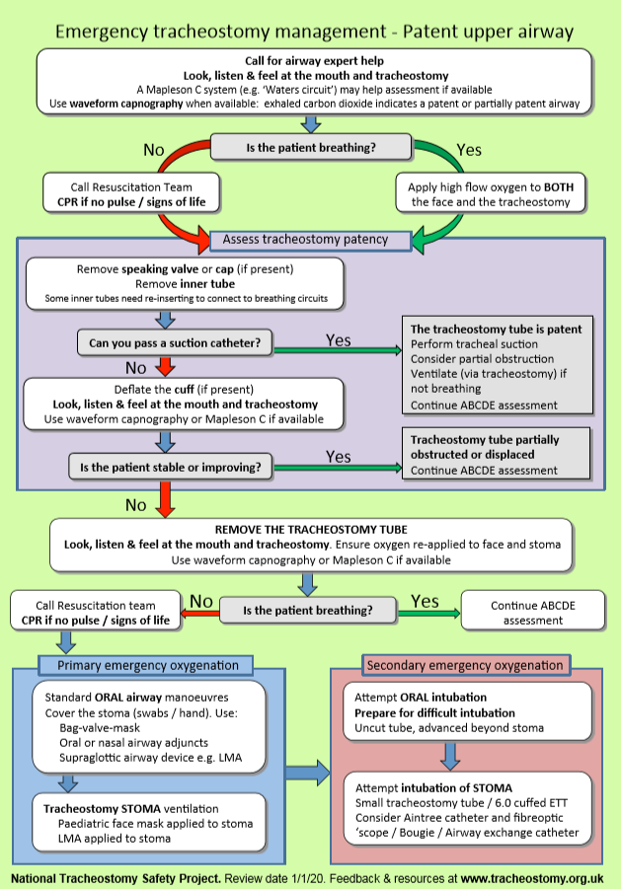
Notes:
Some important points highlighted on next chart: the difference between using it as an ‘airway doctor’ and a ward doctor.

Slide 9
You are airway help
but still call for senior support
Use ETCO2 and waters circuit: 1. Is there ETCO2?
2. Is the waters circuit bag moving?
If the patient is breathing (or trying to breathe):
High flow or mask oxygen over both face and tracheostomy
*
Remove speaking valve and replace inner tube.
Pass suction catheter and then replace breathing circuit.
If the patient is not breathing (previous sedated or due to events), deliver 1-2 careful breaths:
1. Is there ETCO2?
2. Is the chest moving up and down?
Deflating cuff is to remove possibility of cuff herniation obstructing the tracheostomy tube
*
*
Need to ‘choose’ an airway and if the upper airway is available, you should ensure the stoma is covered

Slide 10
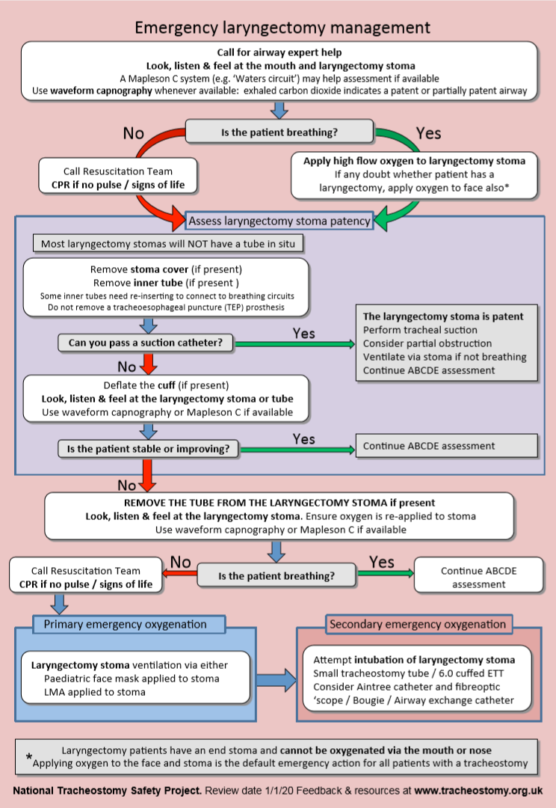

Slide 11
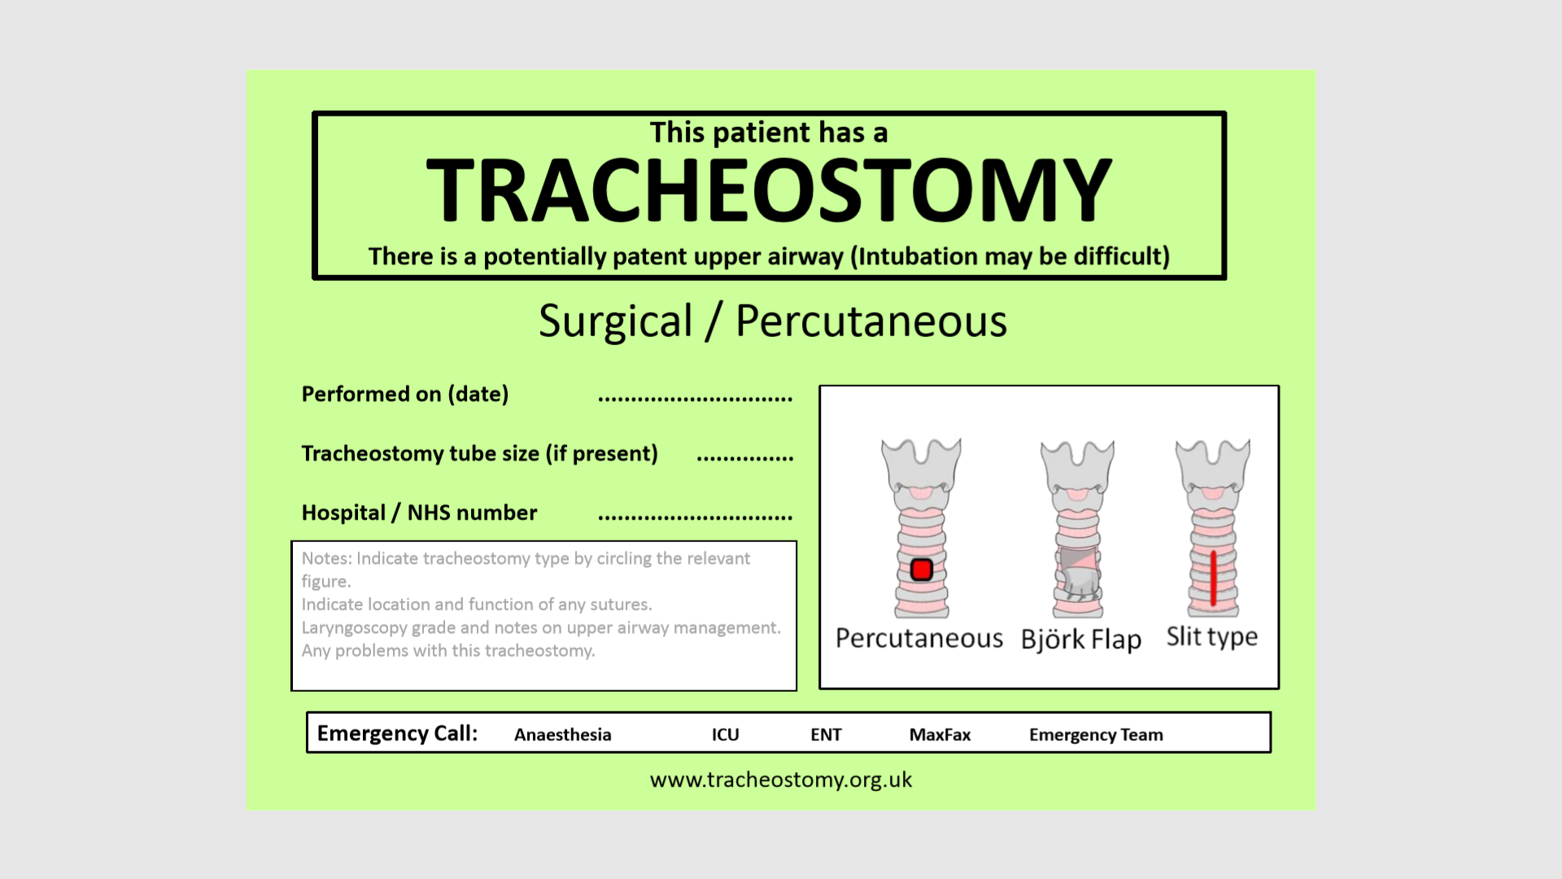

Slide 12
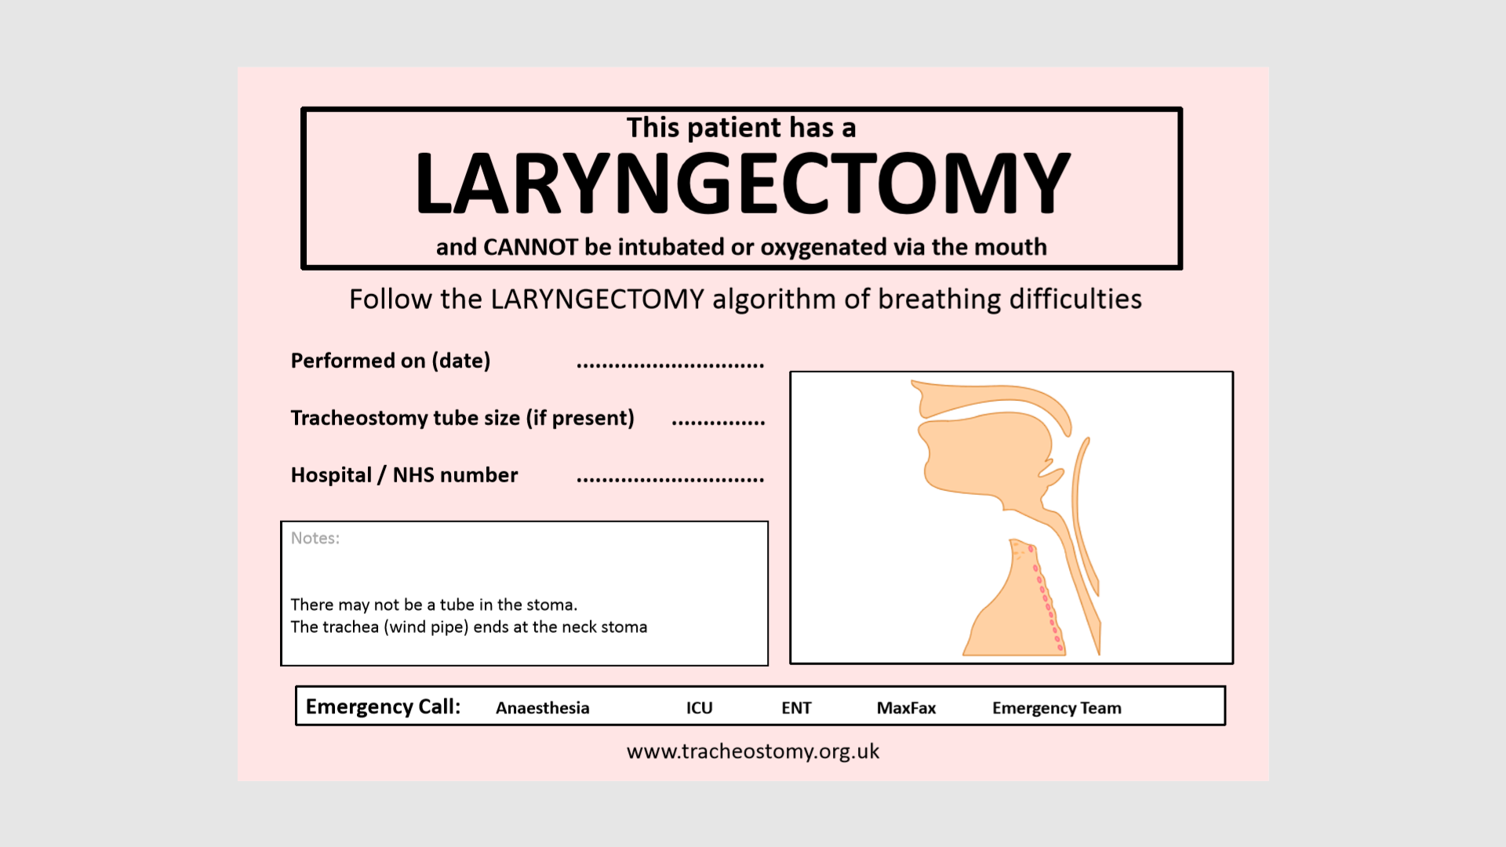

Slide 13
DRILL 3

Slide 14
SETTING UP LPV
TV 6ml/kg IBW
Appropriate RR (approx. 15-25 initially)
PaO2 10 kPa initially, then 8 kPa*
PaCO2 <8 kPa giving pH >7.25
PEEP matching FiO2
Plateau P <30cmH2O
*Exception: head injuries PaO2 13kPa, then 10kPa

Slide 15
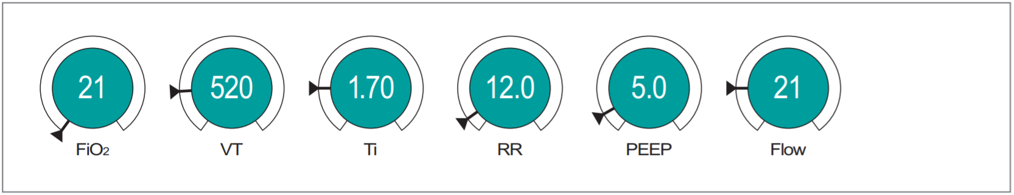
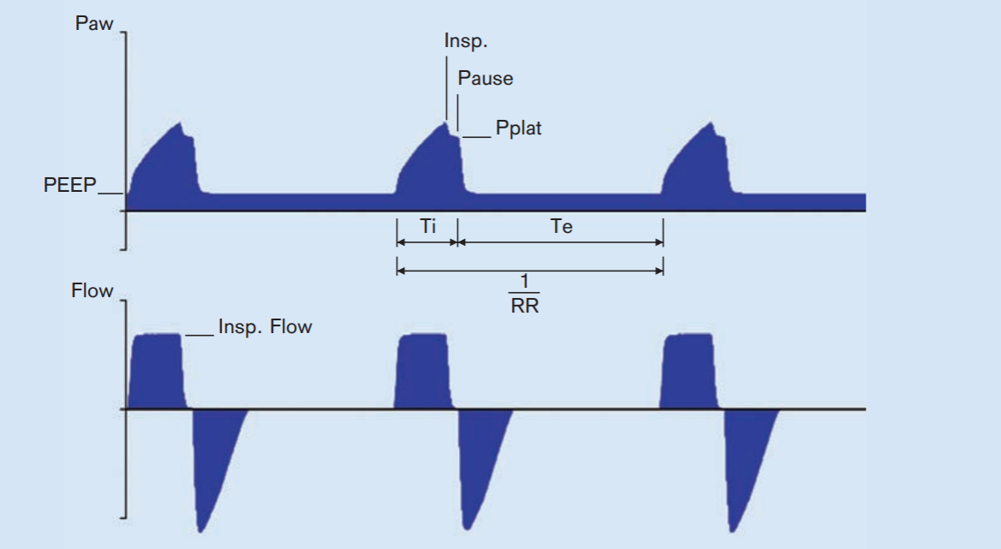
Pneumonia, 60kg female
VC - AC
ABG FiO2 0.6
pH 7.32
pCO2 5.8
pO2 6.3
HCO3 25
BE - 4
Lactate 3.1
60
300
0.95
18
5
20
I:E 1:2.5
21
300
0.95
18
5
20
0.95
18
5
20
Notes:
Problem: hypoxia
Also of note: mild hypercapnia secondary to suboptimal TV, with acidosis but mixed (lactate 3.1)
Optimise TV: 6 x 60 = 360ml
Increase oxygenation (not absolutely necessary if sats >88%, but should consider it)
Increase PEEP (do gradually to see what it does to the Ppeak) – should probably only go to 7 or 8 initially
Increase RR slightly and check to see if I:E linked (ensure inspiratory time optimized – consider changing to 1:2)
Consider suctioning (ask bedside nurse if not done before)
Check that parameters are improving (Sats, ETCO2, Ppeak) and check a gas in 20-30 mins
Other things to consider: increasing ventilation/using muscle relaxants to promote ventilator synchrony, or chest physio (but discuss with reg/senior nurse)

Slide 16
DRILL 4

Slide 17
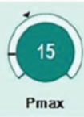
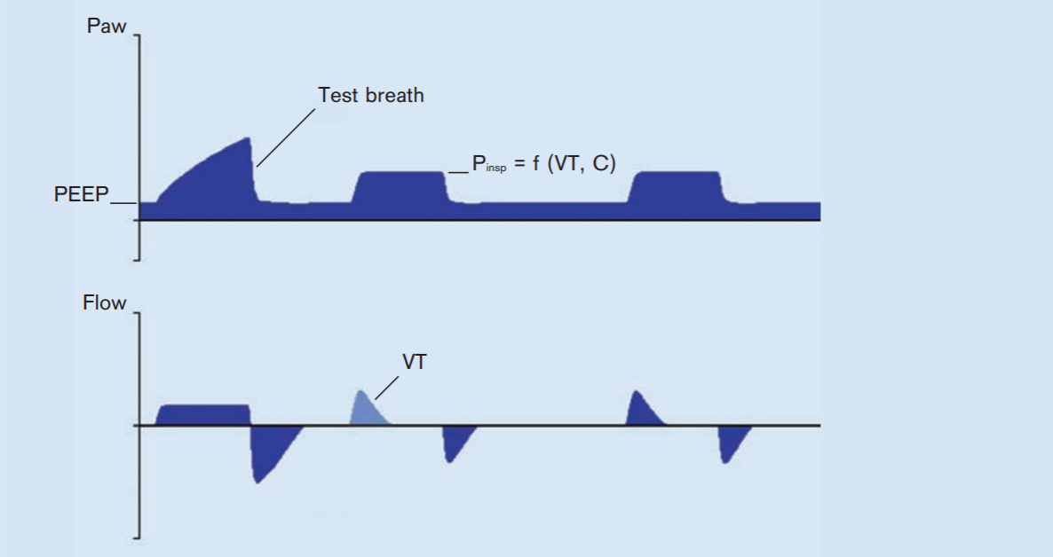
COPD Exacerbation, 68kg female
PC - VG
ABG FiO2 0.4
pH 7.10
pCO2 15.3
pO2 7.9
HCO3 28
BE - 3.4
Lactate 2.1
40
300
0.95
16
5
20
12
21
300
0.95
18
5
20
0.95
18
5
20
Notes:
Not exactly the ventilator screen but gives them the opportunity to get the concept:
Problem: hypercapnia (abnormal pH shows that this is too high even in a COPD patient)
Also of note: risk of pneumothorax given COPD
Optimise TV: 6 x 68 = 400ml
Oxygenation is ok
Increase RR and check to see if I:E linked (ensure I:E is 1:2 – 1:2.5)
Observe to see what Ppeak is (want to recognise the need to limit it somewhat in COPD)
Note that Pmax is 12 and therefore, full TV will not be delivered if P required >12 (more than likely given COPD)
Other things to consider: suctioning, chest physio, increasing ventilation/using muscle relaxants to allow TV to be delivered with appropriate peak pressures (but discuss with reg/senior nurse)

Slide 18

PICTURE BOARD

Slide 19
RULES
9 boxes
The answer begins with the letters on the box
All answers are airway related

Slide 20
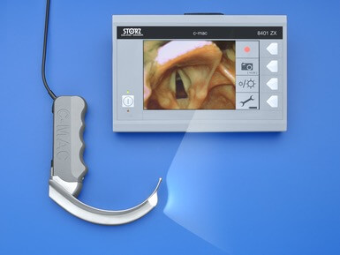
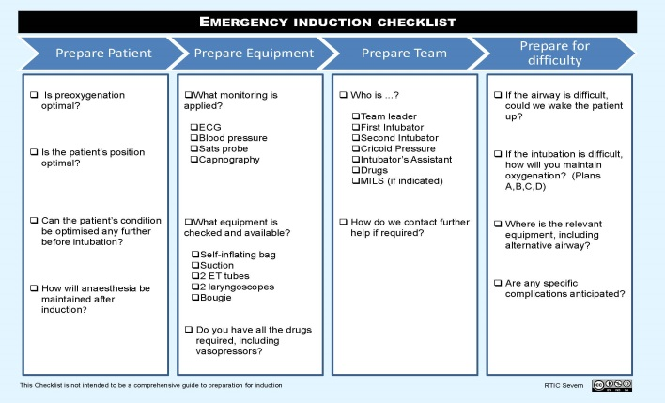
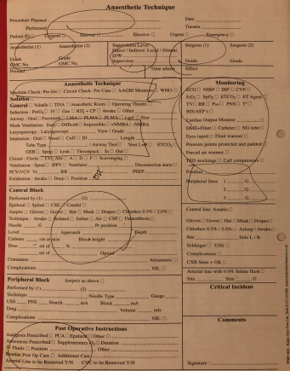
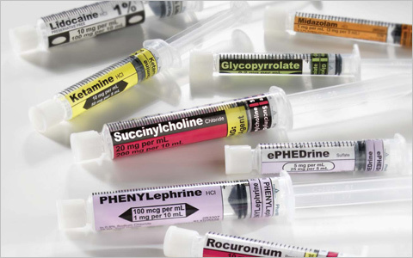
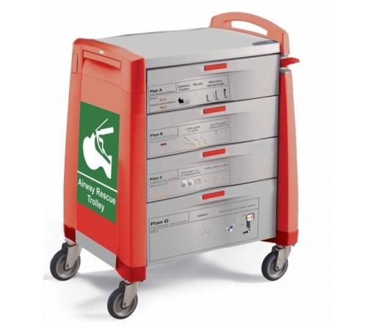
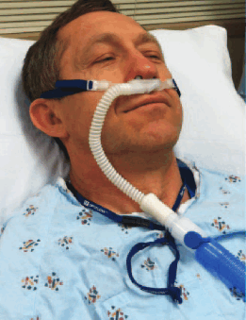
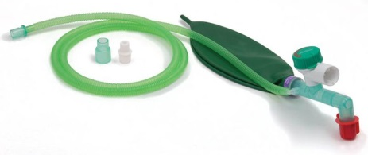
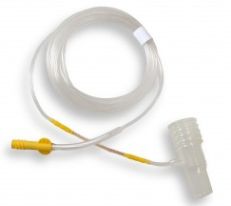
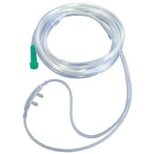
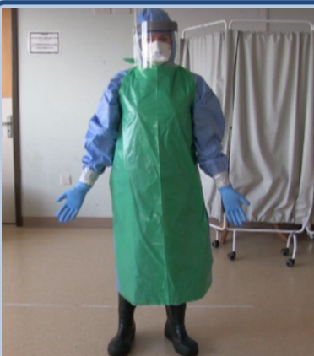


VL
C
AC
D
AT
O
H
PPE
S
HELP
2222
Notes:
9 THINGS BEHIND THESE LETTERS 1 POINT PER BOX
ONE OVERALL SUBJECT 9 – BOXES REVEALED POINTS FOR CORRECT ANSWER

Slide 21
RECOMMENDED READING
NTSP website: http://tracheostomy.org.uk/
https://www.ccam.net.au/handbook/tracheostomy/
https://www.e-lfh.org.uk/ Tracheostomy Safety
Notes:
https://onlinelibrary.wiley.com/doi/pdf/10.1111/anae.12140

