Slide 1

CIRCULATION

Slide 2
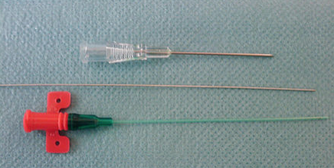
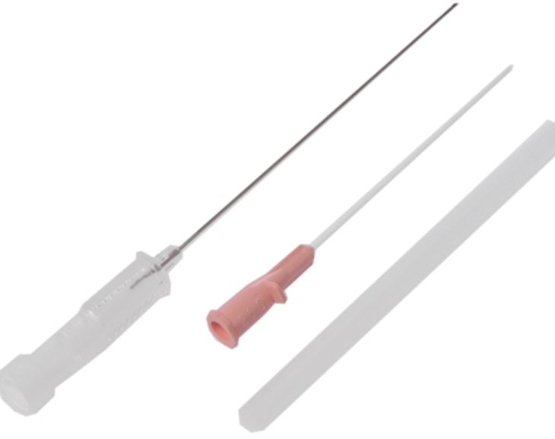
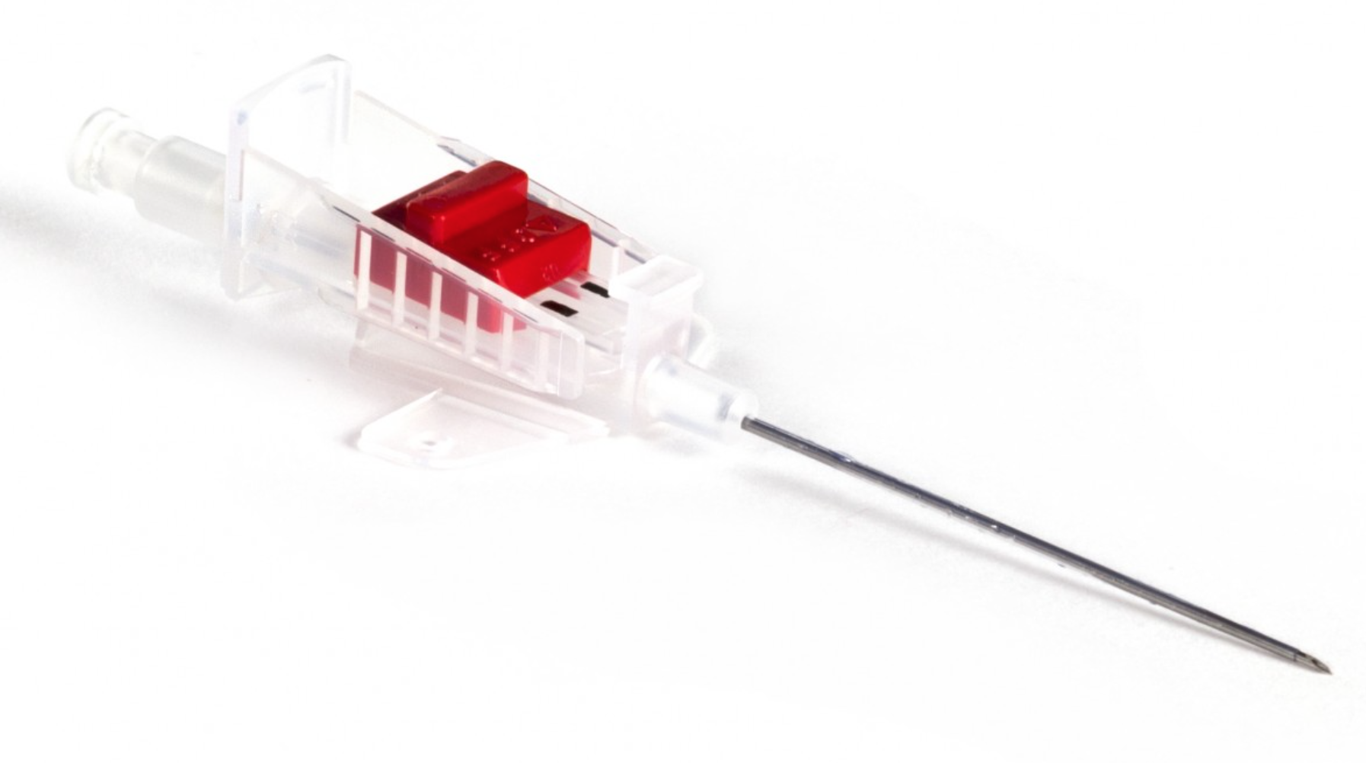
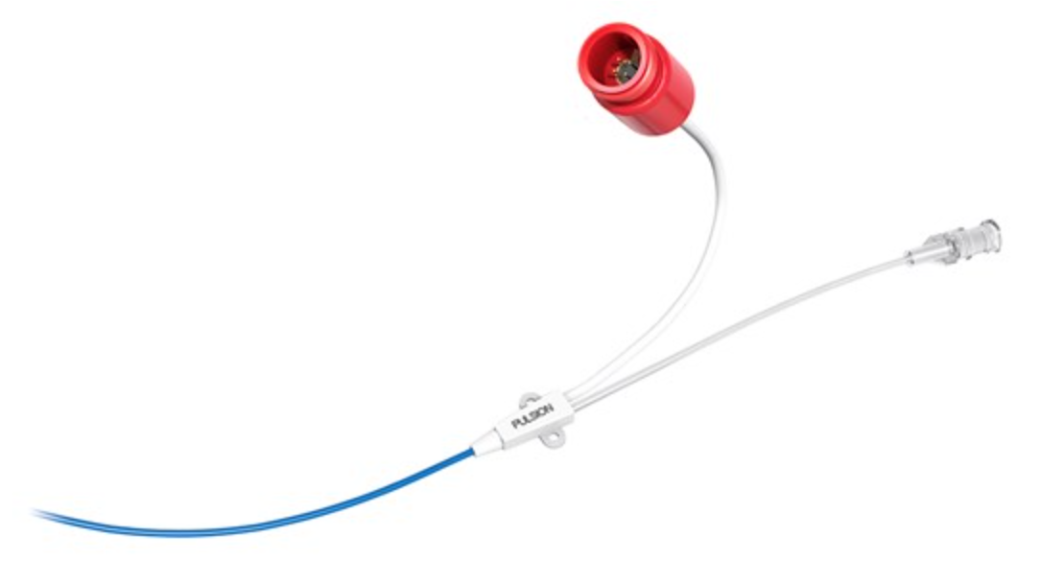
ARTERIAL CANNULA
Notes:
Different Types you may see on ICU
Vygon (top left image) – Seldinger Technique – good for long stay patients, seem to kink less but can be messy to insert: use inco pads if you want to make the ICU nurse happy!
Abbocath (top right image) – cannula technique, some people choose to transfix the vessel
Floswitch (bottom left image) – cannula technique, less bloody and reduced risk air embolism due to on-off switch
PiCCO (bottom right image) – Pulse Contour Cardiac Output monitoring: arterial cannula with thermistor that can be used to monitor cardiac output by thermodilution studies or deriving parameters from shape of arterial waveform

Slide 3
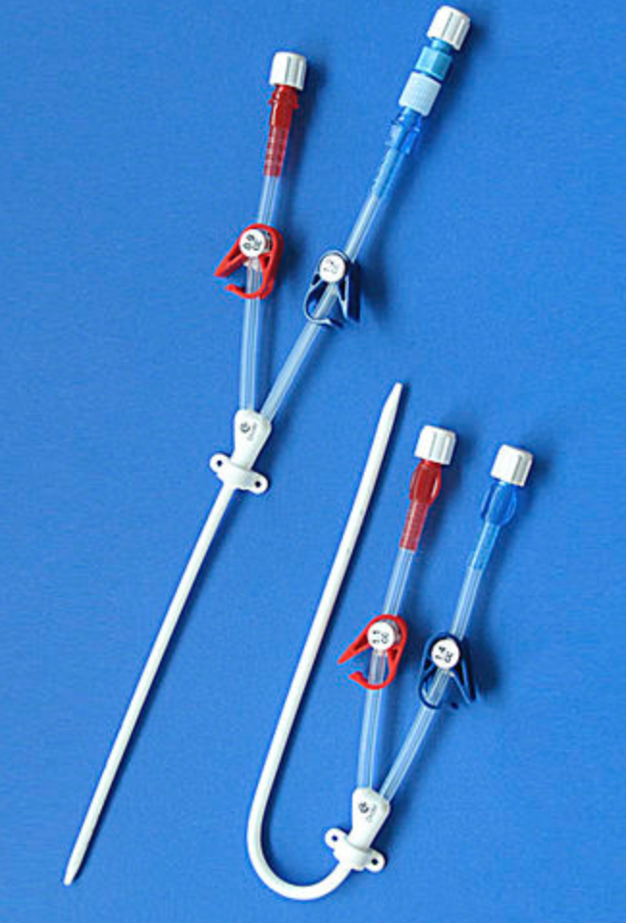
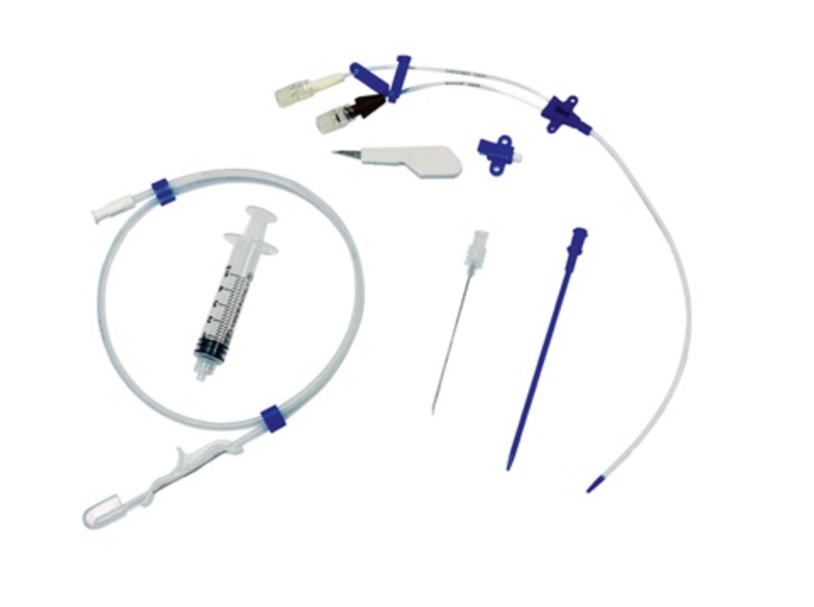
CENTRAL VENOUS ACCESS
Notes:
What we will cover
NOT insertion technique – this will not be expected of trainees new to ICU
Understanding of the following
- Indications
- Common sites of insertion
- Complications

Slide 4
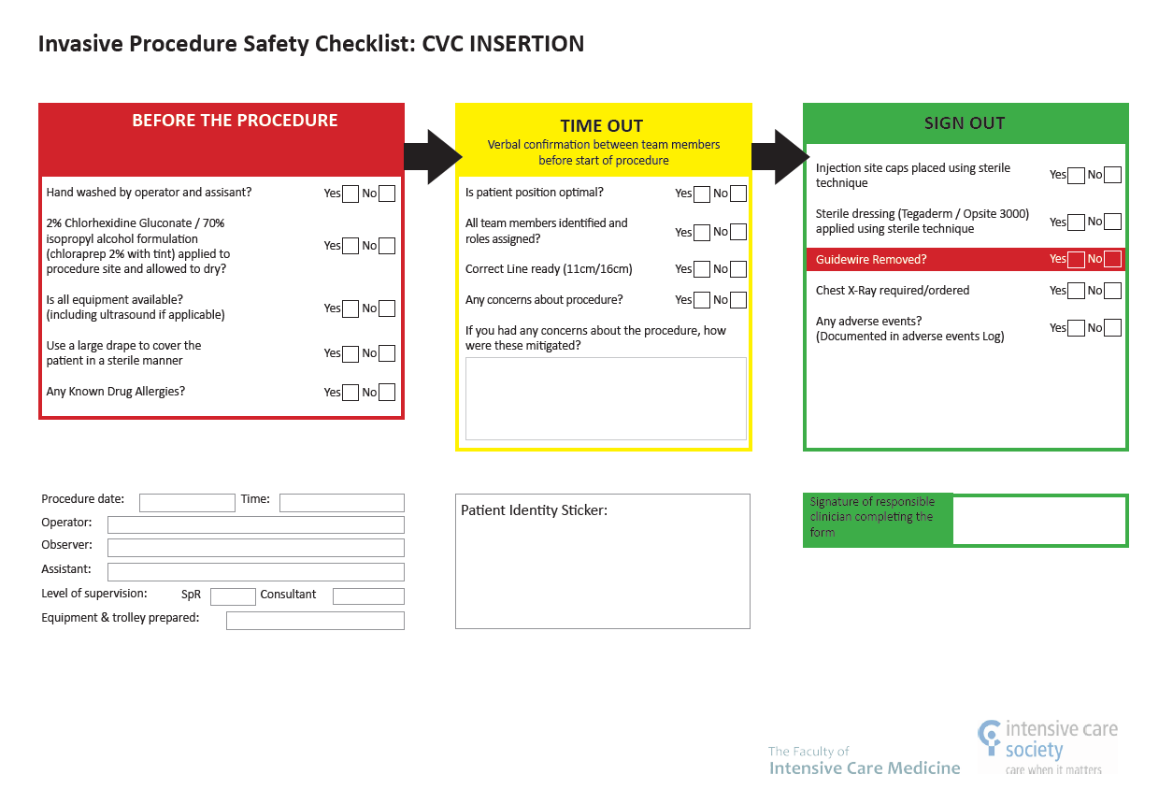

Slide 5
US GUIDED INSERTION OF CVL

Slide 6
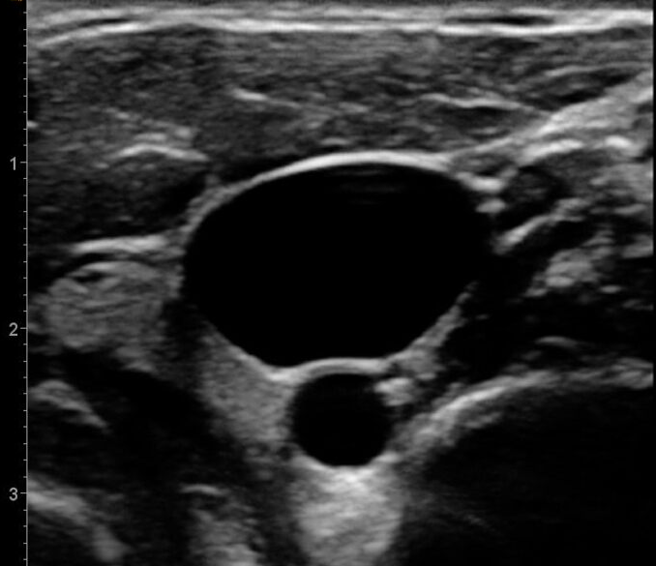

Slide 7
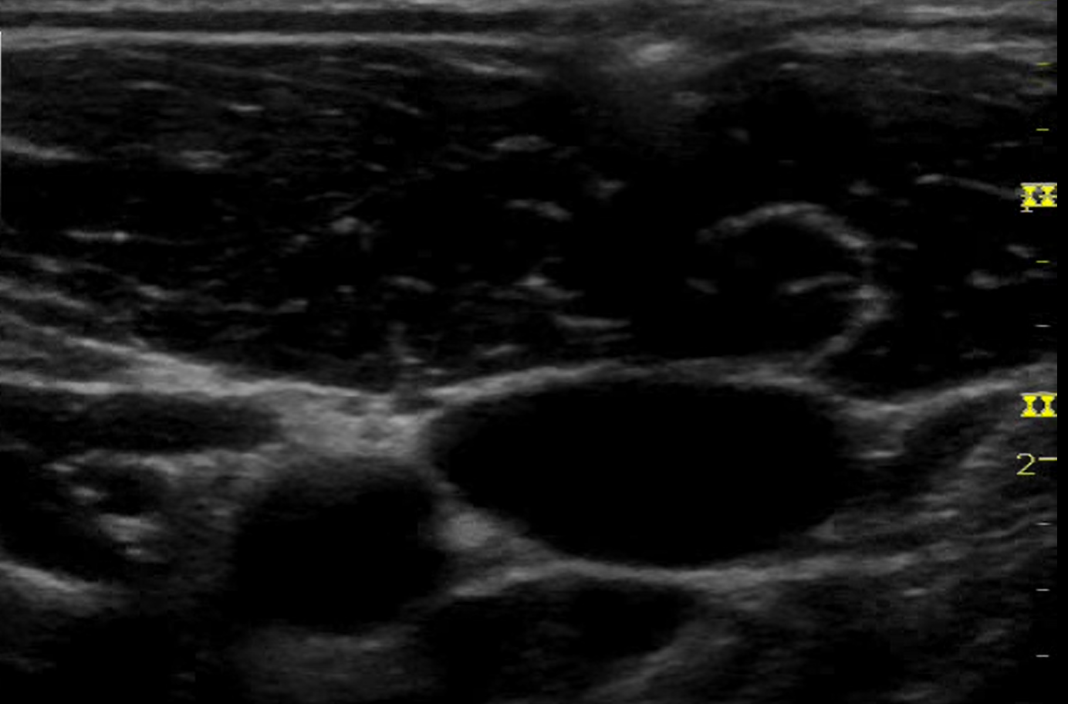

Slide 8
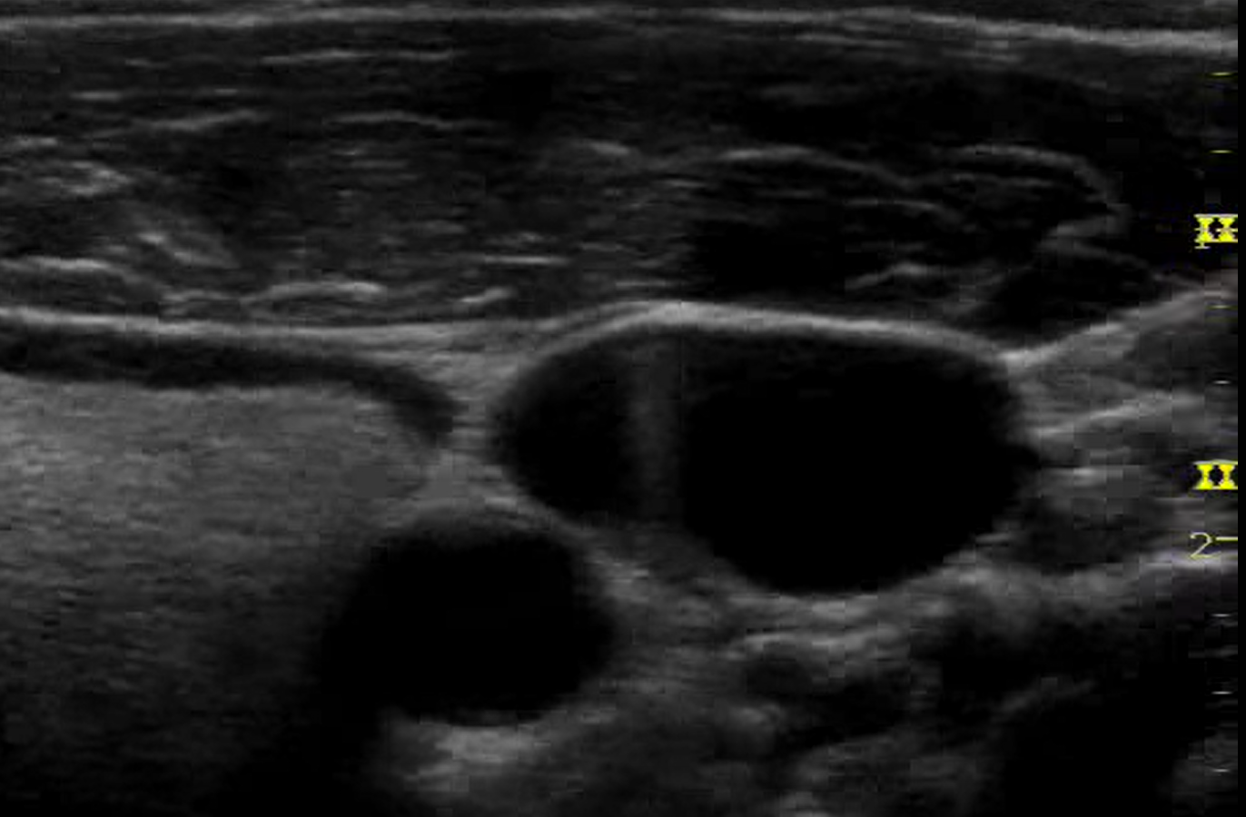
Notes:
https://www.bing.com/videos/search?q=youtube+central+line+insertion+ultrasound&docid=608040349249374567&mid=8DDBC9B0AA08464265B78DDBC9B0AA08464265B7&view=detail&FORM=VIRE

Slide 9
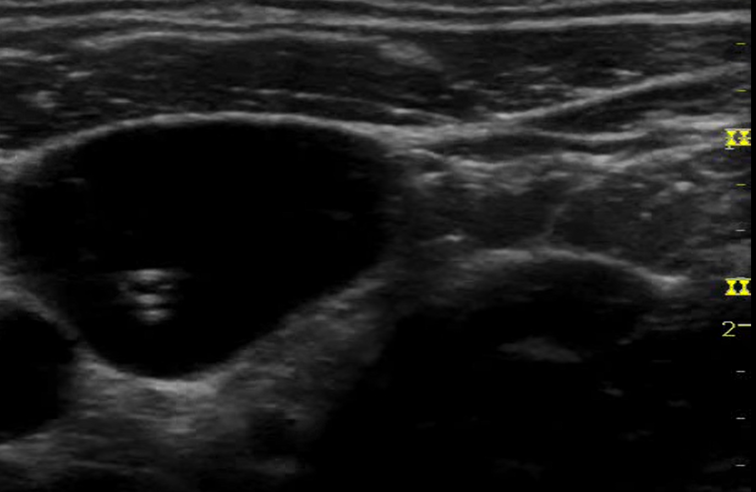

Slide 10
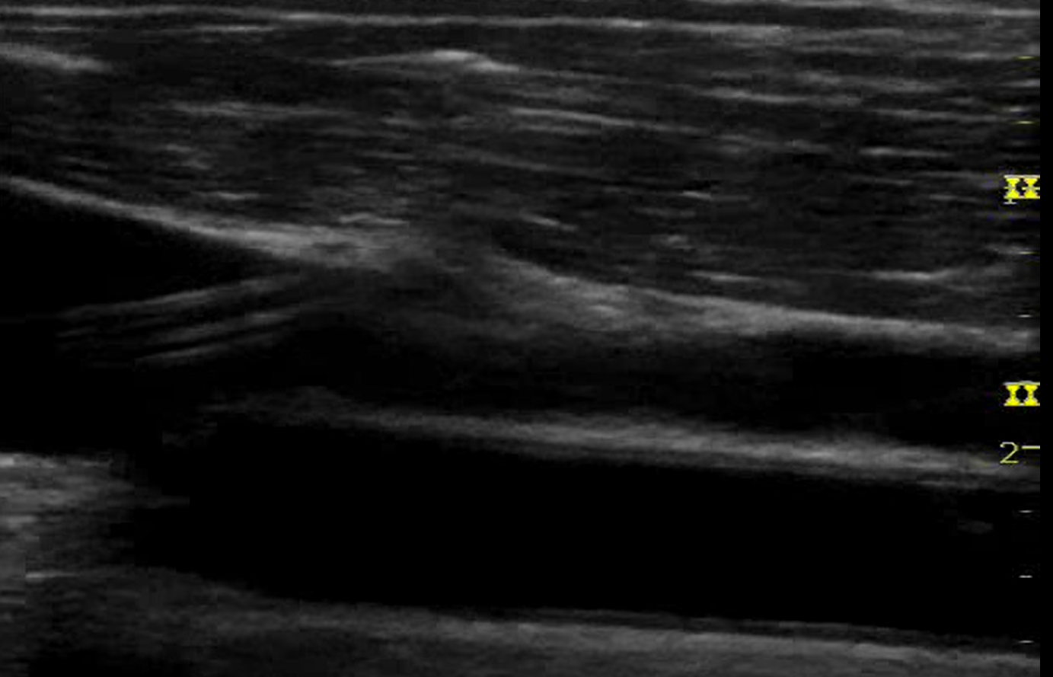

Slide 12
CENTRAL LINE CARE BUNDLE
Surgical scrub hand hygiene, gown, gloves, hat, mask.
2% chlorhexidine in alcohol for skin antisepsis
Maximal barrier precautions before insertion
Optimal catheter selection site
Aseptic access technique
Sterile, transparent dressings (replace 5-7 days or sooner if soiled)
Daily review of central line necessity with prompt removal of unnecessary lines
Alcohol based hub disinfection before access
Education
Notes:
(subclavian is lowest risk, avoid the femoral route)

Slide 13
WAVEFORMS

Slide 14
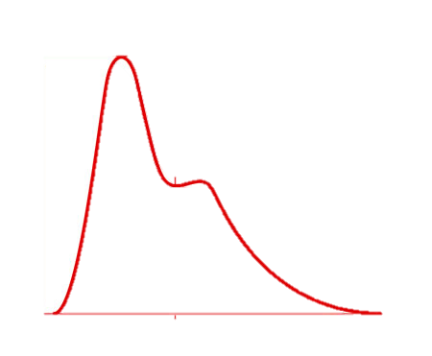
ARTERIAL PRESSURE WAVEFORM
mmHg
120
80
40
0

Slide 15
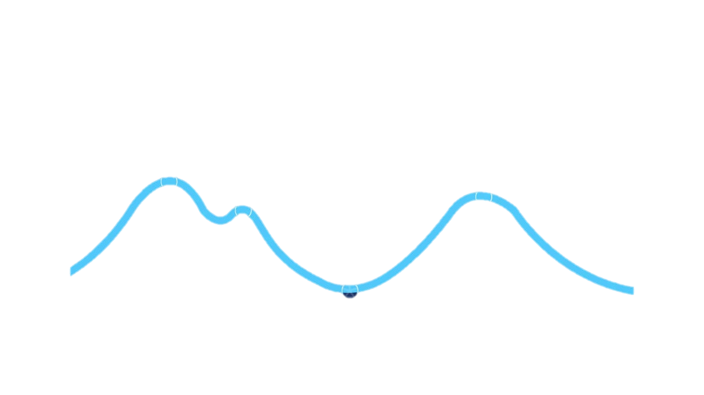
CENTRAL VENOUS PRESSURE WAVEFORM
mmHg
20
15
10
5
0

Slide 16
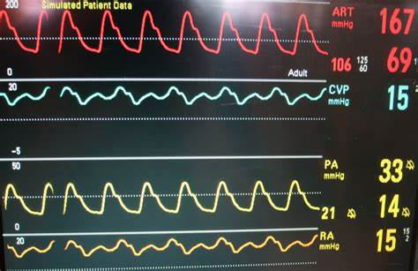
ICU PATIENT PRESSURE WAVEFORM
Make sure you understand and recognise the difference

Slide 17
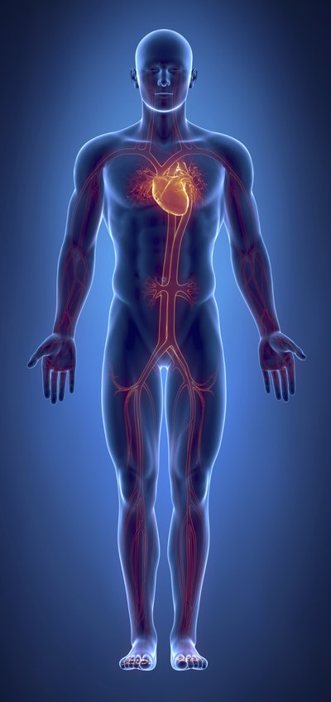
CARDIOVASCULAR SUPPORT
Notes:
Cardiovascular support on ICU may be for hypotension, hypertension or arrhythmias
We will focus on treatment of hypotension in this talk
By considering the physiology and where different drugs act we can see why many ICU patients may require multiple agents as they work in different ways
? What is Blood Pressure (cardiac output x systemic vascular resistance)
? What is Cardiac Output (stroke volume x heart rate)

Slide 18

ASSESSING FLUID BALANCE
Notes:
Can be difficult to assess in ICU patients but you should still use your ward assessment skills to begin:
A – ensure appropriate and patent airway
B – RR, Sats (including magnitude of trace indicating peripheral volume), lung auscultation
C – mucous membranes, peripheral warmth and perfusion, cCRT, BP, HR, what support they are on and if it is increasing or decreasing, oedema, (CVP)
D – level of consciousness
E – lactate, BE, electrolytes
F – urine output, renal function
Additional ICU stuff: arterial line ‘swing’, passive leg raise, cardiac output studies
We want to avoid over zealous fluid administration as can worsen oxygenation.
Consider which fluid is best to use: balanced crystalloids (nb Na content in TBI), RBC, HAS
Exercise caution before considering IV diuretics – patients can become rapidly unstable if big fluid shifts, 20mg frusemide IV as starting dose in patients requiring diuresis but seek senior advice.
None of the above are perfect but taken together they should help guide your clinical decision making

Slide 19
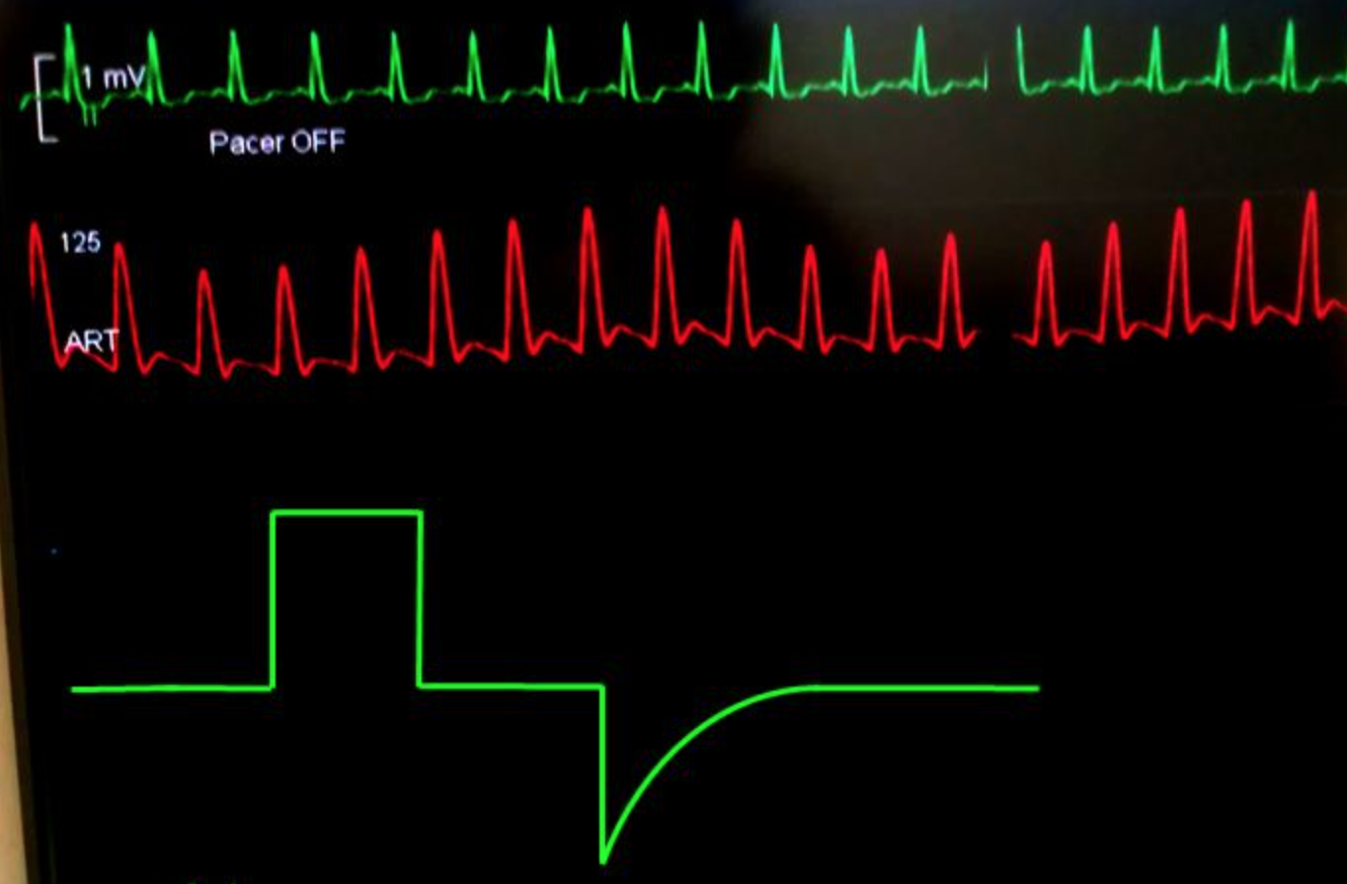
‘SWINGING’ ARTERIAL LINE WAVEFORM
Notes:
In spontaneous ventilation systolic blood pressure varies within the respiratory cycle by about 5-10mmHg
Pulsus paradoxus = variation >10mmHg
Reverse pulsus paradoxus — occurs during controlled mechanical ventilation when arterial pressure rises during inspiration and falls during expiration due to changes in intra-thoracic pressure secondary to positive pressure ventilation
Many causes but hypovolaemia exacerbates the variation and is seen as obvious increase and decrease in arterial waveform amplitude with respiratory cycle – this is pulse pressure variation (PPV)
Indicates that the patient may be fluid responsive

Slide 20
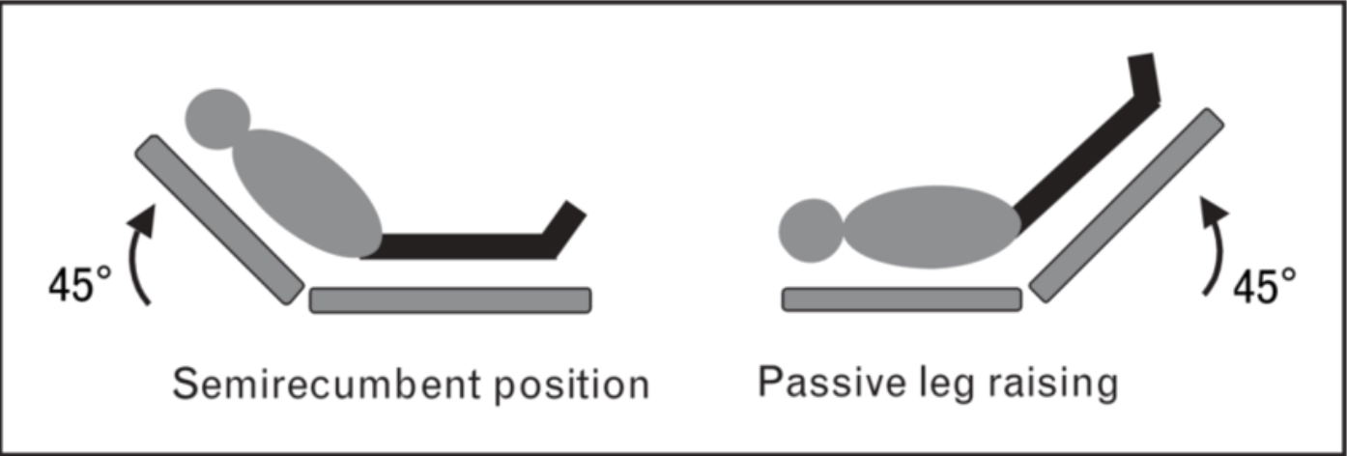
PASSIVE LEG RAISE
Notes:
Extremely useful bedside test to assess fluid responsiveness – recommended in Covid-19 daily checklist
Allows you to judge how the patient might respond to a fluid bolus before you administer it
Using gravity to deliver a ‘bolus’ of plasma from the lower body circulation to the heart
If the response if positive/reassuring you can feel confident to give a bolus of IV fluid
If no response indicates adequately filled
If patient responds poorly – worsening oxygenation – returning the patient to semi-recumbent position will redistribute the fluid and no harm is done
Start with patient at 45 degrees head up semi-recumbent position
Lower patient’s upper body to horizontal and passively raise legs at 45 degrees up – can use bed controls or two strong people raising a leg each
Maximal effect occurs at 30-90 seconds
Assess for a 10% increase in stroke volume using a surrogate such as pulse pressure on the arterial line

Slide 21
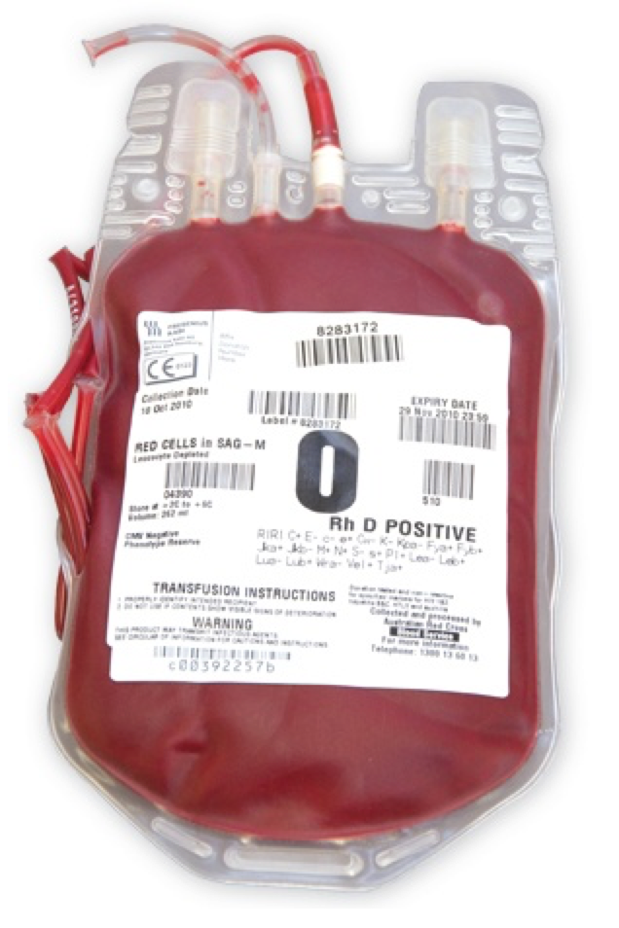
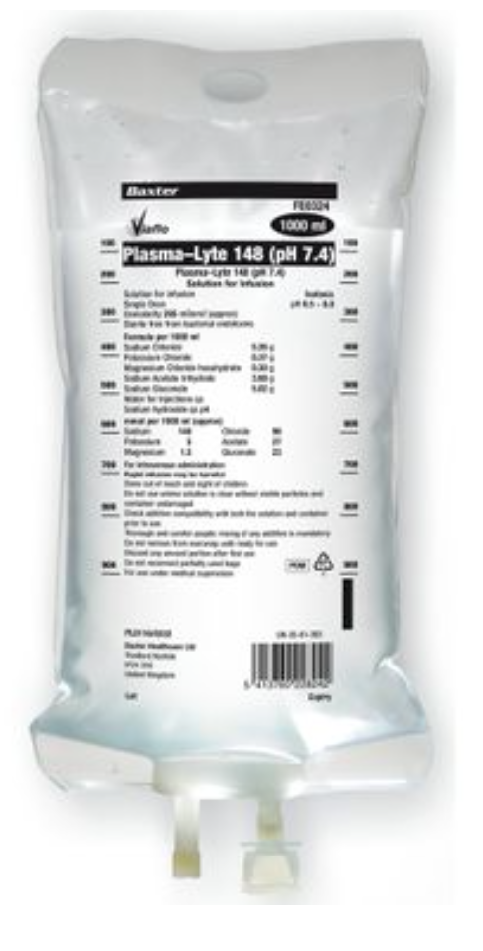
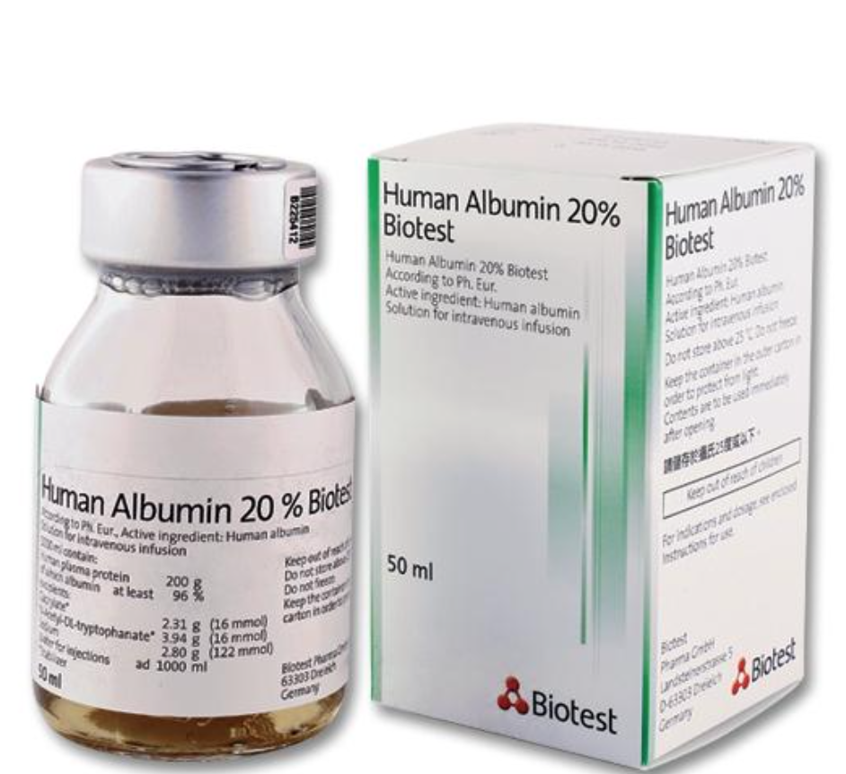
TYPES OF FLUID
Notes:
So you’ve decided to give a fluid challenge – how much, of what and how quickly?
250ml is a safe volume to start with
Give ‘stat’ as easier to assess response
If you are considering further boluses consult senior clinician
We most commonly give crystalloid in form of a balanced salt solution such as plasmalyte or Hartmann’s
Human albumin is used as oncotic pressure it exerts draws fluid from interstitial space to the intravascular compartment
5%, 10% and 20% available
Packed red cells to keep Hb >70 (some patients may have a higher transfusion trigger but confirm with senior clinician)

Slide 22
PHYSIOLOGY
BP = CO x SVR
CO = SV x HR
Notes:
What is Blood Pressure?
- cardiac output x systemic vascular resistance
What is Cardiac Output?
- stroke volume x heart rate

Slide 23
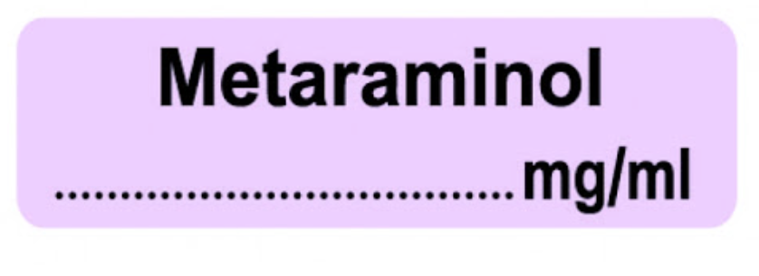
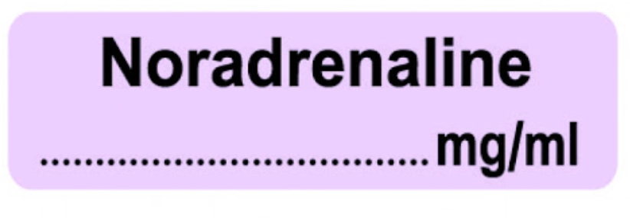
Notes:
Metaraminol and Noradrenaline (Vasopressors)
- Drugs that increase systemic vascular resistance
Cause vasoconstriction by agonist action at α1 adrenoceptors
Increases blood pressure
Can cause reflex bradycardia
Both used to treat vasodilatory shock or offset vasodilatation from sedation.
Neither increase CO
Metaraminol
Can be used peripherally
Can be bolused
Often used initially in theatre / resus
Usually diluted to use but can get pre-diluted ampules so be cautious
Noradrenaline
Should always be used centrally
Should never be bolused
Only used if CVL in-situ and checked position (venous gas, CXR)
Requires double pumping
Used in ml/hr but should consider what is ‘a lot’ by conversion to mcg/kg/min
Be aware of different ‘standard’ preparations in Bristol

Slide 24
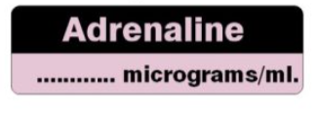
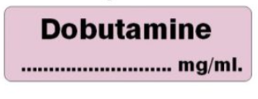
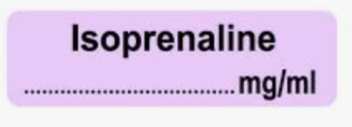
Notes:
Adrenaline, Dopamine, Dobutamine, Isoprenaline (Inotropes)
- Drugs that can increase cardiac output (some also have effects on SVR)
Most of these increase BP through increasing CO and HR
Agonists at β1 adrenoreceptors in the heart
Used to treat low CO states, profound hypotension, cardiac arrest, severe bradycardia/heart block
Adrenaline
Acts on both α (at high dose) and β receptors (at low dose)
Can be used peripherally (preferably only in the short term)
Can be bolused, but outside of cardiac arrest should only be bolused by people with experience (for BP support)
Comes in multiple different concentrations and preparations so be very careful
If someone asks you to give adrenaline bolus clarify the concentration and how much they want you to give
Dopamine
Causes increased heart rate and peripheral vasoconstriction by stimulating noradrenaline release
Not commonly used in adult intensive care – more commonly used in paediatric setting
Also act on dopaminergic receptors
Dobutamine
Causes increased heart rate (β1) and peripheral vasodilatation by stimulating β2 receptors
Must be used centrally
Used after myocardial infarction /cardiogenic causes as has reduced myocardial oxygen consumption and offsets noradrenaline vasoconstriction
Also act on dopaminergic receptors
Isoprenaline
Can be used peripherally or centrally in treatment of heart block or severe bradycardia
More of a CCU drug – in ICU we mainly use Dobutamine or Adrenaline

Slide 25
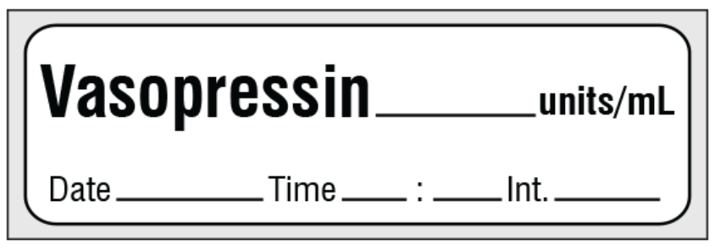
Notes:
Vasopressin (vasopressor)
- Increases systemic vascular resistance
Endogenous peptide (anti-diuretic hormone)
V1 receptors (vascular) – action here causes vasoconstriction
V2 receptors (renal) - action here causes anti-diuretic action
Vasoconstriction in septic shock
Continuous infusion of up to 0.04units/min
Used in patients with refractory vasodilatation
Allows reduction in other vasopressors such as noradrenaline

Slide 26
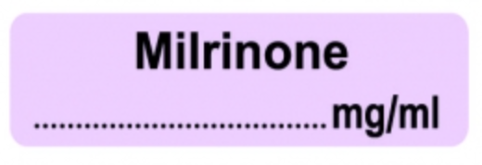
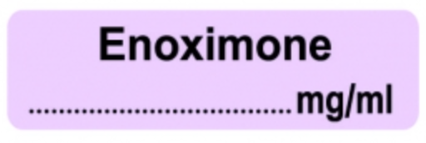

Notes:
Phosphodiesterase inhibitors – Enoximone and Milrinone
- Inodilators (increase stroke volume and reduce SVR)
Increase cAMP (by inhibiting breakdown by PDE3)
Increase contractility (positive inotropy) and improved diastolic relaxation (lusitropy)
Increase cardiac output
Decrease systemic vascular resistance
Levosimendan
- Calcium sensitisation
‘inodilator’
Positive inotropy with increased cardiac output, and vasodilatation

