Slide 1
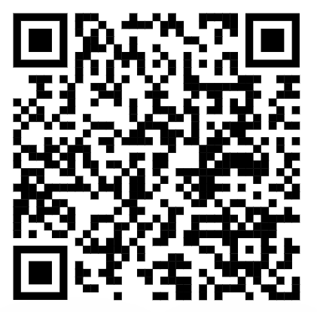


Course Directors:
Date of course
Notes:
Good morning and welcome to New2ICU. We’re so pleased we’ve been able to run this course, given what has happened over the last six months. A lot of work has gone in to trying to make it as valuable and fun as previous courses so we hope you find it worthwhile.
The world of ICU and medicine in general has changed a lot recently as you are all well aware. This course is an ICU course, rather than a COVID course but we will be pointing out some slight differences between management of a general ICU patient, versus a patient with COVID along the way. We are lucky to have a really experienced group of faculty who have all worked in various ICUs around the region so should be able to share their knowledge with you today.

Slide 2
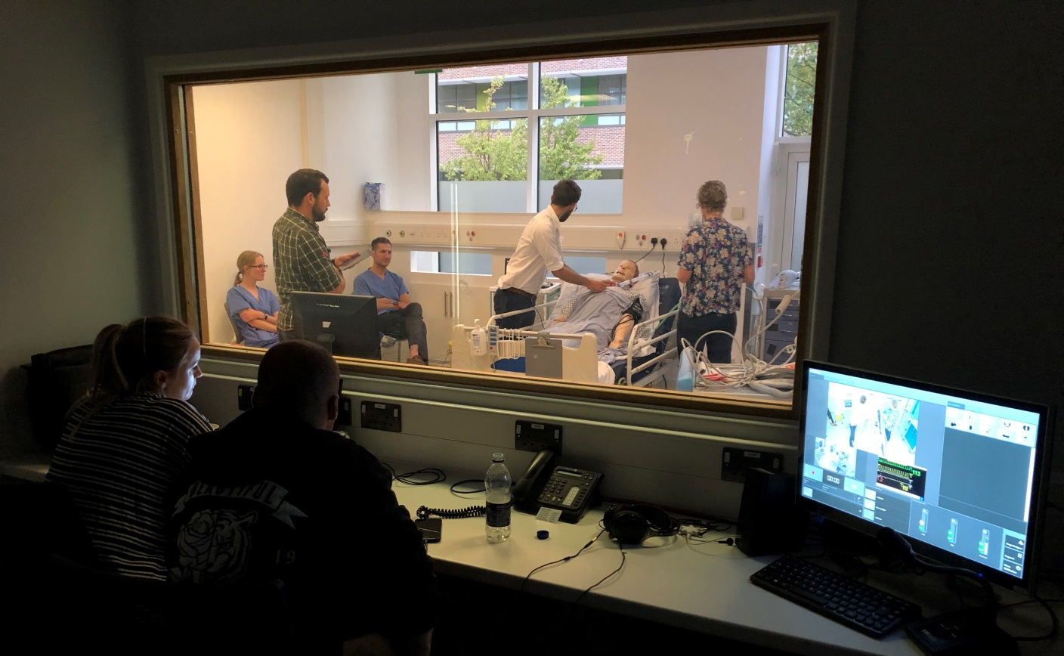
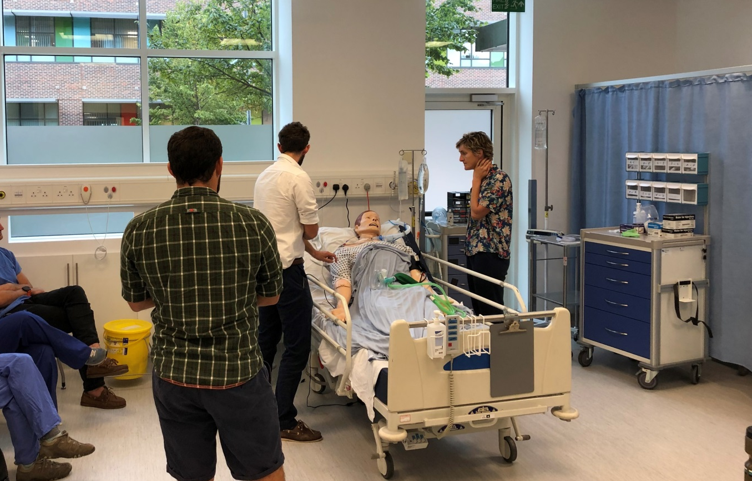
Notes:
The aim of this course is to give you some tools to help you whilst working on ICU. However, we can’t teach you everything in one day! Hopefully you have read part of the manual as pre-reading, an you feel you know a bit more already. We hope that you find the rest of the manual helpful as a basic and quick reference guide for some ICU topics over the rest of your time on ICU.

Slide 3
WHAT YOU CAN GET FROM TODAY
Airway skills
How to cope with an airway emergency
Basic ventilator use
Vascular access insertion
Experience in managing critical patient scenarios
Basic but important aspects of ICU care
Notes:
Our aim of today is to improve your confidence in managing some commonly occurring ICU problems. These include airway emergencies, basic ventilator use or troubleshooting, and central and arterial line insertion. We will try to get you as hands on as possible, in learning more about the management of critically ill patients, and other basic but incredibly important aspects of ICU care.

Slide 4
WHAT YOU WON’T GET FROM TODAY
The ability to cope alone – always ask for help
The skills to intubate an ICU patient
Situation-specific knowledge
Protocols relevant to your unit
Experience
Notes:
What we won’t be teaching you is how to cope alone. ICU is a team specialty and you should always ask for help. Hopefully today we will be able to signpost you recognize when this is needed, and who’s help you should ask for. You won’t be learning to intubate an ICU patient today and we won’t be covering specific unit knowledge, for example TBI or specific unit protocols. Most importantly, today cannot even begin to replace the experience you will gain over the next few months. So use today as practice for getting involved and asking questions, which is what you should do back on your units.

Slide 5
HOUSEKEEPING
Fire Alarms
Toilets
Tea/Coffee
Lunch
Permission for photos
Notes:
A quick bit of housekeeping:
We are not expecting a fire alarm today so if we are asked to evacuate please follow instructions from the L&R staff.
The toilets are diagonally opposite reception
We will provide tea, coffee, lunch and refreshments during the day.
Please remember that we have only been given permission to run this course as we have promised full social distancing, mask wearing and not gathering in big groups. So please please stick to this. We are the only deanery novice course being run face to face so we would like to show them how well it can happen.
Finally, we will be taking photos during the course for future educational purposes, so if you don’t want to be in any, please let us know.

Slide 6
HOW TO MAKE TODAY SUCCESSFUL
Full SIM interaction
Everyone have a go
Confidential
Ask questions
Questionnaires and Feedback
Enjoy!
Notes:
You can make the most of today by fully throwing yourselves into SIM and other skills stations. Please remember that everything that happens on the course is confidential. Please ask questions and make the most of the faculty you have teaching you. If anyone needs to chat about anything at all, we will all be around during the break times so just come and find us.
You should have all completed the pre-course questionnaire. Please could you all make sure you complete the end of course questionnaire and feedback too, as that is how we improve this course. Most importantly, we hope you all have a great day and enjoy it.

Slide 7
Insert a copy of the candidate groups here

Slide 8
